Slide 1
DPU-Bench: A New Micro-Benchmark Suite to Measure the Offload Efficiency of SmartNICs
Ben Michalowicz
SC’23 OSU Booth Talk
Network-Based Computing Laboratory, The Ohio State University
Original Reference:
Benjamin Michalowicz, Kaushik Kandadi Suresh, Hari Subramoni, Dhabaleswar Panda, and Steve Poole. 2023. “DPU-Bench: A Micro-Benchmark Suite to Measure Offload Efficiency Of SmartNICs”, In Practice and Experience in Advanced Research Computing (PEARC ‘23)
Notes:
Ask about familiarity with DPUs

Slide 2
Breakdown
Introduction, Problem Statement, Motivation
Design Choices and Important Terminology
Implementation
Experimental Results
Conclusion and Future Work

Slide 3
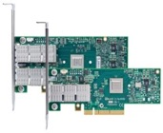
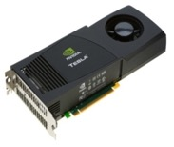
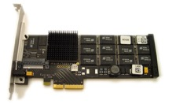

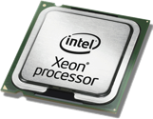
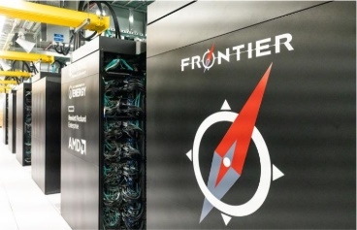
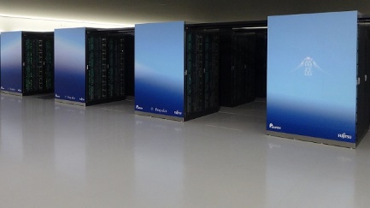
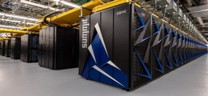
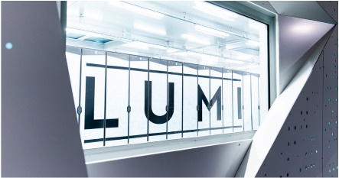
Introduction: Drivers of Modern HPC Cluster Architectures
High Performance Interconnects – InfiniBand (DPU), Slingshot
<1usec latency, 200-400Gbps Bandwidth>
Accelerators
high compute density, high performance/watt
>9.7 TFlop DP on a chip
Multi-/Many-core Processors
SSD, NVMe-SSD, NVRAM
Multi-core/many-core technologies
Remote Direct Memory Access (RDMA)-enabled networking (InfiniBand, RoCE, Slingshot)
Solid State Drives (SSDs), Non-Volatile Random-Access Memory (NVRAM), NVMe-SSD
Accelerators (NVIDIA GPGPUs)
Smart Network Cards (SmartNIC)/Data Processing Units (DPU)
Frontier
Fugaku
Summit
Lumi

Slide 4
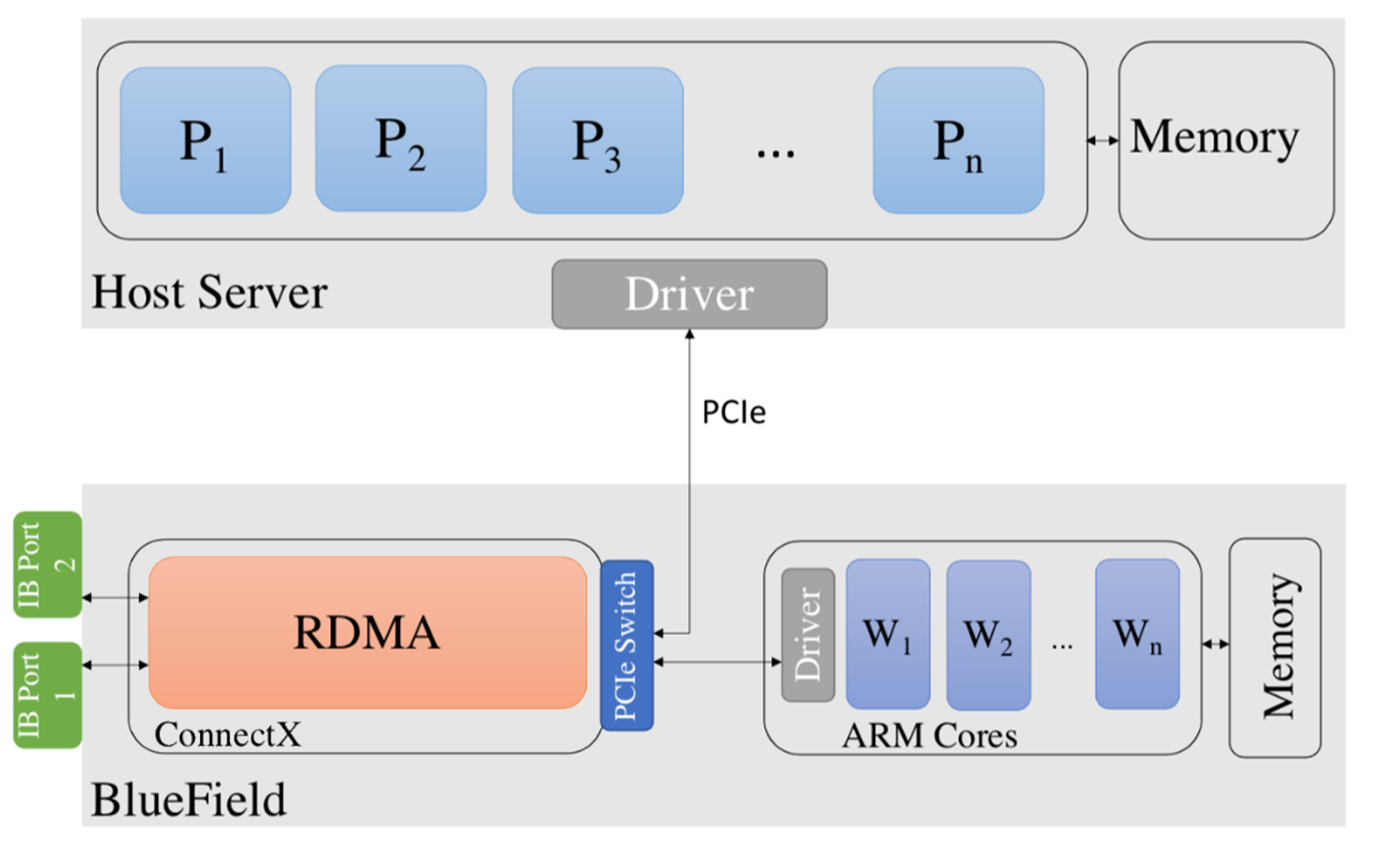
Introduction: What is a DPU?
A system on a chip (SoC) that combines the following:
  A Multi-Core CPU (BlueFields use ARM)
  High-performance network interface
  Acceleration engines to help with things like AI and Security
DPUs need to be flexible enough to handle all sorts of packet processing
  RDMA transport, TCP, acceleration, network virtualization, and more (for more information, see https://blogs.nvidia.com/blog/2020/05/20/whats-a-dpu-data-processing-unit/)

Slide 5
Introduction/Motivation: Why are DPUs Important?
Can act as a NIC as well as a separate "host" along side their CPU-based “hosts”
  We are interested in the latter – more resources to utilize
Another accelerator alongside GPUs and FPGAs – all evolving rapidly!
  BlueField-2 released in 2021, BlueField-3 in 2022/2023, BlueField-4 projected for 2024!

Slide 6
Problem Statement: We Need a New, DPU-Aware Microbenchmark Suite
Already have plenty of Suites: OMB, IMB, mpiBench, OpenHPCA, etc.
  NONE are DPU-Aware!
Previous works: Utilize DPUs to offload in the context of an MPI-library, for specific apps, or in the context of Deep Learning, but no micro/benchmarks!
SmartNICs are becoming popular: NVIDIA BlueField, AMD Pensando, etc.
What algorithm is the “best” to offload to a DPU? Can we design a microbenchmark suite to measure the offload potential achieved from placing communication to the DPU?

Slide 7
Breakdown
Introduction, Problem Statement, Motivation
Design Choices and Important Terminology
Implementation
Experimental Results
Conclusion and Future Work

Slide 8
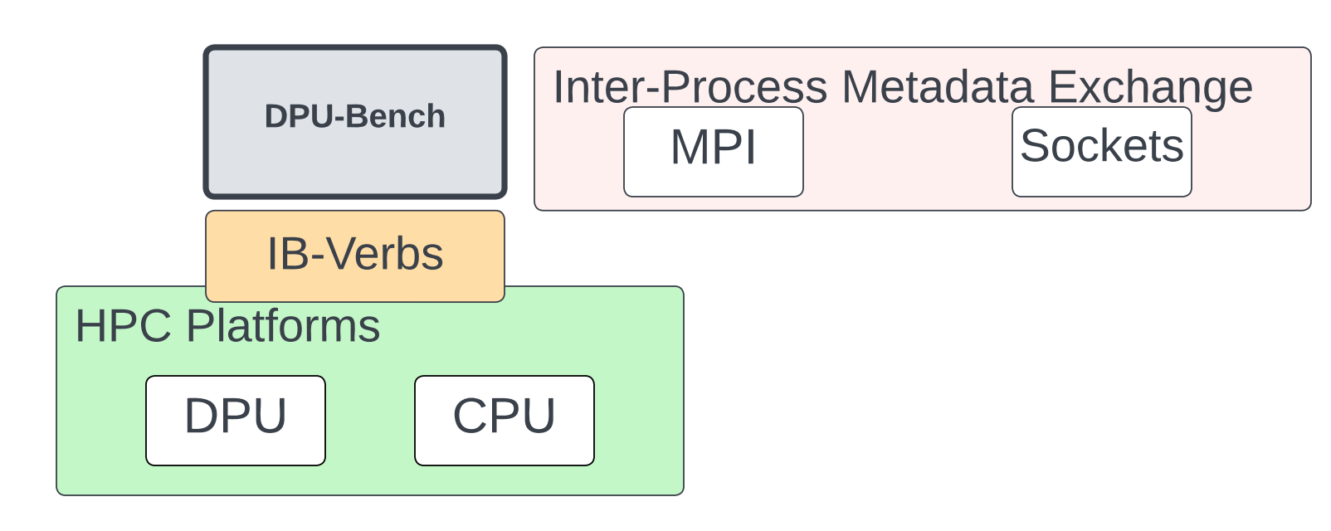
How Does DPU-Bench Fit In?
Lower Levels of HPC Ecosystem
MPI used for metadata exchange and synchronization

Slide 9
Design Choice: Running at the IB-Verbs Level
Running at the MPI level is bottlenecked by progress on the host
  Naively offloading MPI-level ranks in, e.g., MPI_Ialltoall could create a bottleneck
  Host issues MPI_Isends to a DPU process → needs to check message progress
Running over IB-Verbs:
  Closer to the hardware
  DPU issues all RDMA operations – host/CPU is not involved
    No need for asynchronous progress on the host
Notes:
Double check with everyone on their familiarity with IB-Verbs

Slide 10
Terminology
Worker/Worker Process: Process placed on the DPU
WPN: Workers Per Node; PPN: Processes Per Node
"Pure-Host": Referring to anything done without involvement from the workers
Reference Time: Communication time of a pure-host execution
Pure_comm: Pure communication time
Notes:
GVMI: A firmware-level feature on NVIDIA BlueField SmartNICs that allows host processes to expose their memory region to DPUs

Slide 11
Breakdown
Introduction, Problem Statement, Motivation
Design Choices and Important Terminology
Implementation
Experimental Results
Conclusion and Future Work

Slide 12
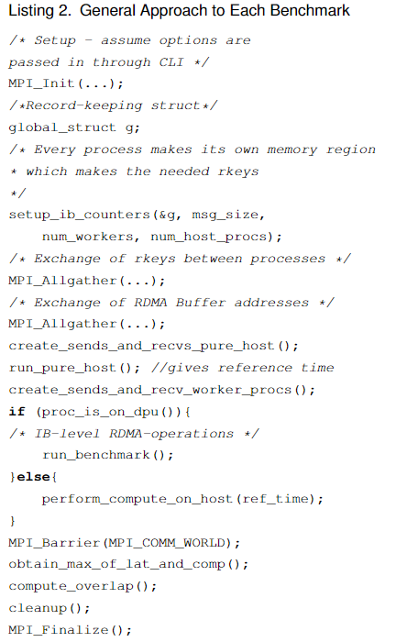
General Breakdown of
DPU-Bench benchmarks (1/2)
Initialization
At initialization:
  Exchange of metadata for RDMA Read/Write ops
    lkeys, rkeys, buffer addresses, QP numbers, etc.
Runtime:
  Step 1: Do Pure-Host execution → obtain reference time for dummy compute.
  Step 2: Offload communication to DPUs while the host side does compute
  Step 3: Measure Offload Efficiency
Step 1
Step 2
Step 3 +
Cleanup
Notes:
Bottom picture: Higher-numbered ranks get placed on the DPU. Helps with setting up Config files, MPMD mode, Hostfiles

Slide 13
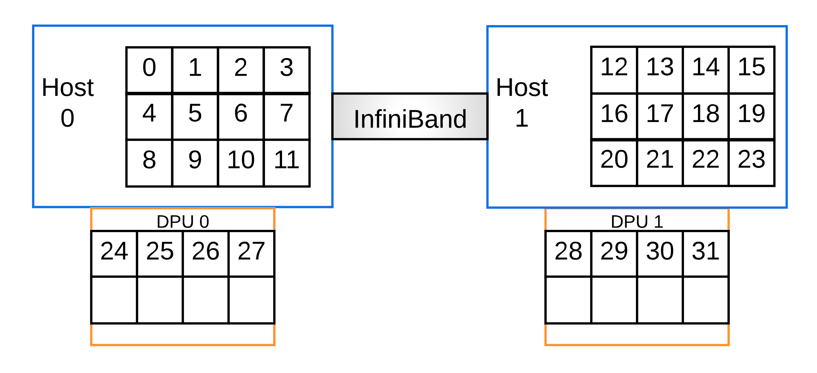
General Breakdown of DPU-Bench benchmarks (2/2)
Assumptions made about MPI runtime
  Use of a block-style hostfile – helps with organization of config files
  Higher-numbered ranks are placed on the DPU
  Multiple Program, Multiple Data (MPMD) mode – required for dealing with CPU/DPU configurations
  mpirun –np <procs> --hostfile <hostfile> --configfile <configfile>
  Config file :
    -n <host_proc_count> : /path/to/x86_benchmark_app –m <msg_size> -w <num_workers> -x <warmups> -i <iter_count> -v <validate – 0 or 1>
    -n <worker_proc_count: /path/to/DPU_benchmark_app <same flags>
    Make sure all code is in identical paths:
      e.g. both CPU and DPU binaries lead to something
      like "/tmp/path/to/executable"
Notes:
Bottom picture: Higher-numbered ranks get placed on the DPU. Helps with setting up Config files, MPMD mode, Hostfiles

Slide 14
Collective patterns in this benchmark suite
Non-personalized one-to-all: Direct/Linear Broadcast
Personalized all-to-one: Direct/Linear Gather
Non-Personalized all-to-all: Direct/Linear Allgather with a single “root” worker
  Later slides: Improve upon this to utilize multiple workers to demonstrate more efficient staging

Slide 15
Cyclic versus Block-based work assignment
Akin to hostfiles with MPI process placement
Cyclic work distribution: round robin assignment of host processes to each worker
Block work distribution: The first (host_procs/num_workers) host processes are assigned to worker 1, the next to worker 2, etc.
  If you run out of work, other workers stay idle
  If you run out of workers, wrap around and start from worker 1 again
    Leads to work imbalance, as we will later see in results.

Slide 16
Staged one-to-all/"broadcast" (Cyclic Approach)
Host 0
Host 1
Host 2
Host 3
Host 4
Host 5
Host 6
Arrow Legend:
Green: RDMA Read from Host
Orange: RDMA Write to Host
Worker 1
Worker 2
Worker 3
Worker 4
DPUs perform RDMA reads from the "root" process (Host 0) before writing to each host process
All-to-one/"gather" is just this but in reverse

Slide 17
Staged non-personalized all-to-all/"allgather" (Cyclic Approach) – Single Root Worker
Multi-step approach needed compared to just a "Gather"
First step: Each DPU RDMA-reads from each host
Second step: "Root" Worker is written to by other workers
Third Step: "Root" worker broadcasts to each host process
  Caveat: Highly inefficient!
  Later: See multi-root design
Host 1
Host 2
Host 3
Host 4
Worker 1
Worker 2
Worker 3
Worker 4
Arrow Legend:
Black: RDMA Read (Host procs to Workers)
Blue: RDMA Write (Workers to “Root” Worker)
Orange: RDMA Write (“Root” Worker to Host Processes)

Slide 18
Breakdown
Introduction, Problem Statement, Motivation
Design Choices and Important Terminology
Implementation
Experimental Results
Conclusion and Future Work

Slide 19
Experimental Testbed
“Thor” Partition of the HPC-AI Advisory Council (HPCAC) Cluster
  32 Nodes, Dual-Socket Intel® Xeon® 16-core CPUs E5-2697A V4 @ 2.60 GHz
  NVIDIA ConnectX-6 HDR100 100Gb/s VPI Adapters
  NVIDIA BlueField-2 SoC, HDR100 100Gb/s Adapters (one per node)
  256GB DDR4 2400MHz RDIMMs per node
  Since the time of this paper’s acceptance – 16 nodes also have BlueField-3’s

Slide 20
Experiments Performed
8 nodes, 8 PPN on host
Ranging from 1 worker (total) to 8 WPN on 8 DPUs (64 total workers)
  Powers of 2: 1, 2, 4, 8…
Study message sizes from 256K to 4 MB
Offload Efficiency:
(reference_time/max(pure_comm, compute)) * 100
Show offload efficiency results for broadcast, gather, and allgather with both cyclic and block work
Notes:
WPN = workers per node: EXPLAIN THIS!!!!
Benchmarks perform 1K iterations internally – we run each configuration (workers and message size) with 4 back-to-back executions

Slide 21
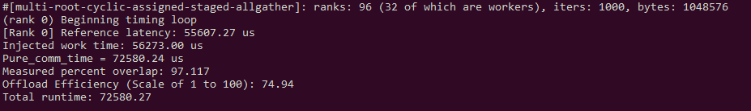
Sample Output
Example: 96 rank (8-node, 8-PPN, 4 WPN)
Outputs reference time, injected work time, pure comm time, measured overlap, and offload efficiency.
Notes:
/tmp/benjaminm/MV2/bin/mpirun_rsh --export-all -np 96 --hostfile /global/scratch/users/benjaminm/DPU-related/benchmark-work/ROME-RunScripts/Cyclic-work/multi-allgather/hostfile-4-pDPU --config /global/scratch/users/benjaminm/DPU-related/benchmark-work/ROME-RunScripts/Cyclic-work/multi-allgather/bcast-config-1048576-32-worker /tmp/benjaminm/allgather/bin/multi-root-cyclic-allgather.exe

Slide 22
Offload Efficiency Results: Broadcast – Cyclic Work Assignment
General takeaway: 1 WPN is a “sweet spot” for maximum efficiency
8 WPN: Incurs overhead from the BF-2’s single memory controller and limited cache sizes
Notes:
Sweet Spot → 1 WPN hits asymptotic “maximum” efficiency for both here and for “gather” results..

Slide 23
Offload Efficiency Results: Broadcast – Block Work Assignment
General takeaway: 1 WPN is a “sweet spot” for maximum efficiency
8 WPN: Incurs overhead from the BF-2’s single memory controller and limited cache sizes
6 WPN shows a larger work imbalance in the block work assignment setup
Notes:
Sweet Spot → 1 WPN hits asymptotic “maximum” efficiency for both here and for “gather” results..

Slide 24
Offload Efficiency Results: Gather – Cyclic Work Assignment
1 Worker: Adds overhead of an “intermediate” process to write to the root
Similar trends to the “Broadcast” results

Slide 25
Offload Efficiency Results: Gather – Block Work Assignment
1 Worker: Adds overhead of an “intermediate” process to write to the root
Similar trends to the “Broadcast” results

Slide 26
Offload Efficiency Results: Allgather (Single-Root Worker) – Cyclic Work Assignment
Gather and Broadcast placed back-to-back incurs massive overhead
Slight degradations with increase in message size
Notes:
Allgather is not only communication intensive, but after evaluating, we note that using a single worker as a root to broadcast data to each host process is inefficient and thus we need to look at both hierarchical algorithms and multi-root solutions moving forward. These are non-trivial items

Slide 27
Offload Efficiency Results: Allgather (Single-Root Worker) – Block Work Assignment
Gather and Broadcast placed back-to-back incurs massive overhead
Slight degradations with increase in message size
Notes:
Allgather is not only communication intensive, but after evaluating, we note that using a single worker as a root to broadcast data to each host process is inefficient and thus we need to look at both hierarchical algorithms and multi-root solutions moving forward. These are non-trivial items

Slide 28
Offload Efficiency Results: Allgather
(Efficient Use of Multiple Workers)
“Track” buffers by marking when initializing commands for RDMA reads and writes
Allows for multiple DPUs to write to multiple hosts without overwriting
  To show a more efficient approach in benchmarking the offload efficiency of SmartNICs for All-to-all-based communication
Notes:
Allgather is not only communication intensive, but after evaluating, we note that using a single worker as a root to broadcast data to each host process is inefficient and thus we need to look at both hierarchical algorithms and multi-root solutions moving forward. These are non-trivial items

Slide 29
Offload Efficiency Results: Allgather (Efficient Use of Multiple Workers – Cyclic Work Assignment)
1 worker (total) to 1 WPN: 1.3-2X improvement in efficiency with the addition of workers
2 WPN – 6 WPN: Predictable trend of decreasing offload efficiency

Slide 30
Breakdown
Introduction, Problem Statement, Motivation
Design Choices and Important Terminology
Implementation
Experimental Results
Conclusion and Future Work

Slide 31
Conclusion/Future Work
Introduction of a new, DPU-Aware Microbenchmark Suite
Explored three communication patterns/algorithms
Generalize the benchmarks to other programming models
Generalize the work to other SmartNICs

Slide 32

Want to see more talks at the OSU Booth?
Follow this QR Code!!
Talks all day, every day, Tuesday-Thursday!!

Slide 33



Thank You!
michalowicz.2@osu.edu
Network Based Computing
Laboratory
Follow us on
Network-Based Computing Laboratory
http://nowlab.cse.ohio-state.edu/
https://twitter.com/mvapich
The High-Performance MPI/PGAS Project
http://mvapich.cse.ohio-state.edu/
The High-Performance Big Data Project
http://hibd.cse.ohio-state.edu/
The High-Performance Deep Learning Project
http://hidl.cse.ohio-state.edu/

Slide 34
Related Work:
DPU-Bench is not to be confused with “DPUBench: An application-driven scalable benchmark suite for comprehensive DPU evaluation”
  Published in June 2023 in the “BenchCouncil Transactions on Benchmarks, Standards and Evaluations (TBench)” Journal
  DPUBench: An application-driven scalable benchmark suite for comprehensive DPU evaluation – ScienceDirect
How we differ from them:
  They focus on application-level benchmarks, we focus on communication patterns (one-to-all, all-to-one, etc.)
  They utilize NVIDIA’s DOCA Library and “applications” folder to study these, we utilize IB-Verbs Primitives
  We focus on offloading collective communication, they analyze other aspects beyond this.
How they’re similar:
  Benchmark suites
  Names
  Involvement using NVIDIA’s BlueField-2 DPUs
Notes:
GitHub - BenchCouncil/DPUBench – utilized application samples from a 2021 release of NVIDIA’s DOCA library

Slide 35
But Wait: BlueField-3’s have come in!!
Twice the core count and InfiniBand bandwidth as BF-2
5600 MT/s (2800 MHz) DDR5 bandwidth
  Faster than most standard “host” nodes
32 GB across two memory controllers
Time for (Drum Roll… MORE results :P) – mainly this cyclic, multi-root Allgather idea from before
Notes:
Allgather is not only communication intensive, but after evaluating, we note that using a single worker as a root to broadcast data to each host process is inefficient and thus we need to look at both hierarchical algorithms and multi-root solutions moving forward. These are non-trivial items

Slide 36
Offload Efficiency Results: Allgather (Take 2, BF-3)
Notes:
Hitting the maximum point of 1 WPN, we note that computation time > communication time (empirical observation), and that any degradations we see also get amplified (see 6 WPN)

