Slide 1
Designing In-network Computing Aware Reduction Collectives in MPI
Presentation at OSU booth at SC’23
Bharath Ramesh
The Ohio State University
ramesh.113@osu.edu
Follow us on
https://twitter.com/mvapich

Slide 2
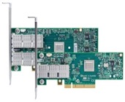
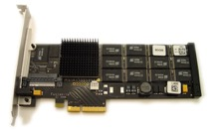







Introduction: Drivers of Modern HPC Cluster Architectures
High Performance Interconnects – InfiniBand
<1usec latency, 200-400Gbps Bandwidth>
Multi-/Many-core Processors
Accelerators
high compute density, high performance/watt
>9.7 TFlop DP on a chip
SSD, NVMe-SSD, NVRAM
Multi-core/many-core technologies
Remote Direct Memory Access (RDMA)-enabled networking (InfiniBand, RoCE, Slingshot)
Solid State Drives (SSDs), Non-Volatile Random-Access Memory (NVRAM), NVMe-SSD
Accelerators (NVIDIA GPGPUs)
Frontier
Fugaku
Summit
Lumi

Slide 3
MPI Reduction collectives and In-network Computing
Reduction collectives (such as MPI_Allreduce) are important for HPC/DL
  Involve both compute and communication
Using CPUs everywhere leads to sub-optimal scale-up and scale-out efficiency
  Motivates the need for offloading common operations away from the CPU to allow the CPU to perform other useful tasks
In-network compute allows offloading operations to network devices
  Switches are a good candidate due to high bandwidth and ability to reduce data on-the-fly eliminating redundancy
  High scale-up efficiency and network topology awareness
  Frees up CPU cycles for other operations

Slide 4
What is SHARP?
Scalable Hierarchical Aggregation and Reduction Protocol
Advantages
  Progress, offload computation and communication
  Focuses on low latency for small messages, maximal bandwidth utilization for large messages
  Hierarchical Aggregation in a logical tree (LLT) providing low latency for small messages
  Streaming aggregation with pipelined ring-based algorithms for large messages
In-Network computing
Focus on creating groups, which can simultaneously execute operations

Slide 5
Shared memory collectives
“Two-copy” mechanism
Cache-aligned
Created using the mmap system call
Needs synchronization for multi-process scenarios
Effective for relatively smaller message sizes

Slide 6
Design for small message reductions
Initialize sharp reduce spec and groups for node level leaders
Implementation
  First, do a shared memory reduce to a root process on each node
  For the inter-node step, call allreduce over the leader communicator
  Root process receives into recvbuf
  If Reduce, we stop here and discard results on other processes
  If Allreduce, do an intra-node broadcast
  Uses the existing allreduce SHARP primitive since reduce hasn’t been implemented in the SHARP APIs

Slide 7
Design for MPI_Barrier
Similar to the implementation for MPI_Allreduce
First, each socket-level leader uses flags to sense arrival of other processes in the socket
Second, a node-level leader senses arrival of socket-level leaders
Third, execute a full pairwise Barrier exchange/SHARP barrier for inter-node
Fourth, a node-level leader uses flags to notify other socket level leaders
Finally, each socket-level leader uses flags to notify other processes in the socket

Slide 8
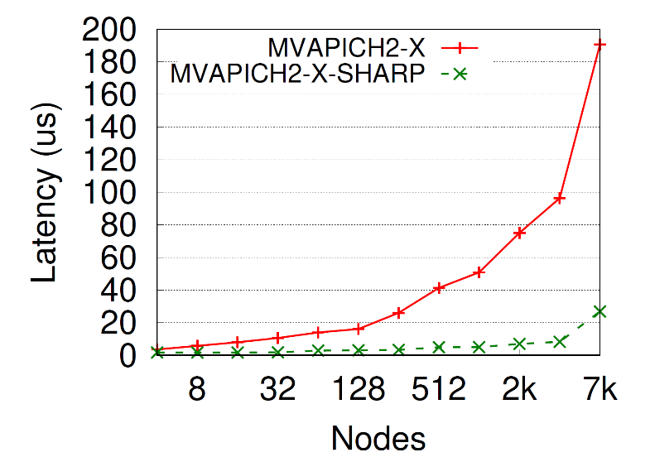
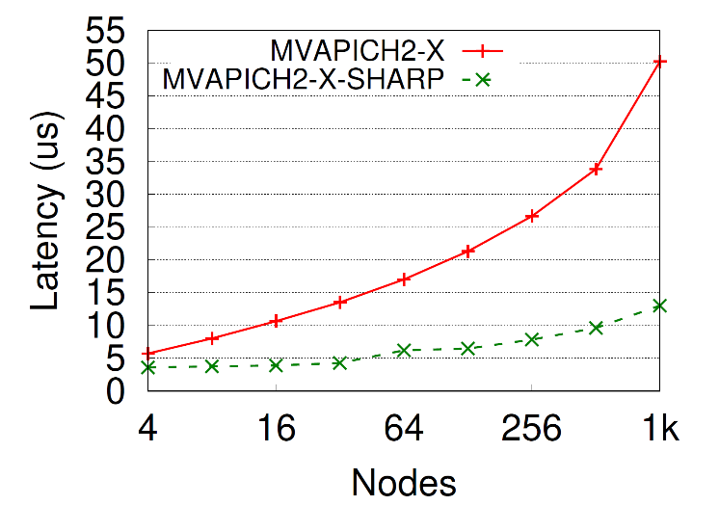
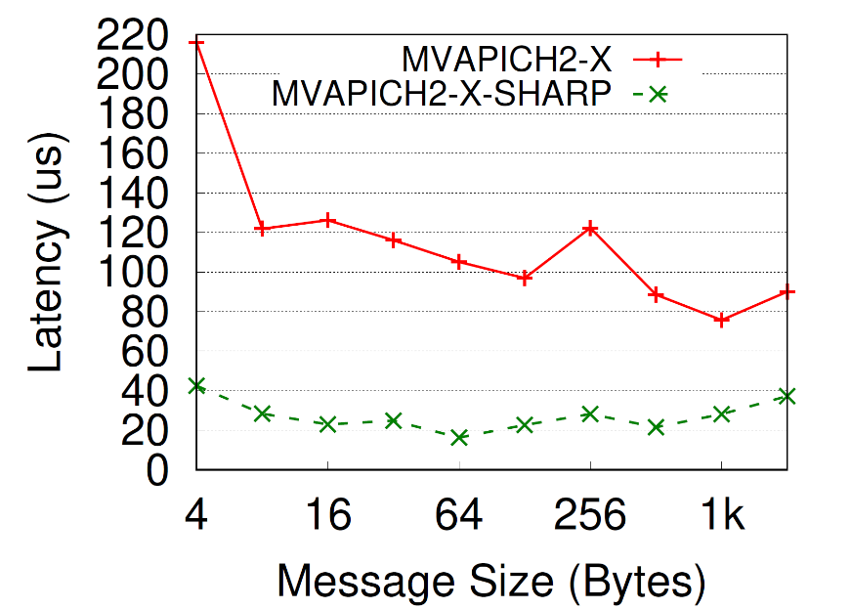
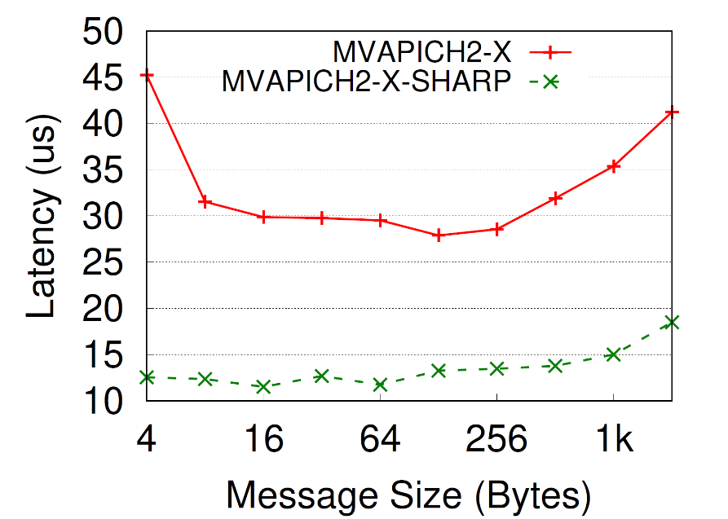
Results for MPI_Reduce – Varying message sizes
1 ppn, 7861 nodes
16 ppn, 1024 nodes
Scaling with message size, max latency
Close to a flat curve across message sizes up to 2K

Slide 9
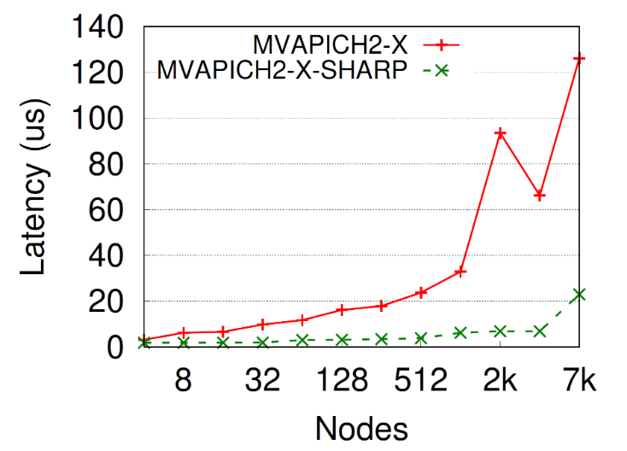
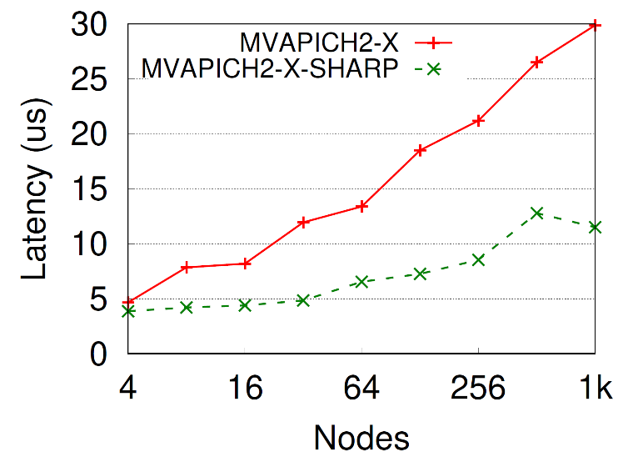
Results for MPI_Reduce – Varying node counts
1 ppn
16ppn
Scaling with increasing node counts, 16 bytes, max latency
Up to 5.4X improvement for 1ppn, 7861 nodes
Up to 2.6X improvement for 16ppn, 1024 nodes

Slide 10
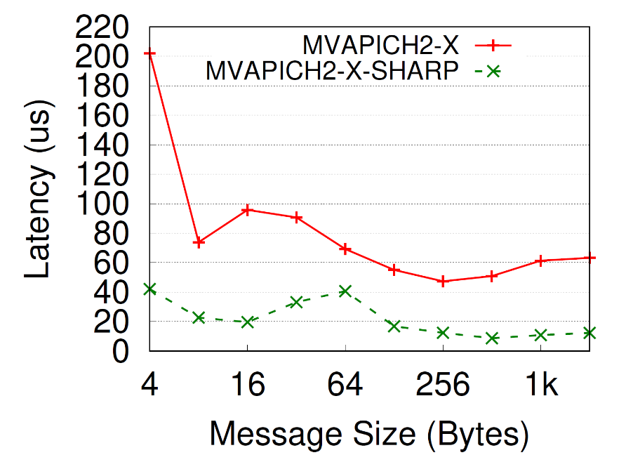
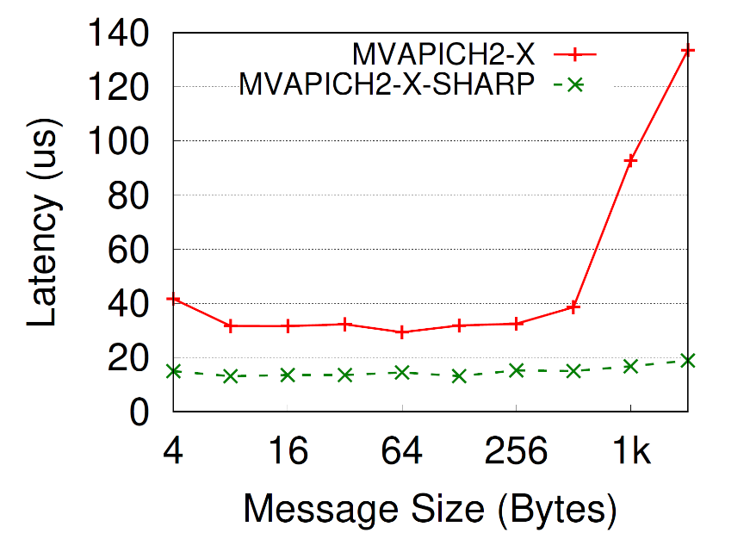
Results for MPI_Allreduce – Varying message sizes
1 ppn, 7861 nodes
16 ppn, 1024 nodes
Scaling with message size, average latency
Close to a flat curve across message sizes up to 2K

Slide 11
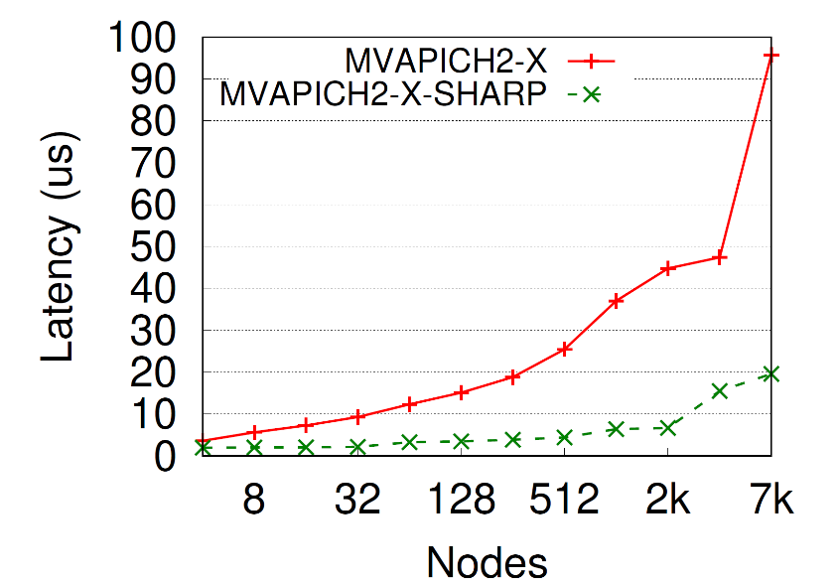
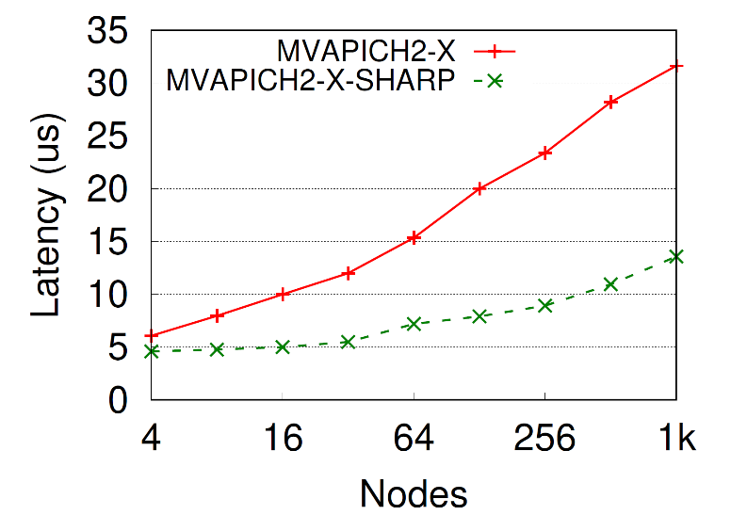
Results for MPI_Allreduce – Varying node counts
1 ppn, 7861 nodes
16 ppn, 1024 nodes
Scaling with increasing node counts, 16 bytes, average latency
Same as trends with reduce (implementations are almost the same except for the intra-node broadcast phases)

Slide 12
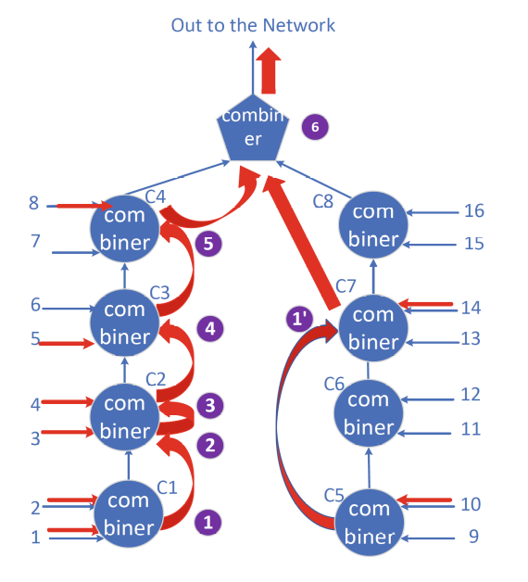
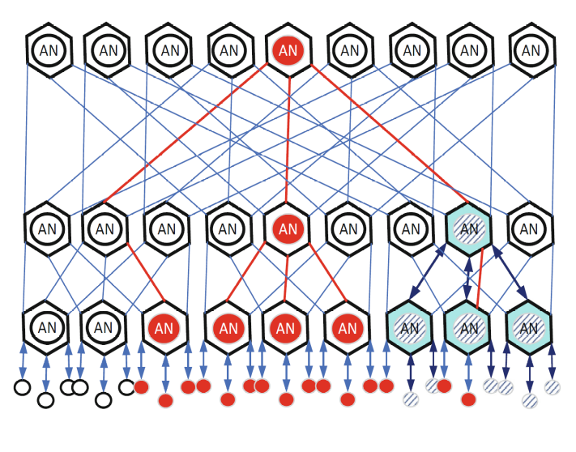
SHARP Reduction trees and Streaming Aggregation (SAT)
Aggregation Tree
Switch-level reduction (radix 16)
Images taken from Graham, Richard et al. Scalable Hierarchical Aggregation and Reduction Protocol (SHARP)TM Streaming-Aggregation Hardware Design and Evaluation. DOI : 10.1007/978-3-030-50743-5_3

Slide 13
Large message reduction collectives
Prior work on reduction collectives with SHARP
  Used leader-based schemes that had a reduction, followed by a SHARP operation and finally a broadcast
  Not suitable for message sizes >= 8K
Single-copy schemes are very efficient for large message data movement
  XPMEM allows remote process to have load/store access through address space mapping
Motivates the need for large message reduction designs that combine advantages of SHARP and single-copy schemes like XPMEM

Slide 14
Proposed Design Overview
Use a registration cache to amortize registration costs in the SHARP runtime
Designate a “leader” process on each node to interact with SHARP
Chunk buffer into PPN (number of processes per node) chunks and reduce to a single buffer belonging to the leader process
  Uses XPMEM for load/store access
  All processes perform local reductions, but only leader process calls the SHARP runtime
  Once local reductions are complete, leader calls a non-blocking MPI_Allreduce
    Perfect overlap of intra-node and inter-node steps
  Local reduction happens in batches for good network utilization
  Final result broadcasted within the node

Slide 15
Registration cache design
Use an AVL tree or similar, to store buffer addresses
  O(log n) insertion/query time
  If buffer entry exists, directly get registration information from cache
Up to 5.6X reduction in latency

Slide 16
Experimental setup
Cluster | MRI | HPCAC
Processor model | AMD EPYC 7713 | Intel(R) Xeon(R) Gold 6138
Max Clock speed | 3.72GHz | 2GHz
Number of sockets | 2 | 2
Cores per socket | 64 | 20
RAM | 256GB | 196GB
Interconnect | NVIDIA HDR-200 with Quantum 2 switches | NVIDIA HDR-200 with Quantum 2 switches
MPI libraries | MVAPICH2-X, HPC-X | MVAPICH2-X, HPC-X

Slide 17
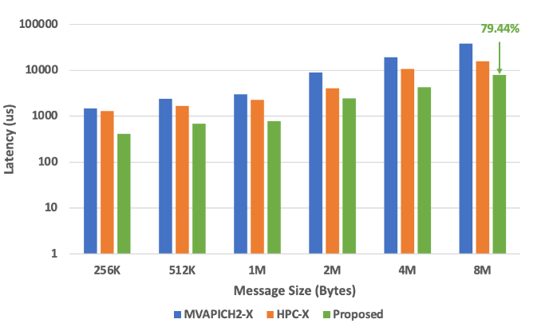
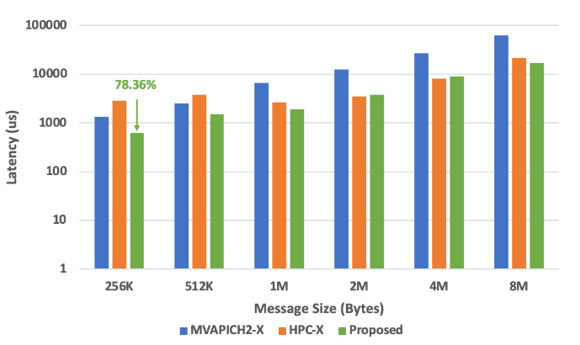
MPI_Allreduce on MRI – 8 nodes
32 PPN
64 PPN
Increased parallelism by using multiple processes and SHARP for reduction
Up to 78.36% over state-of-the-art for 64PPN and 79.44% for 32PPN

Slide 18
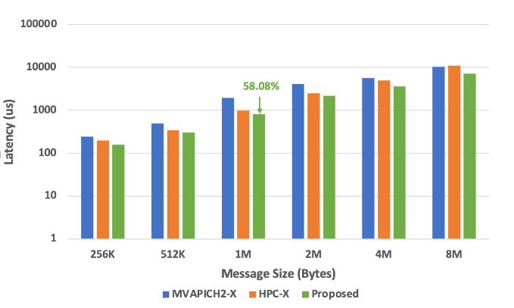
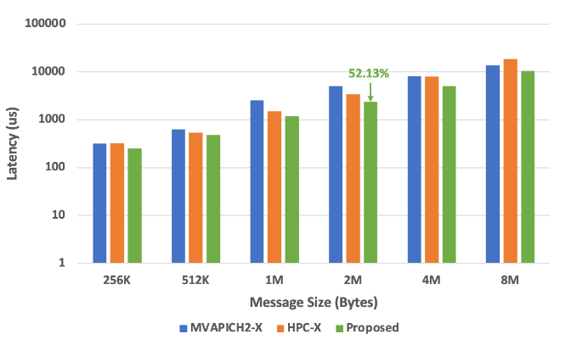
MPI_Allreduce on HPCAC – 8 nodes
32 PPN
64 PPN
Increased parallelism by using multiple processes and SHARP for reduction
Up to 52.13% over state-of-the-art for 64PPN and 58.08% for 32PPN

Slide 19
Conclusion and Future Work
SHARP runtime enables in-network offload with excellent bandwidth utilization
Small message designs can be used in MVAPICH 3.0/MVAPICH 2.3.7
Large message designs will be available in a future release of MVAPICH-plus

Slide 20



THANK YOU!
Network Based Computing
Laboratory
Network-Based Computing Laboratory
http://nowlab.cse.ohio-state.edu/
The High-Performance MPI/PGAS
Project
http://mvapich.cse.ohio-state.edu/
The High-Performance Big Data
Project
http://hibd.cse.ohio-state.edu/
The High-Performance Deep Learning
Project
http://hidl.cse.ohio-state.edu/

