Slide 1
MPI-xCCL: A Portable MPI Library over Collective Communication Libraries for Various Accelerators
Chen-Chun Chen
Presented at Sixth Annual Workshop on Emerging Parallel and Distributed Runtime Systems and Middleware
E-mail: chen.10252@osu.edu

Slide 2
Outline
Introduction
Motivation
Implementation
Evaluation Results
Conclusion and Future Work

Slide 3
Introduction: Modern HPC for DL Frameworks
The emergence of deep learning applications and frameworks
  Early (2014) frameworks used a single fast GPU
  Today, parallel training on multiple GPUs and multiple nodes is being supported by most frameworks
  A lot of fragmentation in the efforts (Horovod, MPI, NCCL, Gloo, gRPC, etc.)
The development of HPC supports
  Multi-core/many-core technologies
  Remote Direct Memory Access (RDMA)-enabled networking (InfiniBand, RoCE, and Slingshot)
  Solid State Drives (SSDs), Non-Volatile Random-Access Memory (NVRAM), NVMe-SSD
  Accelerators (NVIDIA GPGPUs, AMD GPUs, Habana Gaudi)

Slide 4
Introduction:
MPI: communication paradigm used in HPC systems to enable communication across processes, modern GPUs, and new network interconnect.
  GPU-aware MPI libraries: facilitate direct GPU-to-GPU data transfers
Vendor-specific communication libraries: GPU vendors provide it to attain superior collective communication performance, particularly tailored for deep learning (DL) applications.
  E.g.: NVIDIA Collective Communication Library (NCCL), ROCm Collective Communication Library (RCCL), Habana Collective Communications Library (HCCL), Microsoft Collective Communication Library (MSCCL)
Application developers are often responsible for porting or updating their codes to utilize these vender-communication APIs.
  It requires extensive knowledge and can lead to decreased productivity and potential inconsistencies across various hardware platforms.

Slide 5
Outline
Introduction
Motivation
Implementation
Evaluation Results
Conclusion and Future Work

Slide 6
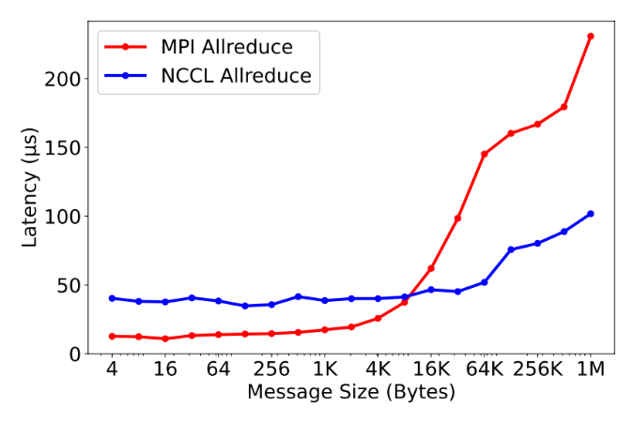
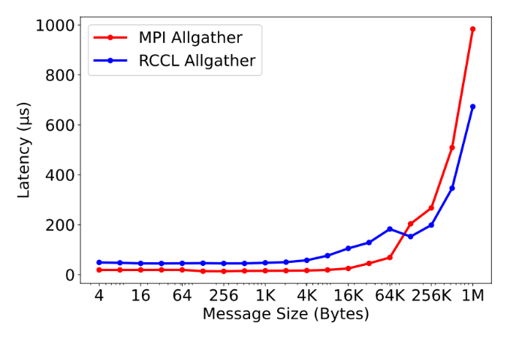
Motivation
Why not rely solely on traditional MPI libraries or vendor-specific communication libraries (CCLs)?
CCLs have superior performance for larger message transfers
  Higher overheads for small messages
High efforts for porting previous designs to use CCLs
  CCLs do not adhere to the MPI standard
  Consider the emergence of new architectures and evolving communication libraries
Comparison of MPI and NCCL Allreduce latency using 32 GPUs (4 nodes) on a DGX A100 system.
Comparison of MPI and RCCL Allgather latency using 8 GPUs (4 nodes) on an AMD GPU system.

Slide 7
Motivation (cont’d)
MPI-xCCL: a unified, portable communication interface that supports various vendor accelerators, enabling users and developers to dynamically leverage the best features from diverse implementations in an application-transparent manner
User perspective:
  Utilize different CCLs across architectures without modifying their code and with standard MPI APIs.
  Manage the complexities of underlying CCL APIs and logic, e.g.: stream handling
  Support automatic error handling , e.g.: falling back to traditional MPI communication
  Include common MPI non-blocking collective operations
  Optimize performance across a wide range of message sizes by using the hybrid designs
  Take advantage of the same features and functionalities provided by pure CCLs
Developer perspective:
  Provide a unified layer for implementing collective operations, eliminating the need to customize algorithms and functions for each new CCL
  Provide a scalable design that can be easily extended to support upcoming architectures and CCLs

Slide 8
Outline
Introduction
Motivation
Implementation
  xCCL Abstraction Layer for GPU-aware MPI
  Built-in Collective Communication Functions
  Customized Send-recv-based Collective Communication Functions
  Non-blocking Designs
  Hybrid Designs
Evaluation Results
Conclusion and Future Work

Slide 9
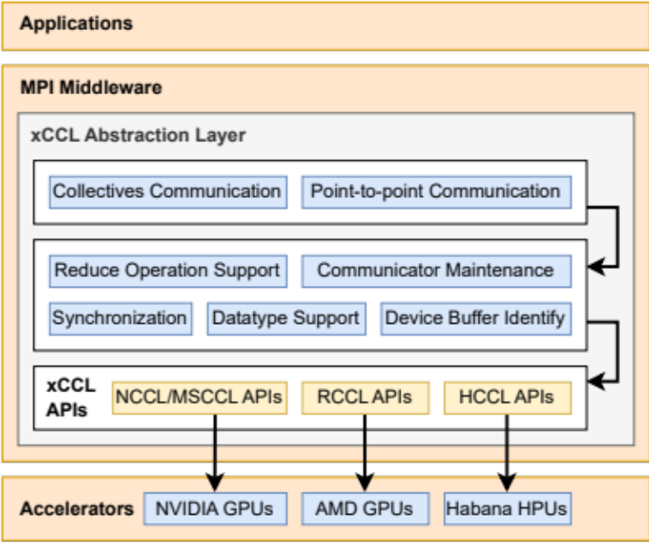
xCCL Abstraction Layer for GPU-aware MPI
Category | NCCL/RCCL/MSCCL | HCCL
Communicator Creation | ncclCommInitRank | hcclCommInitRank
 | ncclCommDestroy | hcclCommDestroy
Collective Communication | ncclBroadcast | hcclBroadcast
 | ncclAllReduce | hcclAllreduce
 | ncclReduce | hcclReduce
 | ncclReduceScatter | hcclReduceScatter
 | ncclAllGather | hcclAllGather
Group Calls | ncclGroupStart | hcclGroupStart
 | ncclGroupEnd | hcclGroupEnd
Point-to-point Communication | ncclSend | hcclSend
 | ncclRecv | cclRecv
Types | ncclComm_t | hcclComm_t
 | ncclDataType_t | hcclDataType_t
 | ncclRedOp_t | hcclRedOp_t
Datatypes | ncclFloat | hcclFloat
 | ncclInt32 | hcclInt32
 | ncclUint8 | hcclUint8
Reduce Operations | ncclSum | hcclSum
 | ncclProd | hcclProd
 | ncclMax | hcclMax
Given the success of NCCL library, other venders have proposed very similar communication APIs with compatible functionalities.
  RCCL/MSCCL: keep using the prefix to nccl
  HCCL: by changing the prefix to hccl
xCCL abstraction layer
enables us to use a single
API to access third-party
libraries.
A high level of adaptability
and productivity by
aggregating existing APIs

Slide 10
Built-in Collective Functions
5 built-in collective communication functions:
  Broadcast: ncclBroadcast/hcclBroadcast
  AllReduce: ncclAllreduce/hcclAllreduce
  Reduce: ncclReduce/hcclReduce
  ReduceScatter: ncclReduceScatter/hcclReduceScatter
  AllGather: ncclAllGather/hcclAllGather
Map these NCCL and HCCL APIs to our xCCL APIs and directly call those
  E.g.: xcclAllReduce is created on top of ncclAllReduce/hcclAllReduce
Checking mechanism for the supported datatype and reduce operations
  Note that HCCL support less datatype currently (only support float currently)

Slide 11
Customized Send-recv-based Collective Functions
The other collective calls are simple send-recv-based communications
  E.g.: Gather, Scatter, Alltoall
No vendor-optimized built-in implementation, typically users used to have to implement it on their own.
  Use ncclGroupStart, ncclGroupEnd, ncclSend, and ncclRecv to implement by their own
We implemented those functions with our high-level xCCL APIs and provided hooks in MPI runtimes
  Alltoall, Alltoallv, Gather, Gatherv, Scatter, Scatterv, and Allgatherv

Slide 12
Non-blocking Designs
Support MPI_Isend and MPI_Irecv (MPI_Wait)
Support non-blocking collective operations
  E.g.: MPI_Iallreduce
The xCCL communication calls are non-blocking operations
  Remove the synchronization and defer it until the MPI_Wait stage
  Maintain the necessary information between the non-blocking and wait operations

Slide 13
Hybrid Designs
Hybrid designs enable users to leverage both vendor-optimized collective communication libraries and the existing MPI implementations.
  In fact, modern MPI libraries utilize different protocols and algorithms according to different conditions, such as system architectures, MPI operations, and message sizes.
With the xCCL Abstraction Layer designs, each operation can be easily encapsulated into one of the MPI algorithms and be called as one of the regular MPI implementations in the tuning tables.
Tune the tuning tables offline, and during runtime, the hybrid designs select the most optimal solution from the tuning tables.
Comparison of MPI and NCCL Allreduce latency using 32 GPUs (4 nodes) on a DGX A100 system.
Comparison of MPI and RCCL Allgather latency using 8 GPUs (4 nodes) on an AMD GPU system.

Slide 14
Outline
Introduction
Motivation
Implementation
Evaluation Results
Conclusion and Future Work

Slide 15
Evaluation Results
System Component | ThetaGPU (ALCF) NVIDIA | MRI (in-house cluster) AMD | Voyager (SDSC) Habana
CPU | AMD EPYC 7742 | AMD EPYC 7713 | Intel Xeon Gold 6336Y
Memory | 1 TB DDR4 | 256 GB DDR4 | 512 GB DDR4
Sockets | 2 | 2 | 2
Core/socket | 64 | 64 | 24
Accelerator/node | 8 NVIDIA DGX A100 GPUs | 2 AMD MI100 GPUs | 8 Habana Gaudi Processors
Device Memory/GPU(HPU) | 40GB HBM2 | 32 GB HDM2 | 32 GB HDM2
Micro benchmark:
  OSU Micro-Benchmarks 7.2 for NVIDIA and AMD platforms
  OSU Micro-Benchmarks 7.0 with extended features for Habana platform
    Use Synapse AI Software Suite APIs to support the device buffer on Habana Gaudi
Application-level benchmark: TensorFlow + Horovod

Slide 16
Micro-Benchmark Evaluation: Point-to-point
Intranode Point-to-Point Latency (Small Message)
Intranode Point-to-Point Latency (Large Message)
Intranode Point-to-Point Bandwidth
Intranode Point-to-Point Bi-Directional Bandwidth
Internode Point-to-Point Latency (Small Message)
Internode Point-to-Point Latency (Large Message)
Internode Point-to-Point Bandwidth
Internode Point-to-Point Bi-Directional Bandwidth
Our designs can facility both intra-node and inter-node, blocking and non-blocking point-to-point communication with varies collective communication libraries on different platforms
There is a similar trend of inter-node compared to the results of intra-node numbers.

Slide 17
Micro-Benchmark Evaluation: Collective - NCCL
Reduce w/ NCCL (1 Node, 8 GPUs)
Allreduce w/ NCCL (16 Node, 128 GPUs)
The performance of proposed pure xCCL designs (blue lines) mirrors that of original vendor-specific xCCL (dotted red lines), highlighting minimal overhead in our implementation.
The proposed hybrid xCCL (black lines) achieves even lower small message latency.
Reduce latencies shrink from 23 to 14 μs for small messages (<8KB) in 1-node case.
Compared our results to Open MPI + UCX + UCC also reveals our designs’ reduced overhead.

Slide 18
Micro-Benchmark Evaluation: Collective - RCCL
Alltoall w/ RCCL (1 Node, 2 GPUs)
Reduce w/ RCCL (8 Node, 16 GPUs)
While no RCCL benchmarks exist for AMD architectures, outcomes suggest our designs’ adaptability to new architectures.
Better performance for small messages (<32KB) with the proposed hybrid designs in both 1-node and 8-node cases.

Slide 19
Micro-Benchmark Evaluation: Collective - HCCL
Allreduce w/ HCCL (1 Node, 8 HPUs)
Allreduce w/ HCCL (4 Node, 32 HPUs)
While no HCCL benchmarks exist for Habana architectures, outcomes suggest our designs’ adaptability to new architectures.
Observe overheads for small messages, especially at the beginning stage, but mostly good on a single node.
For Allreduce on multiple nodes, we observe degradations shown by a step curve around 64 bytes.

Slide 20
Micro-Benchmark Evaluation: Collective - MSCCL
Allreduce w/ MSCCL (1 Node, 8 GPUs)
Bcast w/ MSCCL (2 Node, 16 GPUs)
MSCCL uses NCCL 2.12.12 as the backend, we use pure NCCL 2.12.12 as the baseline.
MSCCL outperforms NCCL for medium messages (256B - 256KB), and our performance mirrors MSCCL.
The proposed hybrid designs have better performance for small messages (<64B, <1KB) due to hybrid designs.

Slide 21
Application-Level Evaluation: NCCL
1 Node, 8 GPUs
16 Node, 128 GPUs
Our xCCL designs (with NCCL 2.18.3 or 2.11.4) either match or surpass pure NCCL performance, it achieves 4850 img/sec compared to pure NCCL’s 4050 img/sec at batch size 32.
Traditional MPI runtimes (Open MPI + UCX or advanced designs with UCC) yield 3450 or 4480 img/sec at a batch size of 128, 44% or 28% below our designs.
On multiple nodes, xCCL’s 94600 img/sec throughput is 1.35x and 1.5x higher than Open MPI + UCX and UCC with a batch size of 128.

Slide 22
Application-Level Evaluation: RCCL
4 Node, 8 GPUs
8 Node, 16 GPUs
Our xCCL designs achieve a throughput of 3192 img/sec with a batch size of 64 on 8 AMD GPUs, which is a 25% improvement over pure RCCL.
On multiple nodes, it shows a throughput of 7210 img/sec with a batch size of 128 on 16 AMD GPUs, which is a 20% improvement over pure RCCL.

Slide 23
Application-Level Evaluation: HCCL
The container image has already contained prebuilt Habaha TensorFlow and Horovod.
The computing kernel is replaced by Habana ops through TensorFlow custom ops, the com munication layer in Horovod is implemented by HCCL directly.
Modify the Horovod communication by replacing all hcclAllreduce calls with MPI_Allreduce operations.
1 Node, 8 HPUs
4 Nodes, 32 HPUs
On single node, xCCL provides 5139 img/sec throughput with batch size 128, and it is close to the throughput of 4936 img/sec using pure HCCL (4% overhead).
On multiple nodes (4 nodes), both xCCL and pure HCCL reach the throughput of 11300 img/sec where the overhead is less than 1%
This evaluation proves that our xCCL designs can be easily extended to new architectures and collective communication libraries with negligible overheads.

Slide 24
Application-Level Evaluation: MSCCL
1 Node, 8 GPUs
2 Node, 16 GPUs
Our xCCL’s performance with the MSCCL backend, mirroring the NCCL trend, with xCCL achieving 12300 img/sec at batch size 128 on 2 nodes.
This evaluation proves that our xCCL designs can be easily extended to new collective communication libraries with negligible overheads.

Slide 25
Outline
Introduction
Motivation
Implementation
Evaluation Results
Conclusion and Future Work

Slide 26
Conclusion and Future Work
Introduction of xCCL communication runtime for optimal communication-level performance in HPC and Deep Learning on supercomputers.
Abstraction layer covering NCCL, RCCL, HCCL, and MSCCL APIs, enabling dynamic selection of hardware-specific API calls.
Performance evaluation on ThetaGPU, MRI, and Voyager clusters with NVIDIA GPUs, AMD GPUs, and Habana HPUs.
Comprehensive assessment of intra-node and inter-node communication, as well as collective operations across single and multiple GPU nodes using four communication backends.
Application-level designs achieving substantial throughput gains over UCC and RCCL by 4.6x and 1.25x.
Pioneering communication-level performance evaluation for upcoming Habana Gaudi Processors.
Future work aims to extend support to additional hardware such as Intel GPUs or FPGAs and new vendor-specific libraries like oneCCL.

Slide 27



Thank You!
chen.10252@osu.edu
Network Based Computing
Laboratory
Follow us on
Network-Based Computing Laboratory
http://nowlab.cse.ohio-state.edu/
https://twitter.com/mvapich
The High-Performance MPI/PGAS Project
http://mvapich.cse.ohio-state.edu/
The High-Performance Big Data Project
http://hibd.cse.ohio-state.edu/
The High-Performance Deep Learning Project
http://hidl.cse.ohio-state.edu/

