Slide 1
Flover: A Temporal Fusion Framework for Efficient Autoregressive Model Parallel Inference
SC ‘23
Jinghan Yao
yao.877@osu.edu
Network-based Computing Laboratory
Department of Computer Science and Engineering
The Ohio State University

Slide 2
Overview
Introduction to large language models
  Property
  Inference scenarios
Temporal fusion/In-flight batching
Performance Optimization
Performance Evaluation
  Latency
  Concurrency

Slide 3
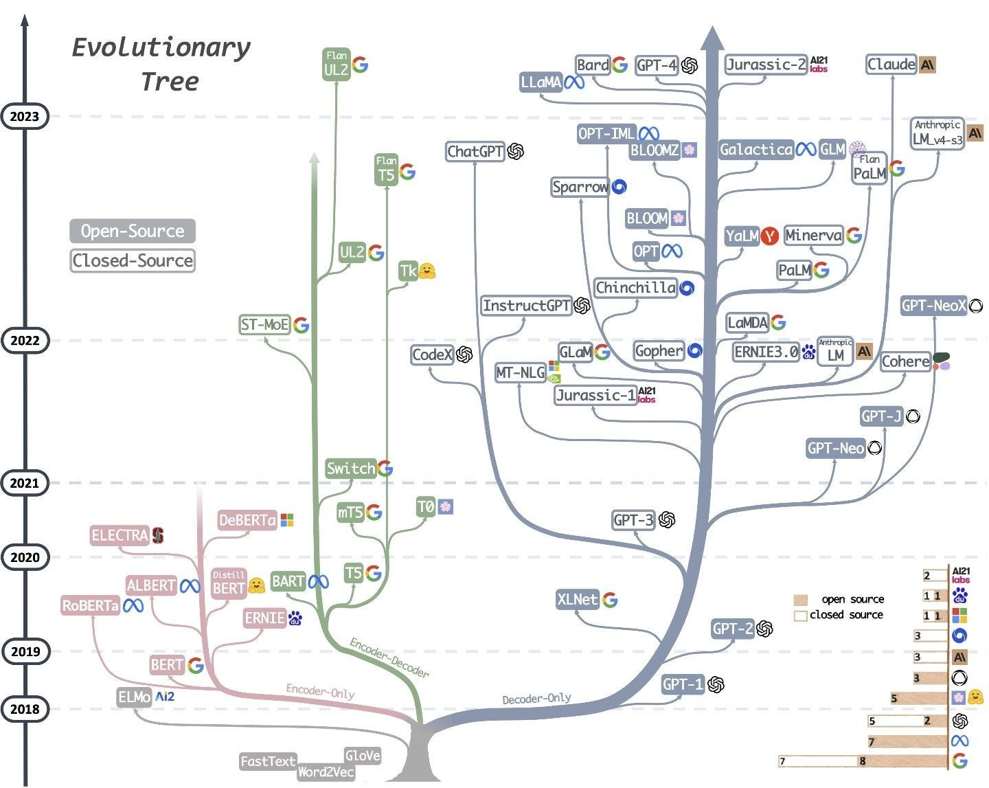
Large Language Models review
GloVe
BERT, GPT-1, GPT-2
RoBERTa, XLNet
BART, T5
GPT-3, GPT-J
GPT-NeoX
Megatron-LLM
PaLM, OPT
BLOOM
ChatGPT
Bard, LLaMA, GPT-4
…
Non-autoregressive vs. Autoregressive
Source: Yang, Jingfeng, et al. "Harnessing the power of llms in practice: A survey on chatgpt and beyond." arXiv preprint arXiv:2304.13712 (2023).

Slide 4
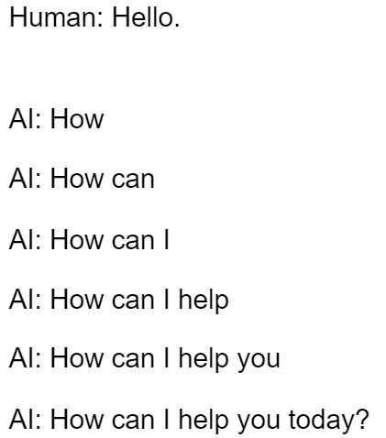
Large Language Models review
GPT families are decoder-only autoregressive models.
During inference, the model only generates one words.
Source: Vaswani, Ashish, et al. "Attention is all you need." Advances in neural information processing systems 30 (2017).

Slide 5
GPT model
An autoregressive model is a type of generative algorithm that
  produces sequences of text by predicting one word at a time
  with each new word being conditioned on the sequence of words that came before it
Notes:
Give example of for loop on blackboard

Slide 6
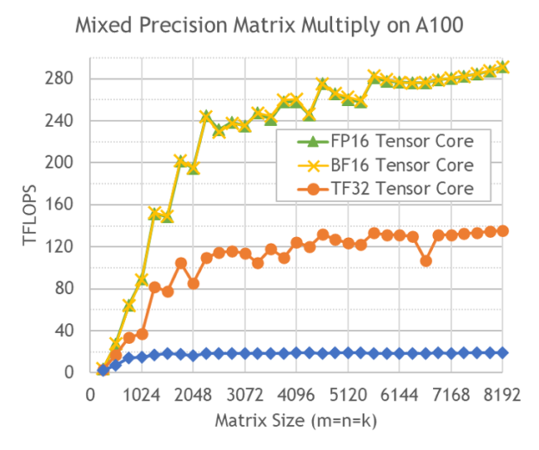
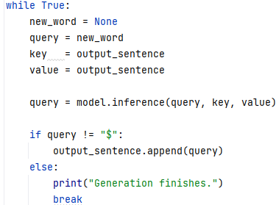
Autoregressive property of GPT model
During training, we can use the lower-tringle attention mask to control the visibility of labels.
But in inference, this becomes infeasible.
  For a sequence with L tokens, training only takes 1 run on the model.
  However, inference takes L runs on the model. Totally sequential!
We are wasting most GPU compute power!
Source: https://www.confluent.io/blog/chatgpt-and-streaming-data-for-real-time-generative-ai/

Slide 7
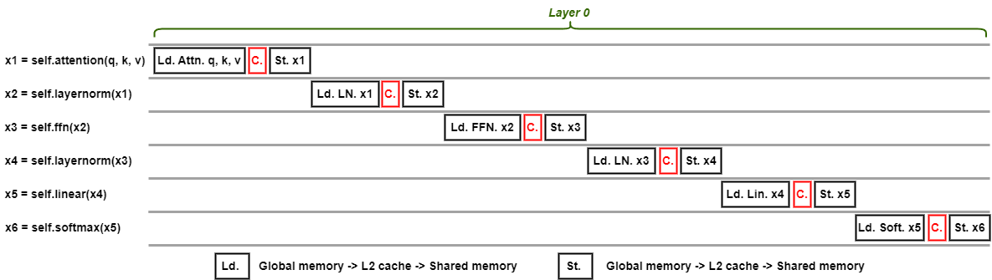
Autoregressive property of GPT model
Given a M-layer Transformer model, we are loading each layer from the global memory to the cache, regardless of how many tokens involved in the computation.
GPU spends too many time on I/O.
The inference of GPT is totally I/O bound.
Notes:
https://www.confluent.io/blog/chatgpt-and-streaming-data-for-real-time-generative-ai/

Slide 8
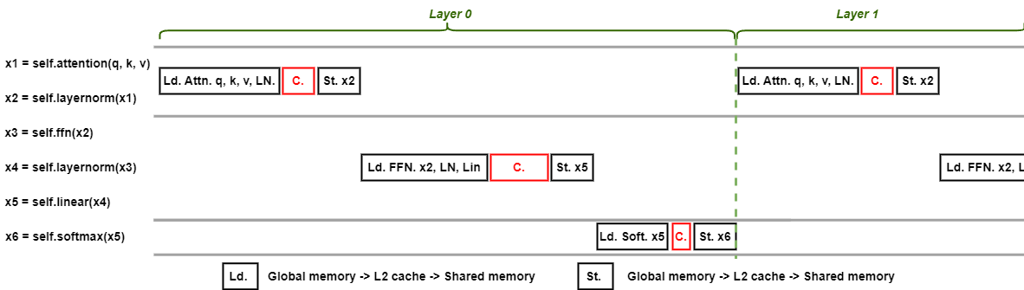
Kernel Fusion is crucial for GPT inference
Kernel fusion is a way of grouping kernel functions.
Assume that shared memory is large.
We can load inputs, attention, layernorm weights to shared memory at once.
Notes:
https://www.confluent.io/blog/chatgpt-and-streaming-data-for-real-time-generative-ai/

Slide 9
The mania of ChatGPT
Average 771 visits / second.
High concurrency application scenario
Source: https://www.digitalinformationworld.com/2023/07/chatgpt-sees-10-dip-in-usage-could.html

Slide 10
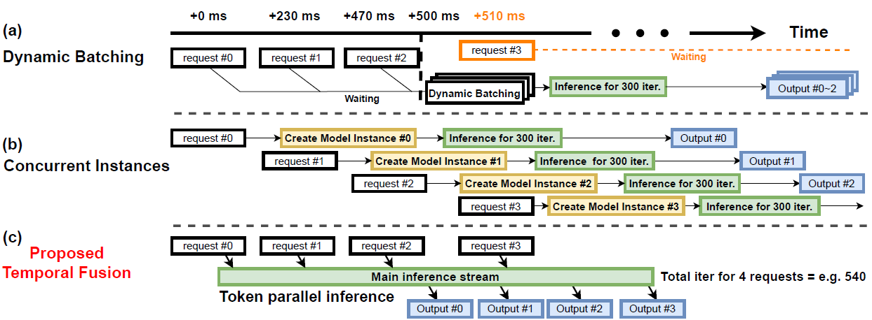

What solutions do we have?
First, allocating 8 A100 GPUs to one user at a time is totally not acceptable!
  Since we cannot reduce GPU usage due to the model size,
  We have to increase the concurrency on these GPUs.
  We want this 8 A100 server to serve more than 1 user at a time.
Wait
300 steps
Solution 1: dynamic batching
Source: Yao, Jinghan, Nawras Alnaasan, Tian Chen, Aamir Shafi, and Hari Subramoni. "Flover: A Temporal Fusion Framework for Efficient Autoregressive Model Parallel Inference." arXiv preprint arXiv:2305.13484 (2023).

Slide 11
Can we do some smart scheduling?
Leveraging the multi process/threading:
Request #1: thread #1
Request #2: thread #2
Request #3: thread #3
Source: Yao, Jinghan, Nawras Alnaasan, Tian Chen, Aamir Shafi, and Hari Subramoni. "Flover: A Temporal Fusion Framework for Efficient Autoregressive Model Parallel Inference." arXiv preprint arXiv:2305.13484 (2023).
Notes:
Yao, Jinghan, Nawras Alnaasan, Tian Chen, Aamir Shafi, and Hari Subramoni. "Flover: A Temporal Fusion Framework for Efficient Autoregressive Model Parallel Inference." arXiv preprint arXiv:2305.13484 (2023).

Slide 12
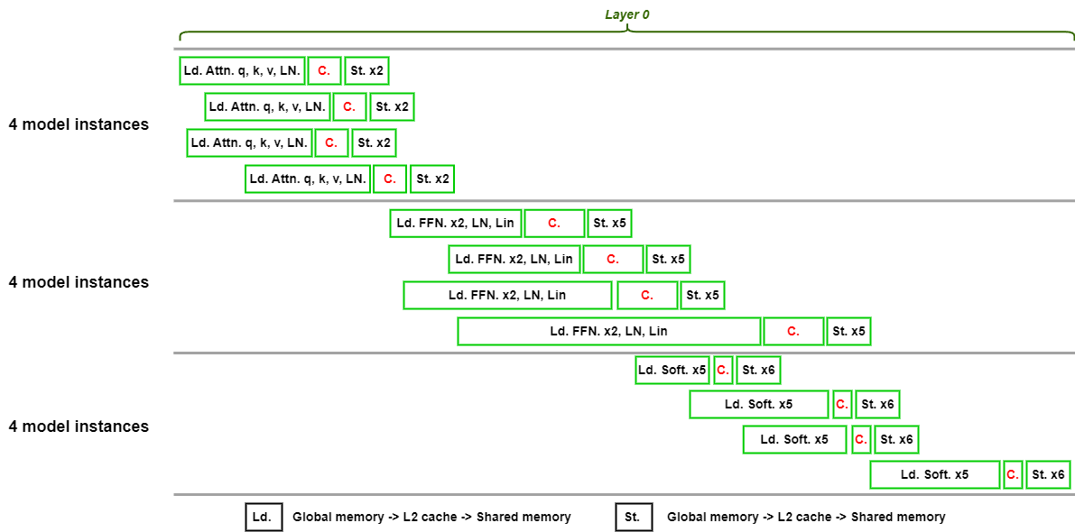
Very bad performance of concurrent model instances
Recall the GPU compute/memory access behaviors in inference:
What will it be like when we have 4 model instances running on the GPU?
Source: Yao, Jinghan, Nawras Alnaasan, Tian Chen, Aamir Shafi, and Hari Subramoni. "Flover: A Temporal Fusion Framework for Efficient Autoregressive Model Parallel Inference." arXiv preprint arXiv:2305.13484 (2023).
Notes:
Yao, Jinghan, Nawras Alnaasan, Tian Chen, Aamir Shafi, and Hari Subramoni. "Flover: A Temporal Fusion Framework for Efficient Autoregressive Model Parallel Inference." arXiv preprint arXiv:2305.13484 (2023).

Slide 13
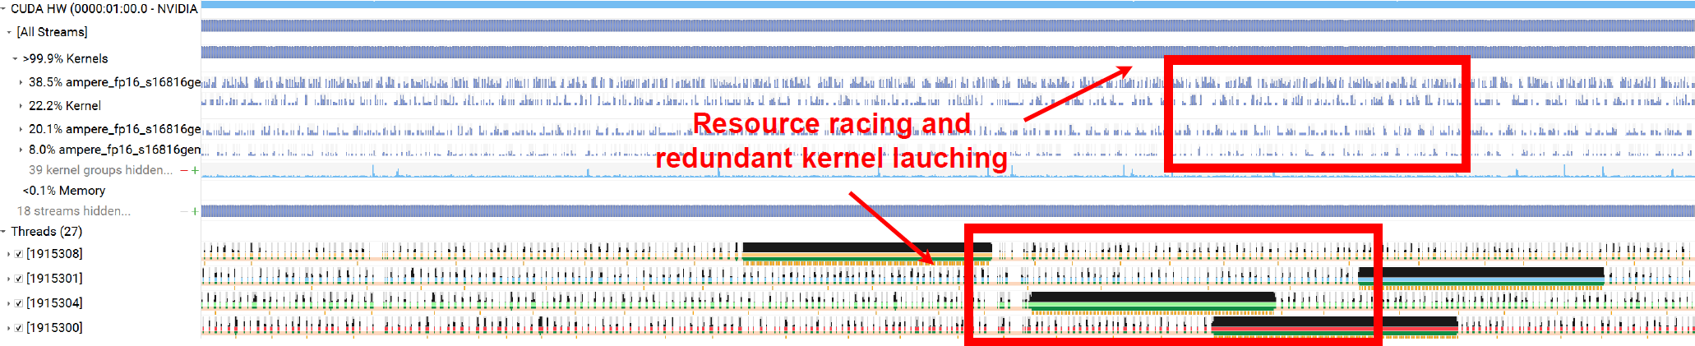
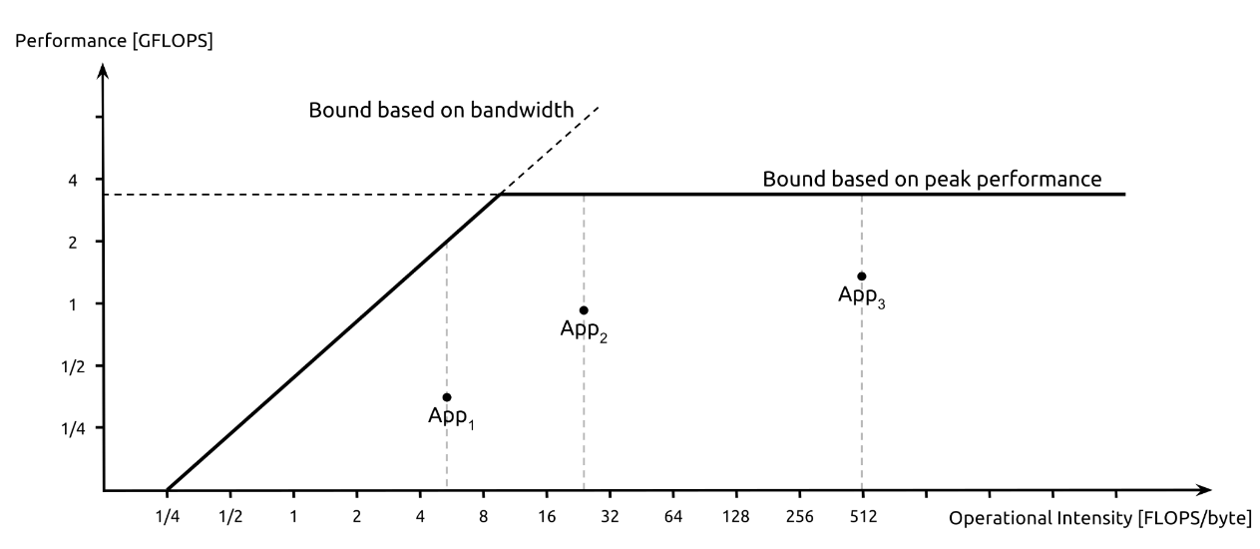
Using Nsight to profile the GPU kernels
GPU memory has a fixed bandwidth.
  Each instance will compete with all other instances for the bandwidth.
We are still memory bound. Each request takes 4 times longer to process.
0 performance gain. ☹
Source: Yao, Jinghan, Nawras Alnaasan, Tian Chen, Aamir Shafi, and Hari Subramoni. "Flover: A Temporal Fusion Framework for Efficient Autoregressive Model Parallel Inference." arXiv preprint arXiv:2305.13484 (2023).
Notes:
Yao, Jinghan, Nawras Alnaasan, Tian Chen, Aamir Shafi, and Hari Subramoni. "Flover: A Temporal Fusion Framework for Efficient Autoregressive Model Parallel Inference." arXiv preprint arXiv:2305.13484 (2023).

Slide 14
Overview
Introduction to large language models
  Property
  Inference scenarios
Temporal fusion/In-flight batching
Performance Optimization
Performance Evaluation
  Latency
  Concurrency

Slide 15
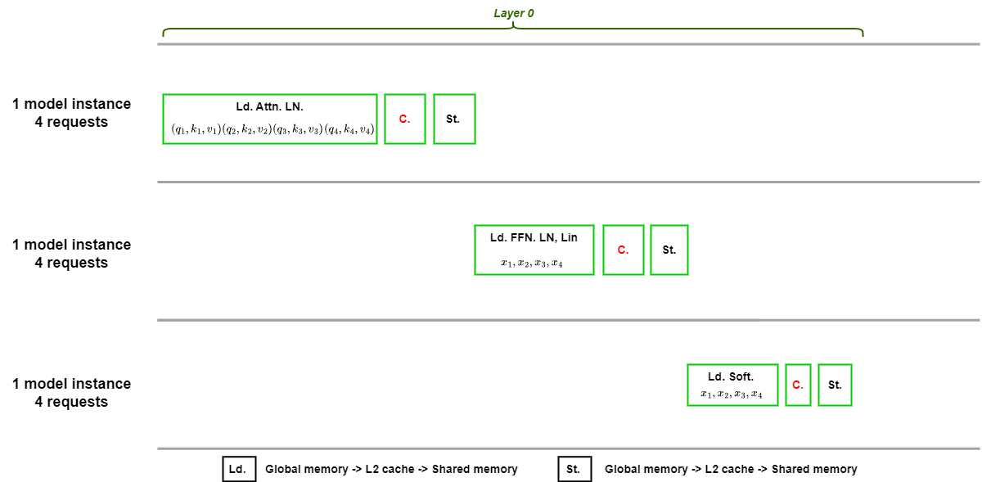
Ultimate solution: Temporal fusion/In-flight batching
Recall that:
  For 1 query that has 512 words as the output, it will run the model for 512 times.
  Each time, the model is dealing with a single token. This token is fed through all layers to get 1 output.
For any query at any time step, the model performs the identical operations.
  Consider kernel fusion, what do you think we can do?

Slide 16
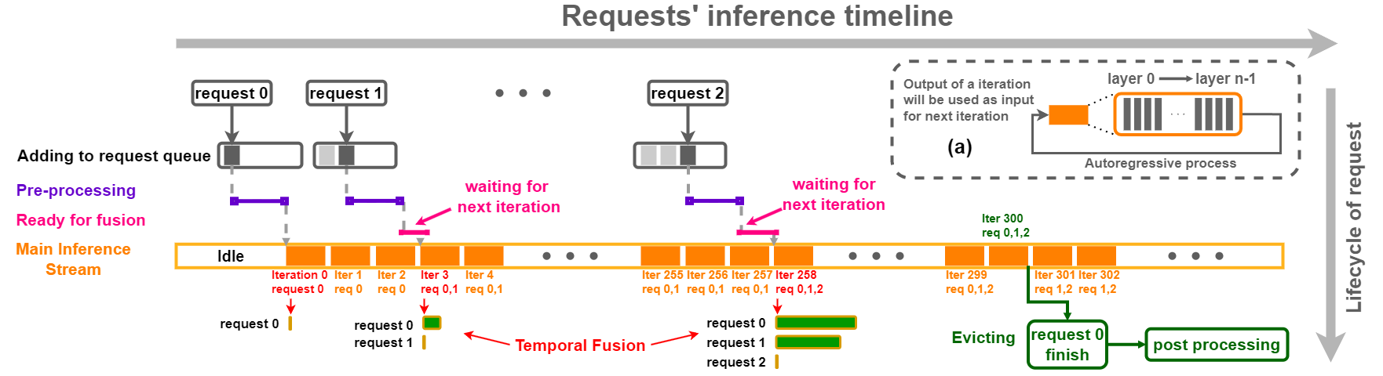
Ultimate solution: In-flight batching
What are we batching?
We are batching the generation of multiple requests in each iteration / step.
Source: Yao, Jinghan, Nawras Alnaasan, Tian Chen, Aamir Shafi, and Hari Subramoni. "Flover: A Temporal Fusion Framework for Efficient Autoregressive Model Parallel Inference." arXiv preprint arXiv:2305.13484 (2023).

Slide 17
Ultimate solution: In-flight batching
Temporal
Fusion
We have the most fine-grained batching now!
Source: Yao, Jinghan, Nawras Alnaasan, Tian Chen, Aamir Shafi, and Hari Subramoni. "Flover: A Temporal Fusion Framework for Efficient Autoregressive Model Parallel Inference." arXiv preprint arXiv:2305.13484 (2023).

Slide 18
Overview
Introduction to large language models
  Property
  Inference scenarios
Temporal fusion/In-flight batching
Performance Optimization
Performance Evaluation
  Latency
  Concurrency

Slide 19
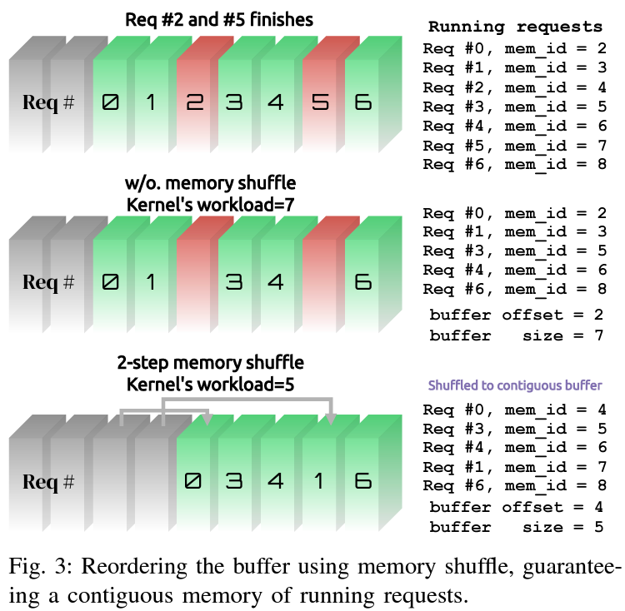
Memory reordering
cuBLAS kernels and collective operations take contiguous memory as the input.
After we batched multiple requests, if some requests finish:
Source: Yao, Jinghan, Nawras Alnaasan, Tian Chen, Aamir Shafi, and Hari Subramoni. "Flover: A Temporal Fusion Framework for Efficient Autoregressive Model Parallel Inference." arXiv preprint arXiv:2305.13484 (2023).

Slide 20
Overview
Introduction to large language models
  Property
  Inference scenarios
Temporal fusion/In-flight batching
Performance Optimization
Performance Evaluation
  Latency
  Concurrency

Slide 21
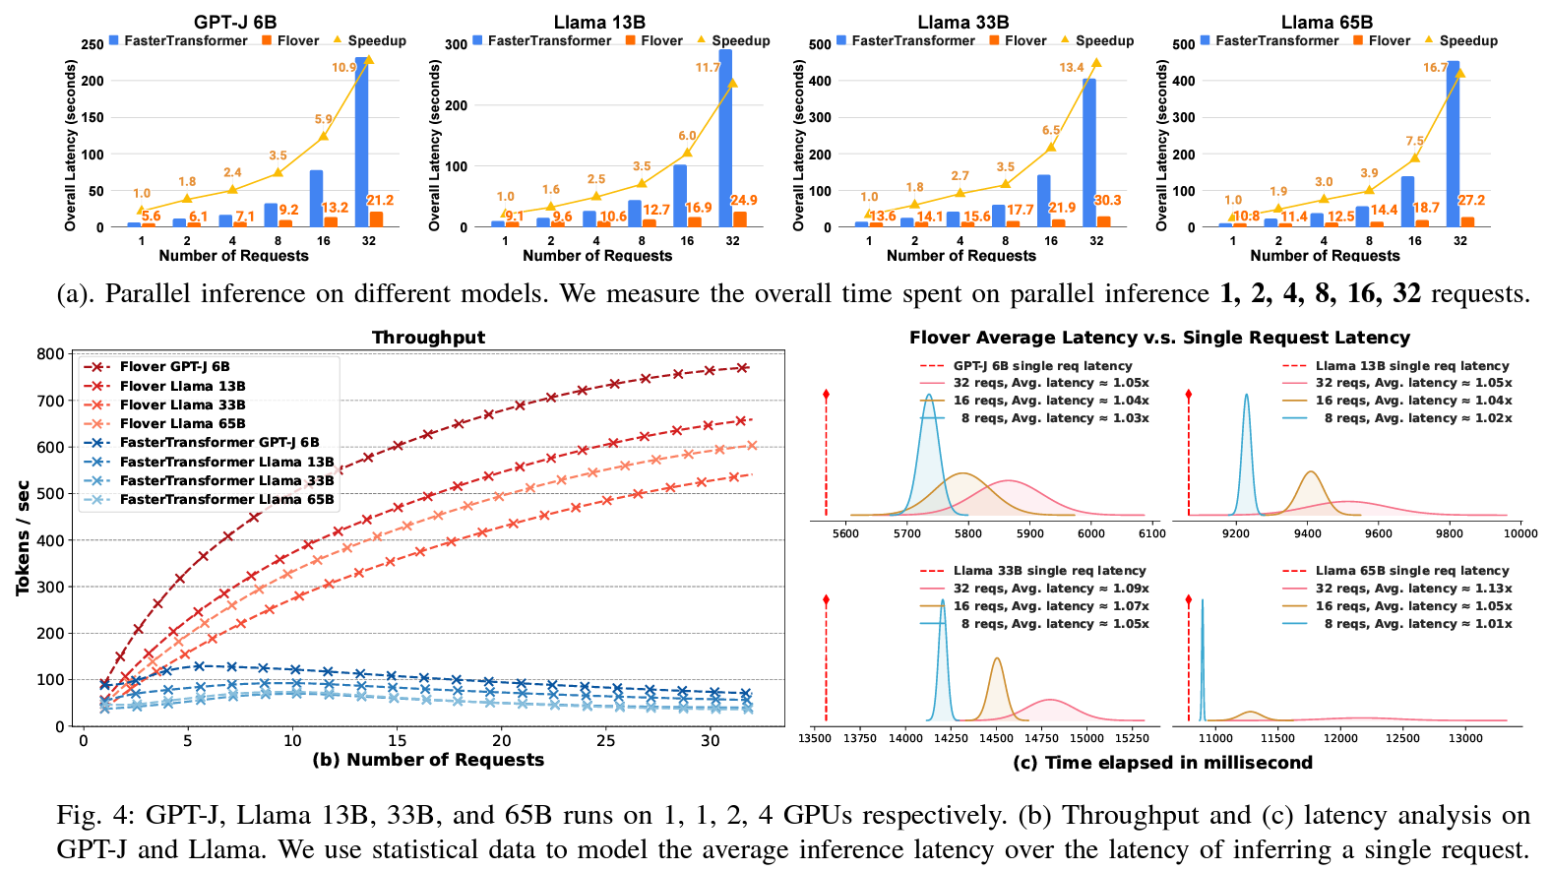
Requests with fixed generation length and arrival interval
Each request will have 512 generation length.
Time interval between arrival of requests is 500 ms.
Source: Yao, Jinghan, Nawras Alnaasan, Tian Chen, Aamir Shafi, and Hari Subramoni. "Flover: A Temporal Fusion Framework for Efficient Autoregressive Model Parallel Inference." arXiv preprint arXiv:2305.13484 (2023).

Slide 22
Requests with fixed generation length and arrival interval
Source: Yao, Jinghan, Nawras Alnaasan, Tian Chen, Aamir Shafi, and Hari Subramoni. "Flover: A Temporal Fusion Framework for Efficient Autoregressive Model Parallel Inference." arXiv preprint arXiv:2305.13484 (2023).

Slide 23
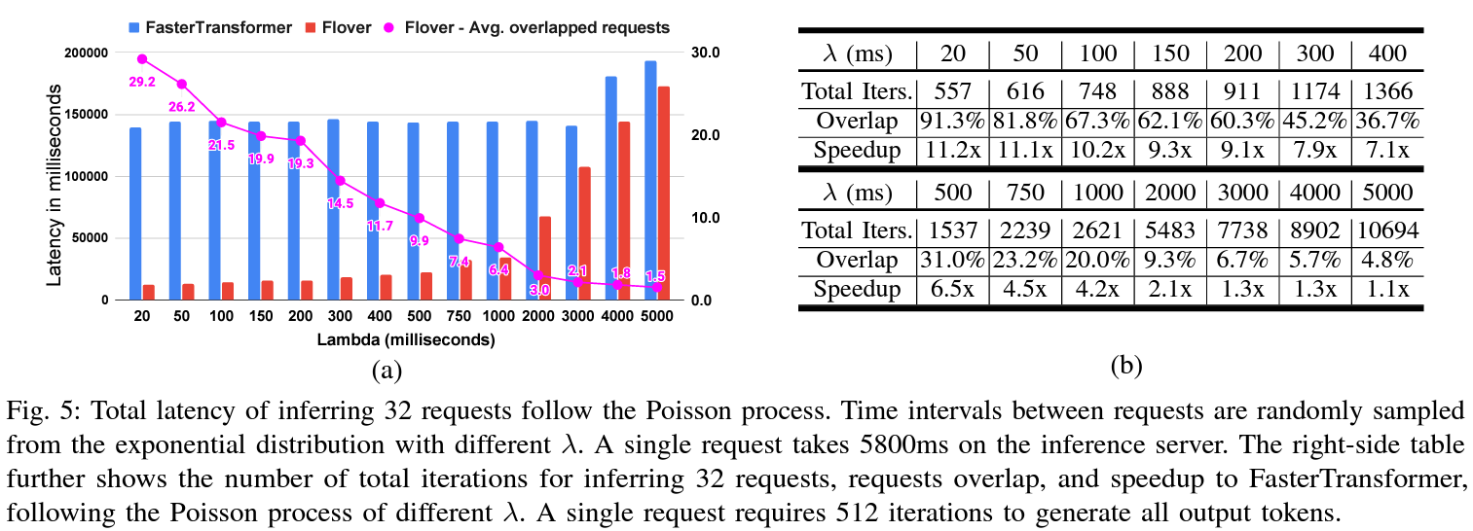
Requests with random arrival interval (Poisson Process)
Source: Yao, Jinghan, Nawras Alnaasan, Tian Chen, Aamir Shafi, and Hari Subramoni. "Flover: A Temporal Fusion Framework for Efficient Autoregressive Model Parallel Inference." arXiv preprint arXiv:2305.13484 (2023).

Slide 24
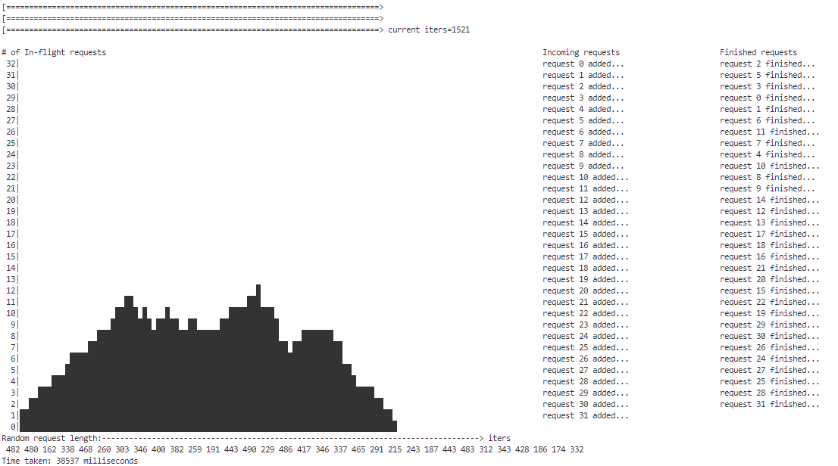
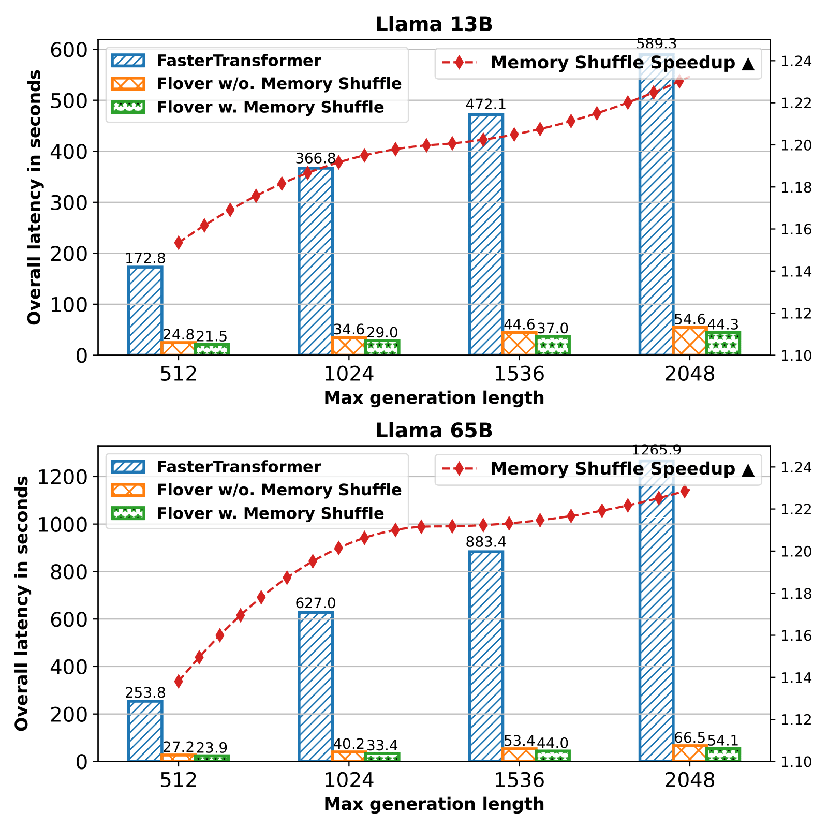
Requests with random generation length
Source: Yao, Jinghan, Nawras Alnaasan, Tian Chen, Aamir Shafi, and Hari Subramoni. "Flover: A Temporal Fusion Framework for Efficient Autoregressive Model Parallel Inference." arXiv preprint arXiv:2305.13484 (2023).

Slide 25
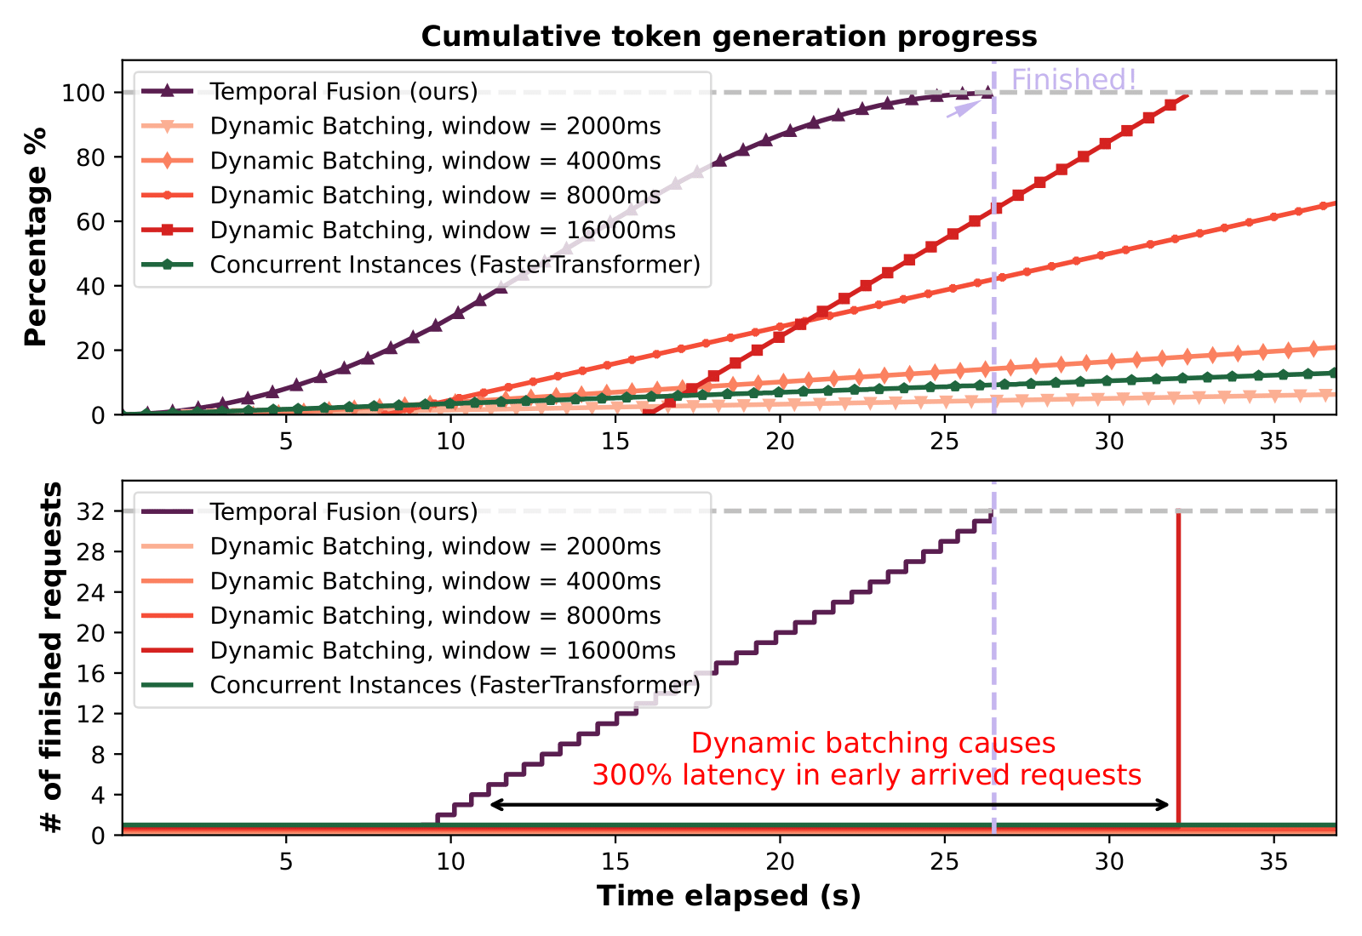
Overall generation progress for 32 requests
Source: Yao, Jinghan, Nawras Alnaasan, Tian Chen, Aamir Shafi, and Hari Subramoni. "Flover: A Temporal Fusion Framework for Efficient Autoregressive Model Parallel Inference." arXiv preprint arXiv:2305.13484 (2023).

Slide 26
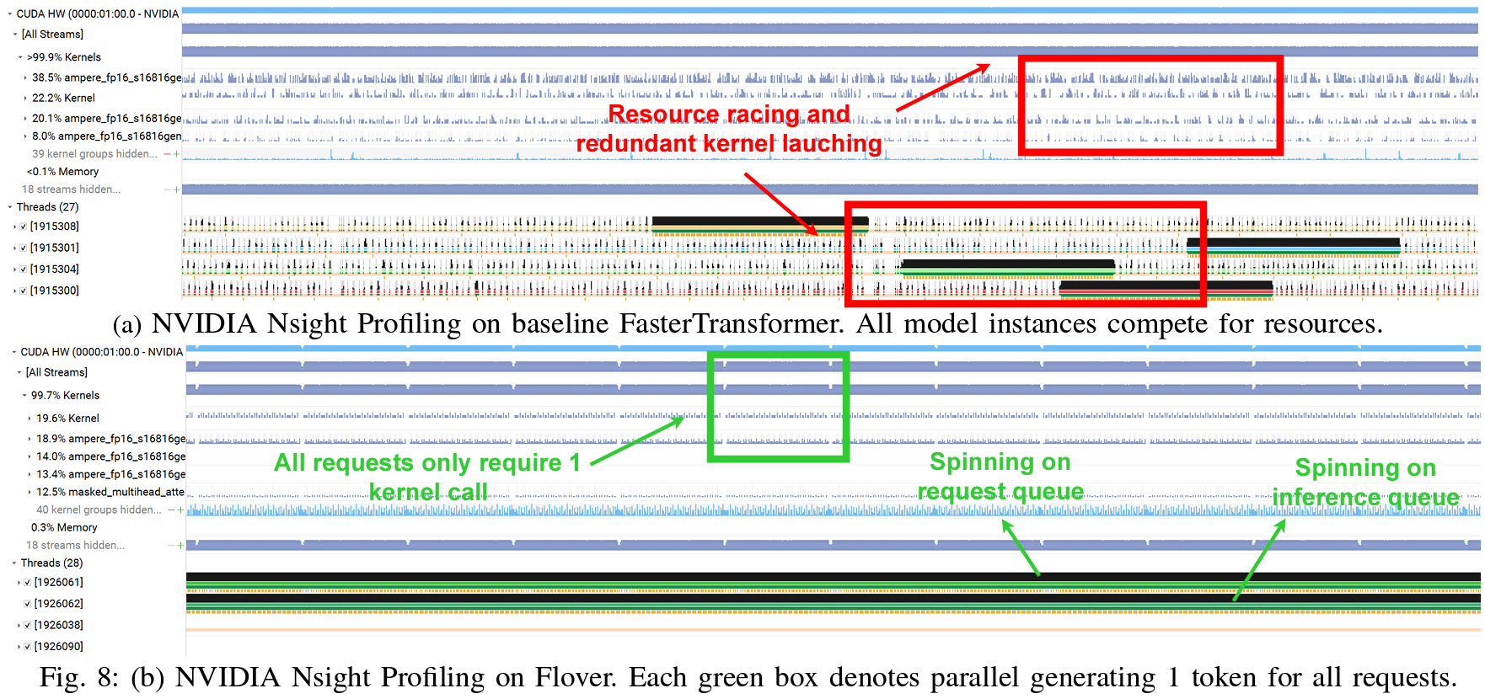
Hardware profiling
Source: Yao, Jinghan, Nawras Alnaasan, Tian Chen, Aamir Shafi, and Hari Subramoni. "Flover: A Temporal Fusion Framework for Efficient Autoregressive Model Parallel Inference." arXiv preprint arXiv:2305.13484 (2023).

Slide 27
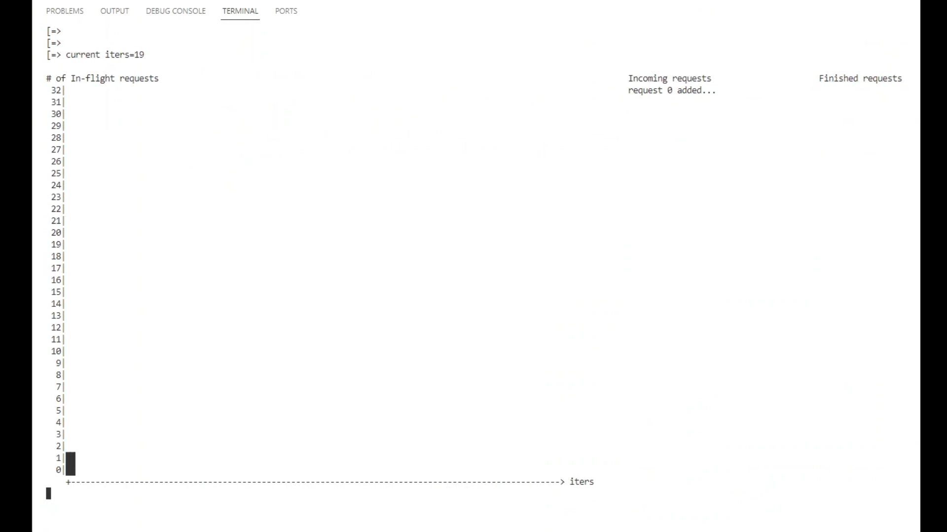
Inference 32 requests on LLaMA 7B (random generation length)
Source: Yao, Jinghan, Nawras Alnaasan, Tian Chen, Aamir Shafi, and Hari Subramoni. "Flover: A Temporal Fusion Framework for Efficient Autoregressive Model Parallel Inference." arXiv preprint arXiv:2305.13484 (2023).

Slide 28



THANK YOU!
Network Based Computing
Laboratory
Network-Based Computing Laboratory
http://nowlab.cse.ohio-state.edu/
The High-Performance MPI/PGAS
Project
http://mvapich.cse.ohio-state.edu/
The High-Performance Big Data
Project
http://hibd.cse.ohio-state.edu/
The High-Performance Deep Learning
Project
http://hidl.cse.ohio-state.edu/

