Slide 1
High Performance & Scalable MPI library over Broadcom RoCE
Mustafa Abduljabbar
abduljabbar.1osu.edu
11/12/2023
Network-based Computing Laboratory
Department of Computer Science and Engineering
The Ohio State University

Slide 2
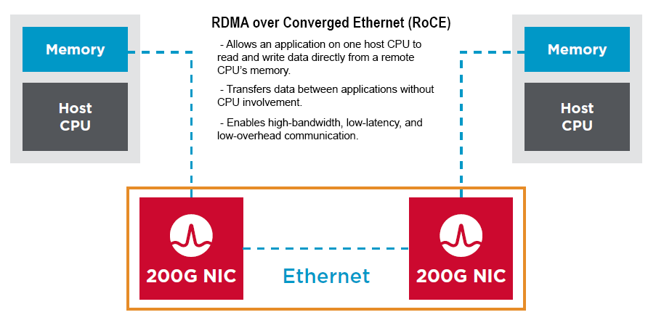
Introduction
https://techdocs.broadcom.com/us/en/storage-and-ethernet-connectivity/ethernet-nic-controllers/bcm957xxx/adapters/RDMA-over-Converged-Ethernet.html

Slide 3
Why RoCE for HPC?
Enhanced Performance: RoCE delivers significantly lower latency and higher throughput compared to traditional Ethernet, empowering HPC applications to achieve peak performance.
Optimized Efficiency: RoCE offloads RDMA operations to specialized hardware, reducing CPU overhead and freeing up valuable processing resources for critical computational tasks.
Cost-Effective Solution: RoCE leverages existing Ethernet infrastructure, minimizing upfront investment and simplifying network management.
Scalable and Flexible: RoCE supports a range of Ethernet speeds and Layer 3 routing, enabling scalability and flexibility to meet evolving HPC demands.
Emerging HPC Interconnect Standard: RoCE is gaining widespread adoption in the HPC community, recognized for its ability to meet the stringent performance requirements of next-generation HPC systems.

Slide 4
Goal: Highly optimized MPI for Broadcom RoCEv2
MVAPICH-CPU release: Optimizing MPI communication operations on new generation Broadcom adapters
  We provide support for newer generation Broadcom network adapters (Thor 200 Gbps) in MVAPICH2 and optimize the communication protocols (RC, UD, Hybrid)
  Focus will be towards point-to-point operations (two-sided) and frequently used collective operations (such as Allreduce and Alltoall).
  Benefits of these designs will be studied at the applications level.
  These design changes will be incorporated into the future MVAPICH release.
MVAPICH-GPU release: Exploring the use of GPUDirect capabilities in new Broadcom adapters for high-performance data transfers to/from GPU device memory
  Broadcom has introduced support for GPUDirect RDMA to enable high-performance communication operations from device memory.
  We study and evaluate the performance of Broadcom’s GPUDirect technology with Thor adapters.
  We explore designs in MVAPICH2-GDR for accelerating relevant portions of device-based communication operations using GPUDirect technology with Thor adapters. The focus will be on point-to-point intra-node, inter-node, and commonly used collectives (Allreduce and Alltoall).
  The designs will be incorporated into the future MVAPICH2-GDR release.

Slide 5

Overview of the MVAPICH2 Project
High Performance open-source MPI Library
Support for multiple interconnects
  InfiniBand, Omni-Path, Ethernet/iWARP, RDMA over Converged Ethernet (RoCE), AWS EFA, OPX, Broadcom RoCE, Intel Ethernet, Rockport Networks, Slingshot 10/11
Support for multiple platforms
  x86, OpenPOWER, ARM, Xeon-Phi, GPGPUs (NVIDIA and AMD)
Started in 2001, first open-source version demonstrated at SC ‘02
Supports the latest MPI-3.1 standard
http://mvapich.cse.ohio-state.edu
Additional optimized versions for different systems/environments:
  MVAPICH2-X (Advanced MPI + PGAS), since 2011
  MVAPICH2-GDR with support for NVIDIA (since 2014) and AMD (since 2020) GPUs
  MVAPICH2-MIC with support for Intel Xeon-Phi, since 2014
  MVAPICH2-Virt with virtualization support, since 2015
  MVAPICH2-EA with support for Energy-Awareness, since 2015
  MVAPICH2-Azure for Azure HPC IB instances, since 2019
  MVAPICH2-X-AWS for AWS HPC+EFA instances, since 2019
Tools:
  OSU MPI Micro-Benchmarks (OMB), since 2003
  OSU InfiniBand Network Analysis and Monitoring (INAM), since 2015
Used by more than 3,325 organizations in 90 countries
More than 1.73 Million downloads from the OSU site directly
Empowering many TOP500 clusters (Nov ‘23 ranking)
  11th , 10,649,600-core (Sunway TaihuLight) at NSC, Wuxi, China
  29th , 448, 448 cores (Frontera) at TACC
  46th, 288,288 cores (Lassen) at LLNL
  61st, 570,020 cores (Nurion) in South Korea and many others
Available with software stacks of many vendors and Linux Distros (RedHat, SuSE, OpenHPC, and Spack)
Partner in the 21st ranked TACC Frontera system
Empowering Top500 systems for more than 16 years

Slide 6
Overview
Introduction
Performance Characterization
  MPI performance overheads vs. IB level
Performance Optimization
Performance Evaluation
  Micro-benchmark level
  Application level
MVAPICH 3.0 RC Performance Evaluation

Slide 7
Configuration & Runtime
MVAPICH2 Runtime:
  RC: MV2_USE_UD_HYBRID=0 MV2_USE_ONLY_UD=0
  UD: MV2_USE_UD_HYBRID=0 MV2_USE_ONLY_UD=1
UCX 1.12.1:
  ./configure --prefix=<UCX_INSTALL_PATH>
OpenMPI 4.1.4 (w/ UCX 1.12.1):
  ./configure –prefix=<INSTALL_PATH> --with-ucx=<UCX_INSTALL_PATH>
OpenMPI Runtime:
  mpirun -np <NP> -npernode <PPN> -hostfile hosts --mca pml ucx –x UCX_TLS=self,sm,rc_v /path/to/cp2k.popt -i /path/to/inputfile

Slide 8
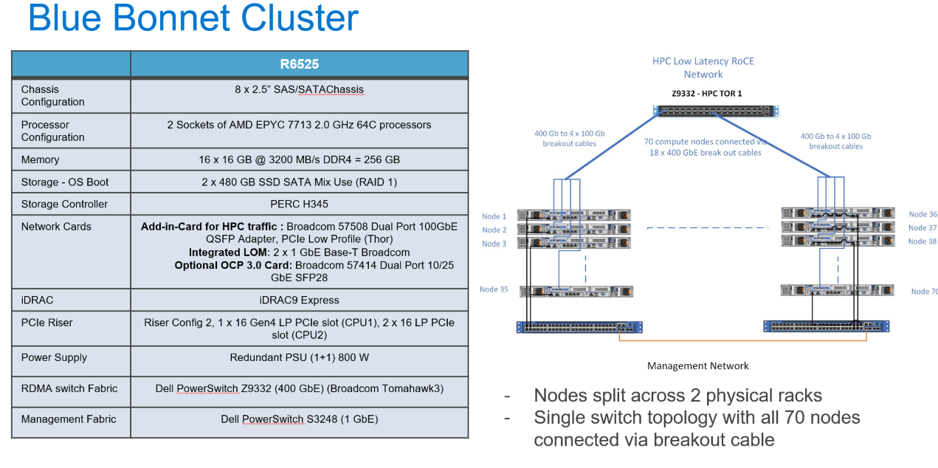
Cluster Setup
*
*Courtesy of DELL Technology

Slide 9
CPU and NIC Setup
Feature | Specification
Model | AMD EPYC 7713
Cores | 64
Socket | 2
Base clock speed | 2.9 GHz
Boost clock speed | 3.6 GHz
L1 cache | 32 KB per core
L2 cache | 512 KB per core
L3 cache | 32 MB per core
Memory support | Up to 32 TB of DDR4-3200
PCIe lanes | 128
TDP | 280W
Feature | Specification
Model | Broadcom Thor RoCE HCA
Driver | bnxt_en
Driver Version | 1.10.2-226.0.141.0
Firmware Version | 226.0.145.1/pkg 22.61.10.71
Number of ports | 1
Speed | 100 Gb/s
Supported link modes | 25000baseCR/Full 50000baseCR2/Full 100000baseCR4/Full 50000baseCR/Full 100000baseCR2/Full 200000baseCR4/Full
Active link mode | 100000baseCR4/Full

Slide 10
RDMA Protocol Performance Characterization on 100 GbE
RC
UD
5.34us
On-par with IB-verbs
3.82us
3.93us

Slide 11
MPI level Overhead – Point-to-point Latency
RC Overhead
UD Overhead
16.86us
2420ns
1520ns
140ns

Slide 12
Overview
Introduction
Performance Characterization
  MPI performance overheads vs. IB level
Performance Optimization
Performance Evaluation
  Micro-benchmark level
  Application level
MVAPICH 3.0 RC Performance Evaluation

Slide 13
Performance Optimization
High-level description of optimization efforts:
  Add corresponding point-to-point & collective tuning tables
    For up to 64 nodes x 128 PPN =
    Based on Dell Bluebonnet (CPU) system and Rattler2 (GPU) system
  Enhanced UD+RC hybrid transport mode tuned for Broadcom adapter
  Optimized default CPU mapping policy
  Support for asynchronous threading progress
  Startup Optimization
  Point-to-point Message Coalescing
  SGL packetized eager communication

Slide 14
UD + RC Transport Protocol Analysis
RC has better performance vs. UD in most cases
UD becomes exclusive on large scales (e.g. alltoall with >= 16 nodes)
Tuned hybrid transport mode
  Use RC for small scale & message sizes
  Use UD for the other cases

Slide 15
Performance Optimization
High-level description of optimization efforts:
  Add corresponding point-to-point & collective tuning tables
  Enhanced UD+RC hybrid transport mode tuned for Broadcom adapter
  Optimized default CPU mapping policy
    Make hybrid spread CPU mapping policy as default
  Support for asynchronous threading progress
  UD Startup Optimization
  Point-to-point Message Coalescing
  SGL packetized eager communication

Slide 16
UD Startup Optimization
Provide up to 2.3x faster UD startup in small 4 nodes scale
Provide up to 2.1x faster UD startup in large 64 nodes scale

Slide 17
Pt-to-Pt Coalescing Performance
osu_bw
osu_bibw
1.6x
2.7x
Enabling/disabling coalescing has an impact on BW and BiBW
  Coalescing effective up to 1K message size
Up to 1.6x higher bandwidth, 2.7x higher bi-bandwidth with medium sized messages

Slide 18
Single-Pair Message Rate - Coalescing Performance
Test Name: Single-Pair Bandwidth and Message Rate Test
Evaluation Focus: Aggregate uni-directional bandwidth and message rate
Participants: 1 process per node
Sending Process Behavior:
  Sends a fixed number of messages (window size)
  Sends messages back-to-back to the paired receiving process
  Waits for a reply from the receiver
Iterations: Repeated for several iterations
osu_mbw_mr
1.5x
Enabling/disabling coalescing has an impact on BW and BiBW (Coalescing effective up to 1K message size)
Up to 1.5x higher bandwidth with limits

Slide 19
SGL packetized eager communication – 100 GbE
Reduce up to 16% alltoall latency for 4 bytes messages size
Enable by adding MV2_USE_EAGER_SGL=1 runtime parameter
Enabled by default for 1B ~ 1KB message sizes

Slide 20
Overview
Introduction
Performance Characterization
Performance Optimization
Performance Evaluation
  Micro-benchmark level
  Application level
MVAPICH 3.0 RC Performance Evaluation

Slide 21
Performance Evaluation – Micro-benchmarks
Experiment results from Dell Bluebonnet
Up to 20% reduction in small message point-to-point latency
From 0.1x to 2x increase in bandwidth
Up to 12.4x lower MPI_Allreduce latency
Up to 5x lower MPI_Scatter latency

Slide 22
Performance Evaluation – Micro-benchmarks
Experiment results from Rattler2
Up to 53% reduction in medium message point-to-point latency
Up to 2.6x increase in bandwidth
Up to 35% reduction in alltoall latency

Slide 23
Performance Evaluation – Applications
Reduce up to 45% execution time of OpenFOAM Motorbike on 16 nodes 128 PPN scale
Reduce up to 51% execution time of GROMACS benchPEP on 64 nodes 128 PPN scale

Slide 24
Performance Evaluation – Applications
Reduce up to 45% execution time of CP2K H2O-dft-ls (NREP4)
Reduce up to 7% execution time of WRF CONUS 3KM

Slide 25
Overview
Introduction
Performance Characterization
Performance Optimization
Performance Evaluation
  Micro-benchmark level
  Application level
MVAPICH 3.0 RC Performance Evaluation

Slide 26
MVAPICH-3.0 Pt-to-Pt Latency (RC) on FW 227 (RHEL 8.8)
MVAPICH 3.0 provides competitive point-to-point performance
Reduce 9% latency with 16KB message size

Slide 27
MVAPICH-3.0 Pt-to-Pt Latency (UD) on FW 227 (RHEL 8.8)
MVAPICH 3.0 provides competitive point-to-point UD performance
Reduce 28% latency with 16KB message size

Slide 28
Conclusion & Future Work
Conclusion:
  Analyze MPI overheads vs. IB level performance on Broadcom adapter
  Significant microbenchmark and application level gains
  Suc
Future Work:
  Optimize additional applications
  Integrate existing optimizations with MVAPICH-3.0 on Broadcom systems
  In progress: MVAPICH-2.3.8 (with enhanced RoCEv2 support)

Slide 29



THANK YOU!
Network Based Computing
Laboratory
Network-Based Computing Laboratory
http://nowlab.cse.ohio-state.edu/
The High-Performance MPI/PGAS
Project
http://mvapich.cse.ohio-state.edu/
The High-Performance Big Data
Project
http://hibd.cse.ohio-state.edu/
The High-Performance Deep Learning
Project
http://hidl.cse.ohio-state.edu/

