Slide 1
Can near-data processing accelerate dense MPI collectives? An MVAPICH Approach
Talk by: Mustafa Abduljabbar
Network-based Computing Laboratory
Department of Computer Science and Engineering
The Ohio State University

Slide 2
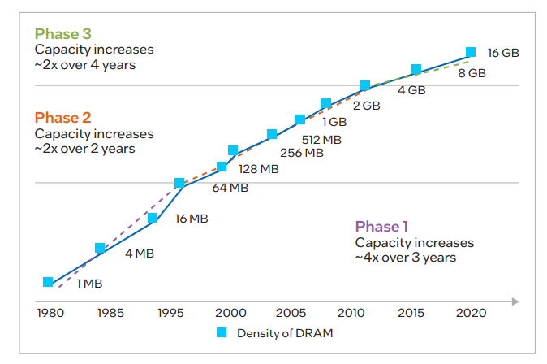
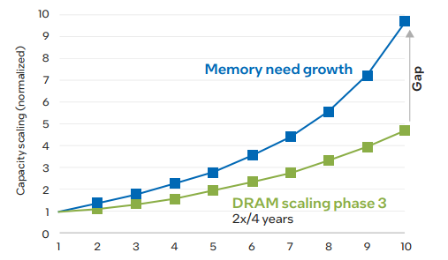
Memory growth trends (e.g. DRAM)
  The end of the Dennard scaling made it more complex to sustain the DRAM growth
  The gap between applications and growth is increasing

Slide 3

Overview of the MVAPICH2 Project
High Performance open-source MPI Library
Support for multiple interconnects
  InfiniBand, Omni-Path, Ethernet/iWARP, RDMA over Converged Ethernet (RoCE), AWS EFA, OPX, Broadcom RoCE, Intel Ethernet, Rockport Networks, Slingshot 10/11
Support for multiple platforms
  x86, OpenPOWER, ARM, Xeon-Phi, GPGPUs (NVIDIA and AMD)
Started in 2001, first open-source version demonstrated at SC ‘02
Supports the latest MPI-3.1 standard
http://mvapich.cse.ohio-state.edu
Additional optimized versions for different systems/environments:
  MVAPICH2-X (Advanced MPI + PGAS), since 2011
  MVAPICH2-GDR with support for NVIDIA (since 2014) and AMD (since 2020) GPUs
  MVAPICH2-MIC with support for Intel Xeon-Phi, since 2014
  MVAPICH2-Virt with virtualization support, since 2015
  MVAPICH2-EA with support for Energy-Awareness, since 2015
  MVAPICH2-Azure for Azure HPC IB instances, since 2019
  MVAPICH2-X-AWS for AWS HPC+EFA instances, since 2019
Tools:
  OSU MPI Micro-Benchmarks (OMB), since 2003
  OSU InfiniBand Network Analysis and Monitoring (INAM), since 2015
Used by more than 3,290 organizations in 90 countries
More than 1.63 Million downloads from the OSU site directly
Empowering many TOP500 clusters (Nov ‘22 ranking)
  7th , 10,649,600-core (Sunway TaihuLight) at NSC, Wuxi, China
  19th, 448, 448 cores (Frontera) at TACC
  34th, 288,288 cores (Lassen) at LLNL
  46th, 570,020 cores (Nurion) in South Korea and many others
Available with software stacks of many vendors and Linux Distros (RedHat, SuSE, OpenHPC, and Spack)
Partner in the 19th ranked TACC Frontera system
Empowering Top500 systems for more than 16 years

Slide 4
Why collectives?
MPI collectives are used by many data intensive (map-reduce) workloads
In MPI libraries, they are the heaviest in terms of computation and communication (interconnect/mem buses)
Collective performance (such as alltoall and allreduce) is based on many factors, including but not limited to:
  The algorithmic choice
  The underlying pt-to-pt performance (inter-node vs intra-node)
  The platform characteristics (e.g. CPU/Memory model)

Slide 5
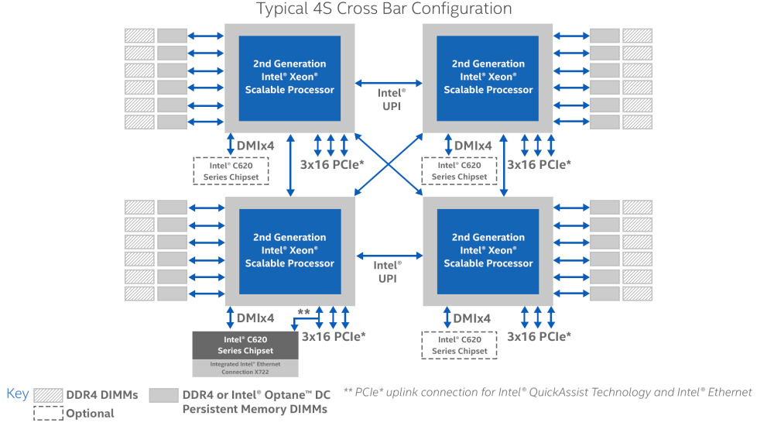
Architecture of our experimental platform
Model | Intel Xeon Platinum 8280M ("Cascade Lake")
Total cores per CLX node: | 112 cores on four sockets (28 cores/socket)
Hardware threads per core: | 1 Hyperthreading is not currently enabled on Frontera
Clock rate: | 2.7GHz nominal
Memory: | 2.1 TB NVDIMM
Cache: | 32KB L1 data cache per core; 1MB L2 per core; 38.5 MB L3 per socket. 384 GB DDR4 RAM configured as an L4 cache Each socket can cache up to 66.5 MB (sum of L2 and L3 capacity).
Local storage: | 144GB /tmp partition on a 240GB SSD 4x 833 GB /mnt/fsdax[0,1,2,3] partitions on NVDIMM 3.2 TB usable local storage

Slide 6
The bigmem (Optane) vs smallmem node
Bigmem Node
Smallmem Node
Model​ | Intel Xeon Platinum 8280M ("Cascade Lake")​
Total cores per CLX node:​ | 112 cores on four sockets (28 cores/socket)​
Hardware threads per core:​ | 1, Hyperthreading is not currently enabled on Frontera​
Clock rate:​ | 2.7GHz nominal​
Memory:​ | 2.1 TB NVDIMM​
Cache:​ | 32KB L1 data cache per core;​ 1MB L2 per core;​ 38.5 MB L3 per socket.​ 384 GB DDR4 RAM configured as an L4 cache​ Each socket can cache up to 66.5 MB (sum of L2 and L3 capacity).​
Local storage:​ | 144GB /tmp partition on a 240GB SSD​ 4x 833 GB /mnt/fsdax[0,1,2,3] partitions on NVDIMM​ 3.2 TB usable local storage​
Model | Intel Xeon Platinum 8280 ("Cascade Lake")
Total cores per CLX node: | 56 cores on two sockets (28 cores/socket)
Hardware threads per core: | 1, Hyperthreading is not currently enabled on Frontera
Clock rate: | 2.7GHz nominal
Memory: | 192GB (2933 MT/s) DDR4
Cache: | 32KB L1 data cache per core; 1MB L2 per core; 38.5 MB L3 per socket. Each socket can cache up to 66.5 MB (sum of L2 and L3 capacity).
Local storage: | 144GB /tmp partition on a 240GB SSD

Slide 7
STREAM bandwidth with PMEM memory modes
NOWLAB system: MRI
  Core(s) per socket: 28
  Socket(s): 2
  L2 cache: 1280K (70MB in total)
  L3 cache: 43008K (84MB in total)
  DRAM: 256GB
  Optane: 991GB
BW (MB/s) | Memory mode | App direct | Memory mode | App direct
Total memory required (GB) | 4.6 | 4.6 | 457.8 | 457.8
Copy | 156246.3 | 2311.2 | 20249.0 | 2453.7
Scale | 174390.6 | 2411.8 | 16097.6 | 2202.2
Add | 194115.5 | 3831.0 | 17414.0 | 2910.5
Triad | 197335.6 | 3854.9 | 22558.8 | 2776.7

Slide 8
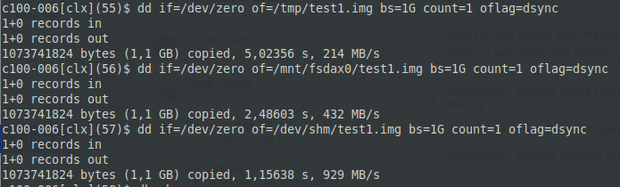
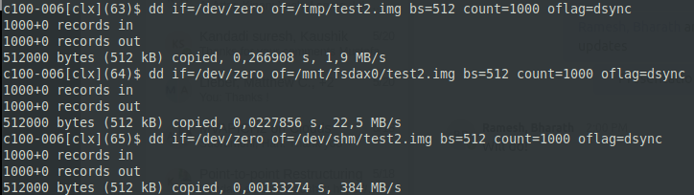
Quick I/O sanity check shows 3 different BW/latency on the Intel-Optane node
Single core, hence, not maximizing streaming BW usage
SSD -> PM -> DRAM
  2x BW increase on each step
  10x latency decrease on each step
SSD
PM
DRAM
SSD
PM
DRAM

Slide 9
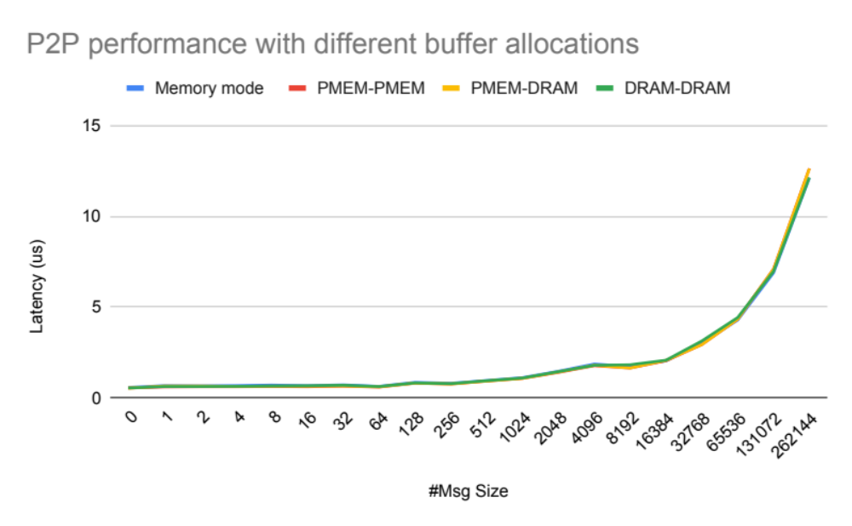
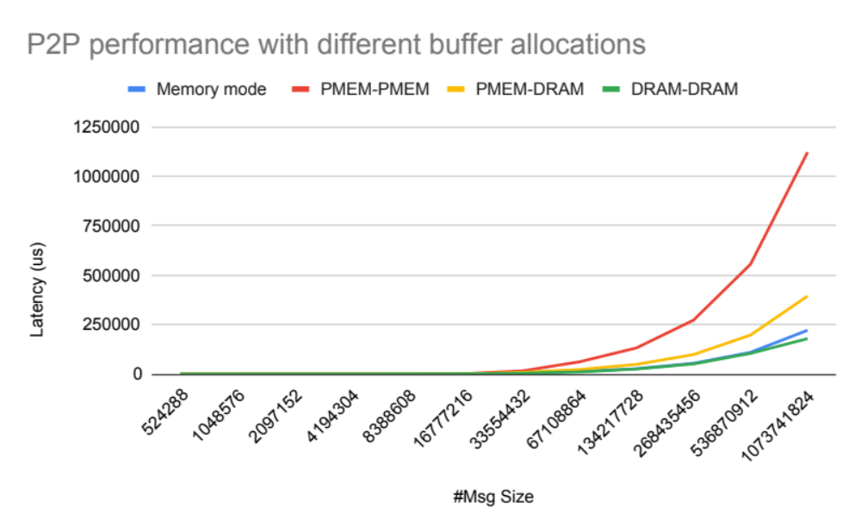
MV2 Pt-to-Pt based with PMEM memory modes
6.3x
2.2x

Slide 10
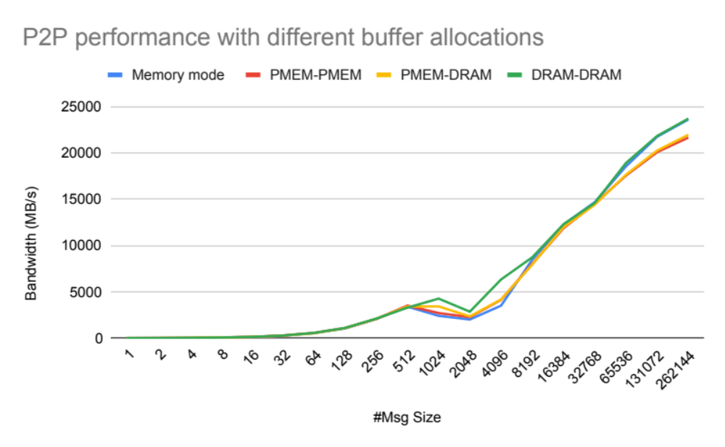
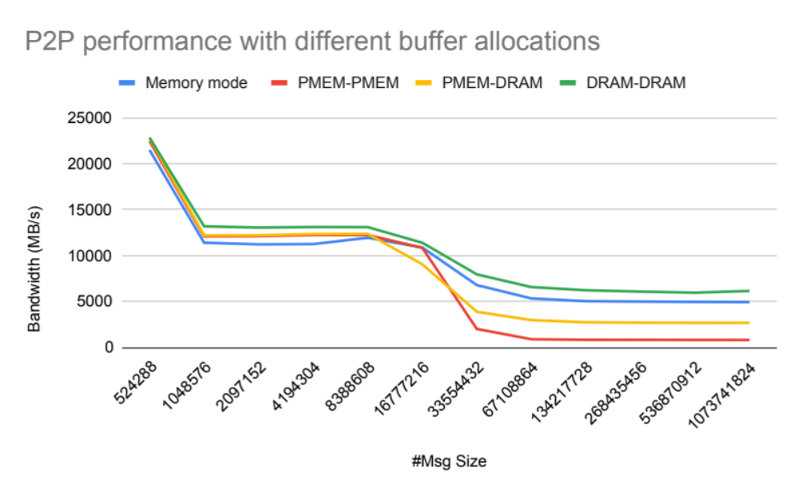
MV2 Pt-to-Pt based with PMEM memory modes
L2 cache
L3 cache

Slide 11
Alltoall collective behavior
Around 1 TB of alltoall exchange without drop in scaling
Proper collective tuning choice and techniques to push the boundaries of effective resource usage
Observed increase in latency due to higher latency

Slide 12
Allreduce collective behavior
Similar performance up to L2 (1MB), and smallmem outperforms bigmem beyond L3 size (32M)
However, lower degradations because allreduce is more computationally heavy
On par with DRAM with the small range ( < 1MB message size)

Slide 13
Using PMEMs for out-of-RAM sorting
We use usort GitHub - hsundar/usort: Fast distributed sorting routines using MPI and OpenMP
Compare and evaluate the performance of one PMEM node with multiple DRAM ones when data cannot fit into a single DRAM at application level
Configuration | DRAM node | PMEM node
Core(s) per socket | 28 | 28
Socket(s) | 2 | 4
L2 cache | 1024K | 1024K
L3 cache | 39424K | 39424K
DRAM | 186G | 186G
Optane | N/A | 1.9T

Slide 14
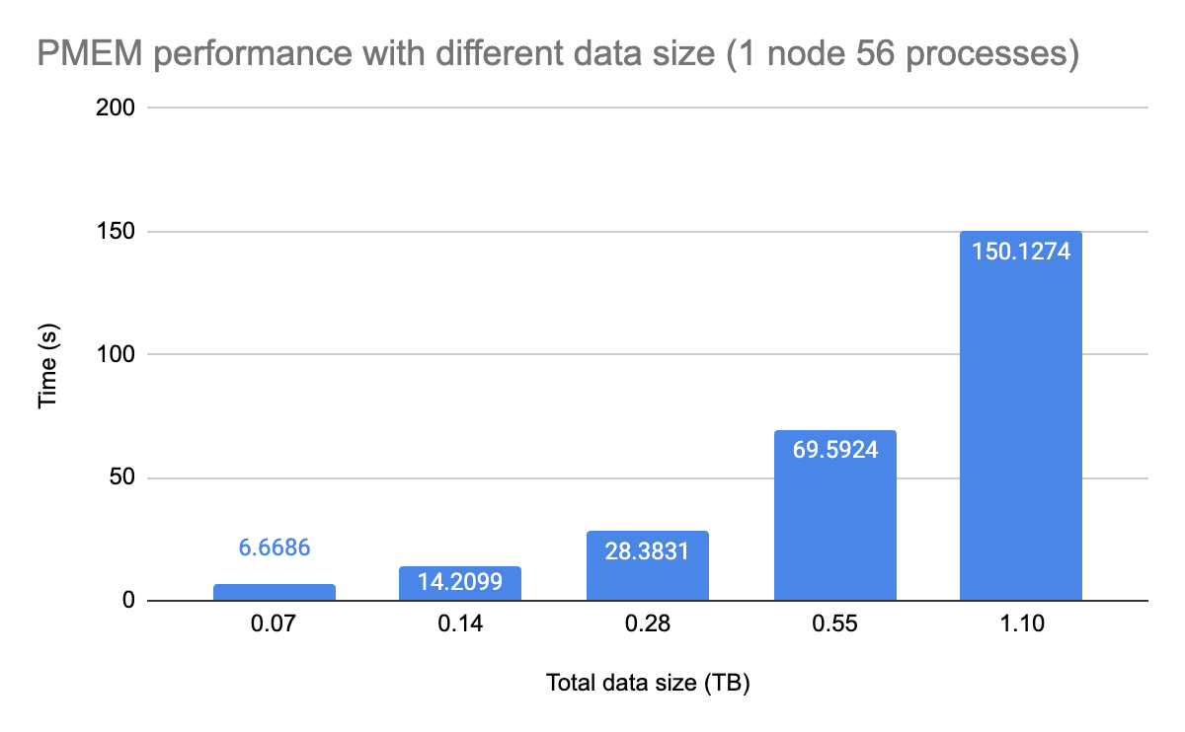
Behavior of distributed sorting (i.e. complexity)
We used the usort (disk-to-disk sorting) as a use-case for large collectives (alltoall and allreduce)
The scale-up mode is scalable according to our tests sorting 1.1 TB of keys on a single PMEM node
Generally speaking, this approach is cost effective (i.e. in terms of performance, operation and energy)

Slide 15
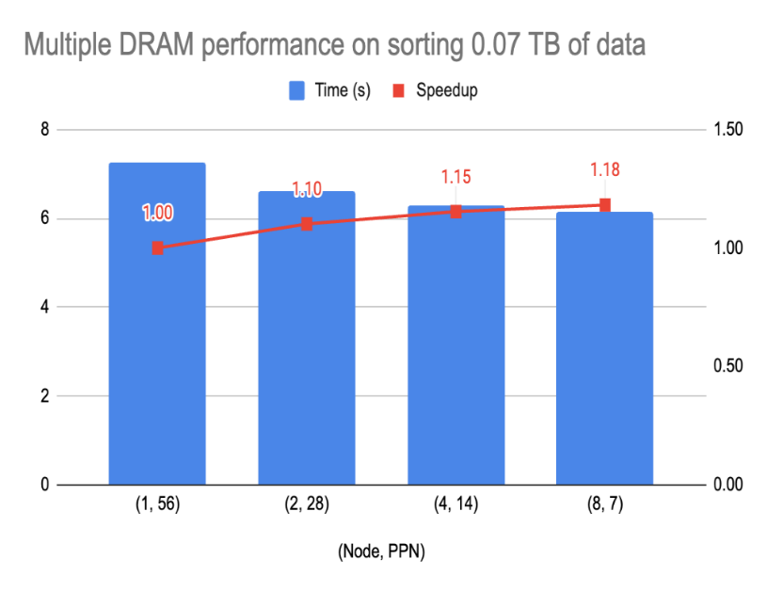
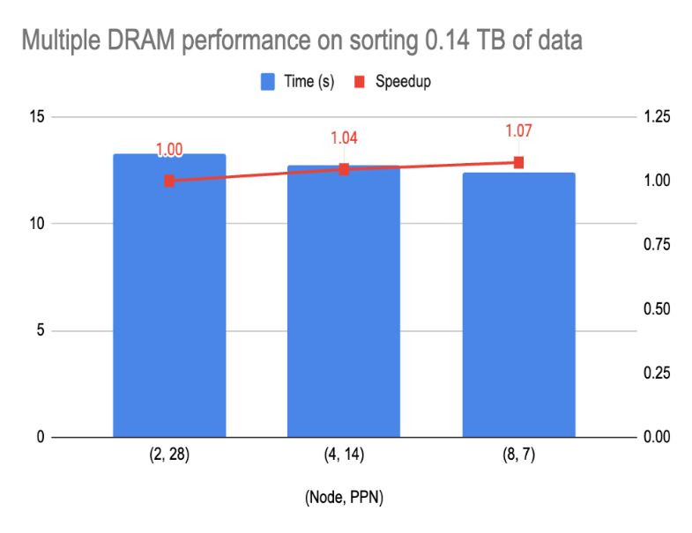
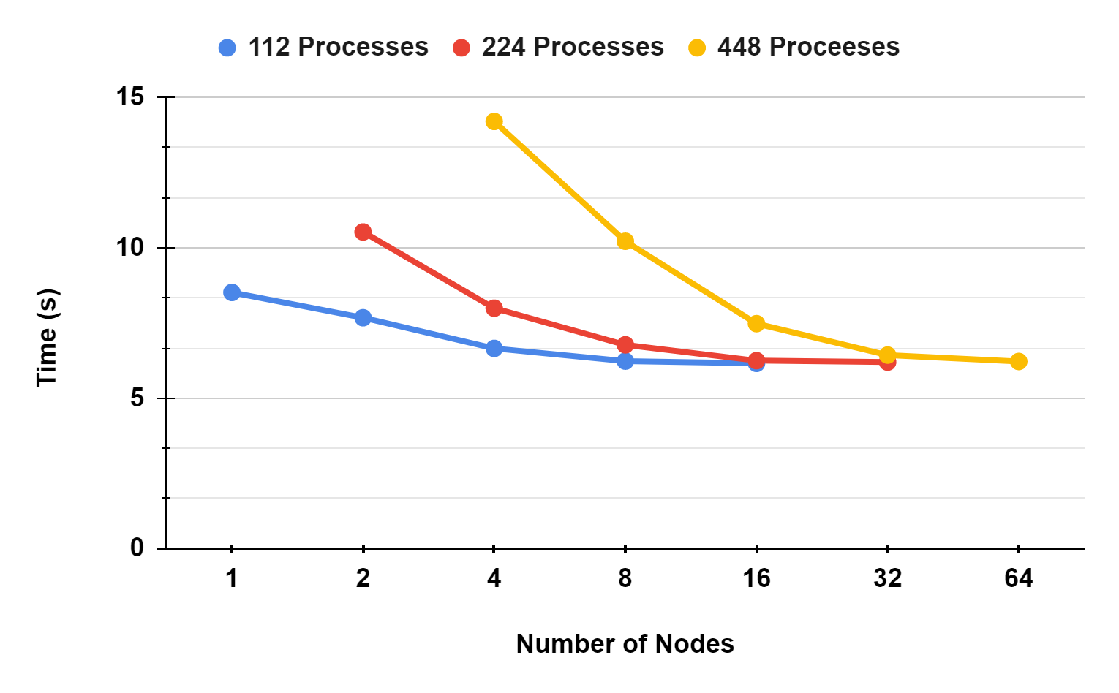
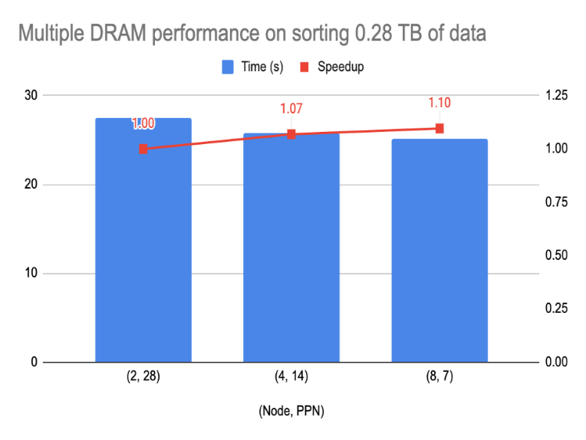
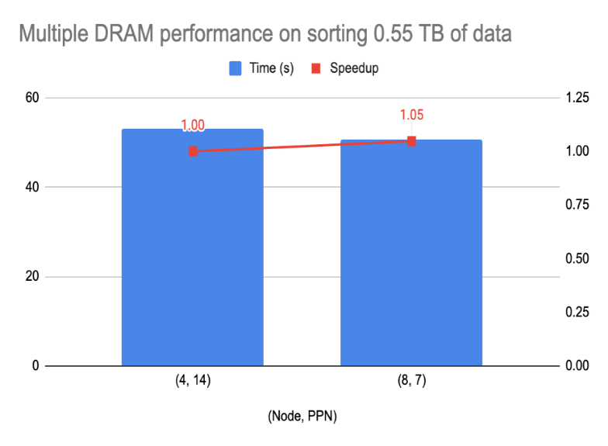
Scale-out vs Scale-up (usort)
Optane PMEM
Scale-up
Scale-out

Slide 16
Observations on the Multi-tiered Approach
Intel PMEMs do not function as HBMs, however, they provide for a cost-effective approach for scale-up and scale-out performance compared to multiple expensive DRAM, HBM nodes
For volatile usage, use in Memory mode (DRAM as an L4 cache)
Intel is discontinuing this series to up their game in advanced interconnects (CXL, CCIX)
Using more DRAMs has only a small benefit of 10 – 18% speedup in the 4-node case
    More cache capacity
    More memory channels
    Higher cost

Slide 17
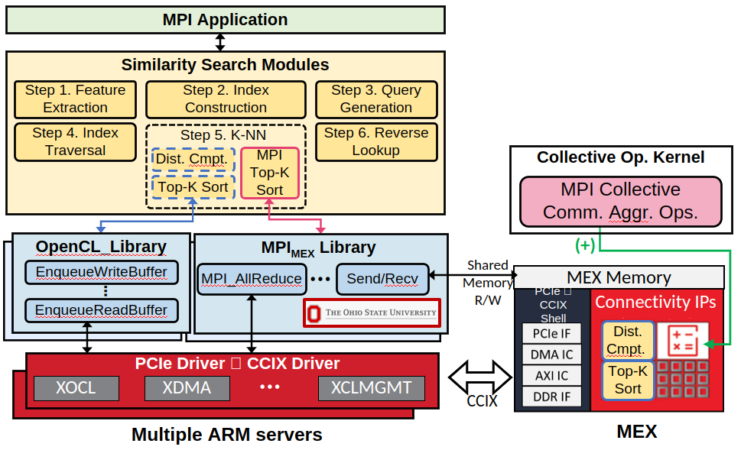
Can we close the performance gap?
To recap, performance is impacted by
  Lower aggregate memory bandwidth
  In the scale-up approach, lower number of core resource (i.e. caches)
We are collaborating with ETRI to close this gap
  Scale-out and process near-memory
Figure: showing the interaction between MVAPICH and the MEX hardware (in development) - courtesy to ETRI

Slide 18
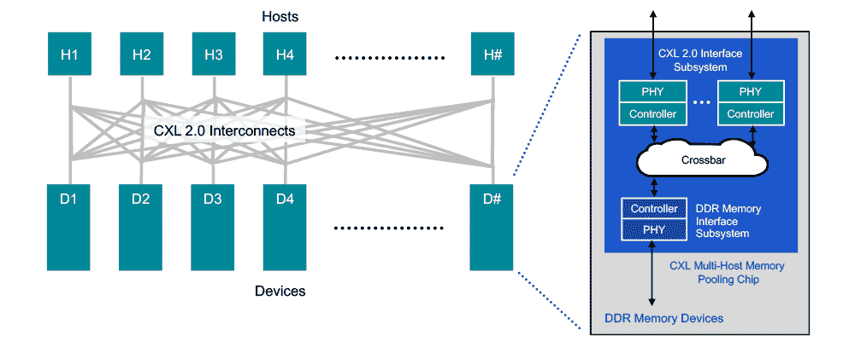
CXL lends hand to advanced near-memory schemes
CXL Builds on PCIe Interfaces:
  Utilizes physical and electrical interfaces of PCIe.
  Introduces protocols for coherency and software stack simplification.
  Maintains compatibility with existing PCIe standards.
  CXL 3.0 supports up to 64 GB/s on top of PCIe 5, and 128 GB/s bi-directional over x16 PCIe 6
Enhanced Connectivity and Memory Coherency:
  Significantly improves computing performance and efficiency at a low cost.
Memory Expansion Capabilities:
  Enables additional memory capacity and bandwidth beyond direct-attach DIMM slots.
  Facilitates adding more memory to a CPU host processor via CXL-attached devices.
Adaptable to Persistent Memory:
  Low-latency CXL link pairs effectively with persistent memory.
  Allows CPU host to use additional memory alongside DRAM
Memory pooling from CXL 2.0:
  CXL 2.0 enables memory pooling through switching technology.
  A host with CXL 2.0 can access multiple devices
  from the memory pool.
  Hosts need to be CXL 2.0-enabled to use this feature.
  Memory devices in the pool can be a mix of
  CXL 1.0, 1.1, and 2.0 hardware.
  CXL 1.0/1.1 devices behave as a single logical device,
  accessible by only one host at a time.
  CXL 2.0 devices can be partitioned into multiple logical devices.
  Allows up to 16 hosts to simultaneously access
  different parts of the memory on a CXL 2.0 device.

Slide 19
Context
How can MPI be geared toward interconnect advancements
  Start a systematic approach to understand the existing behaviors and propose performant designs
    Step 1 (status: almost done): Optimizing the performance of device-accelerated MPI using different devices (e.g. GPUs and FPGAs)
    Step 2 (status: started): Thorough performance analysis schemes to breakdown the timings
    Step 3 (status: started): Understand the architectural knobs to build a representative model
      Better co-design of collective acceleration hardware
      A model that can generalize to the devices, interconnects and memory subsystems at hand

Slide 20
Offloading Benchmark (Motivation)
MPI Collectives Disaggregation
Evaluate the performance benefit of offloading communication to an accelerator like FPGA, GPU or MEX.
  Host-based vs Device-based performance
Help understand system characteristics
  What parameters contribute to the offloading performance?
  What are the bottlenecks?
Processes-to-device mapping
  A device does communication on behalf of processes
    Avoid wasting CPU cycles for data transfer
  Processes are available to do meaningful computation
Communication operations:
  Allreduce and Alltoall
Device-accelerated Node
CPU
Disaggregation Interconnect
Device

Slide 21
Offloading Algorithm (Root-based)
MPI Collectives Disaggregation (baseline)
    Root gathers data from peers
    Root copies data to its device buffer
    Root invokes reduction kernel
    Root copies data back to its buffer
    Peer retrieves results from root
    Note: Processes have different device contexts, so a process cannot access device data stored in another context
Device-accelerated Node
CPU
R
PCIe
R
Root
Device

Slide 22
Offloading Algorithm (Root-based)
MPI Collectives Disaggregation (baseline)
CPU
CPU
CPU
R
Root
Process
R
R
R
PCIe
PCIe
PCIe
Device
Device
Device
Root gathers
peers’ buffers
Root transfer all data to the device
invokes reduction kernel
and take back the data
Root scatters the
results to peers

Slide 23
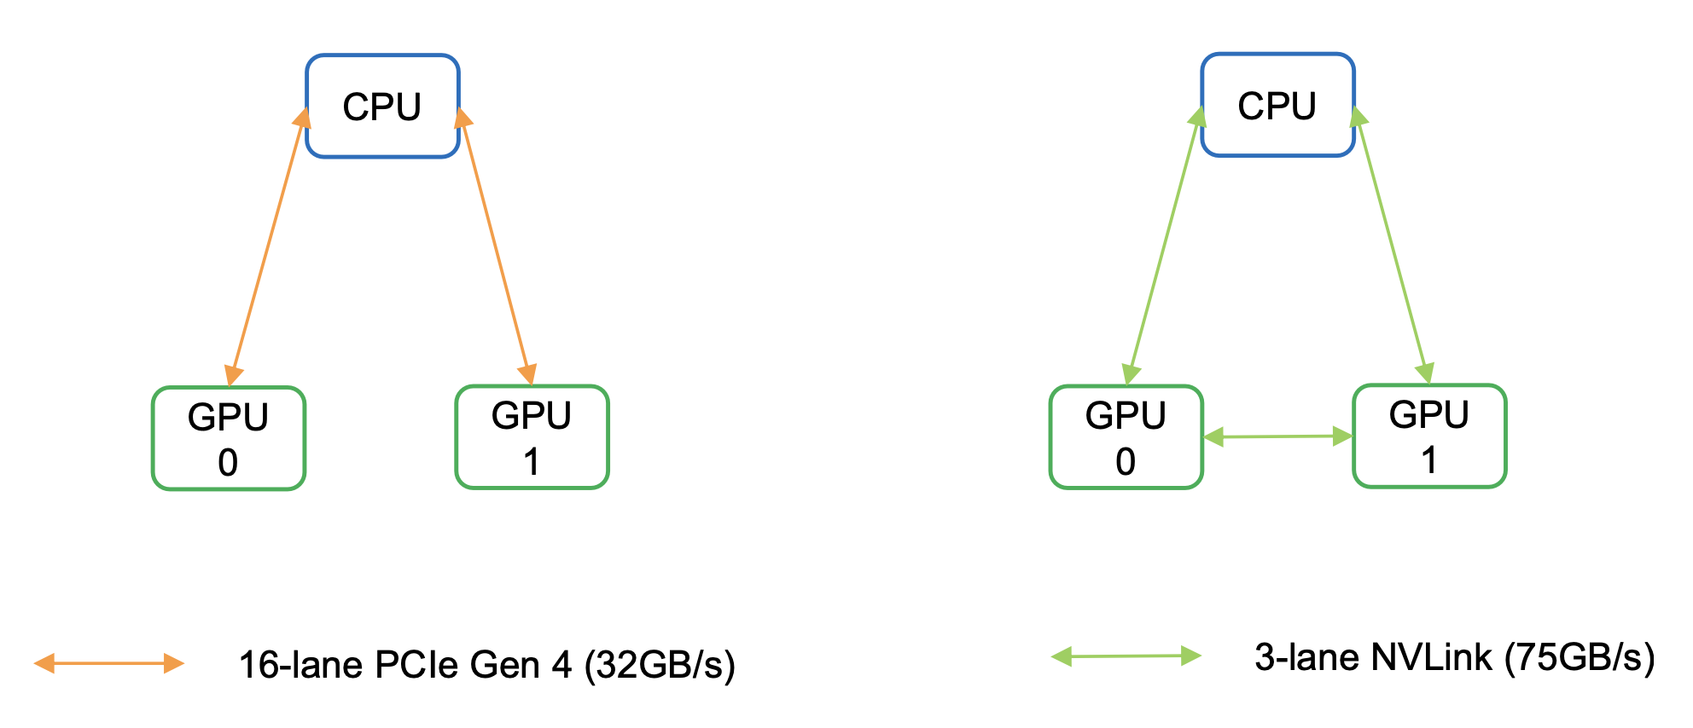
Emulation Environment
Clusters used in experiments:
MRI
Lassen
Cluster | Host Arch | Device Arch | Interconnect | Interconnect BW/lane
MRI | AMD Milan | NV A100 (Newer gen) | PCIe 4.0 | 2 GB/s
Lassen | IBM Power 9 | NV V100 (Older gen) | NVLink 4.0 | 25 GB/s (Faster link)

Slide 24
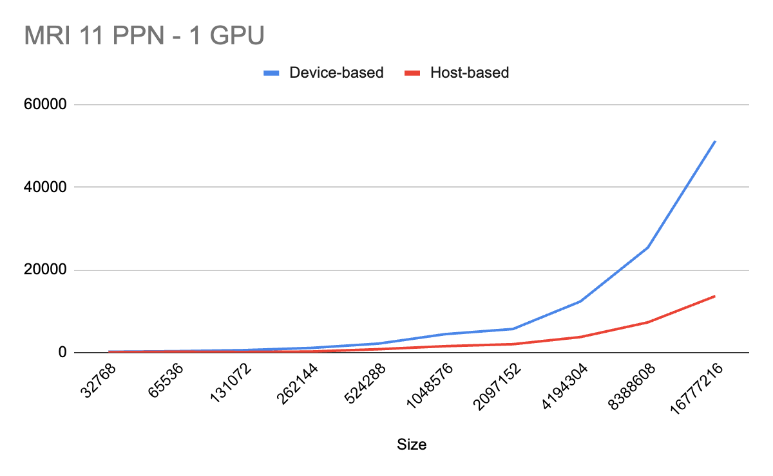
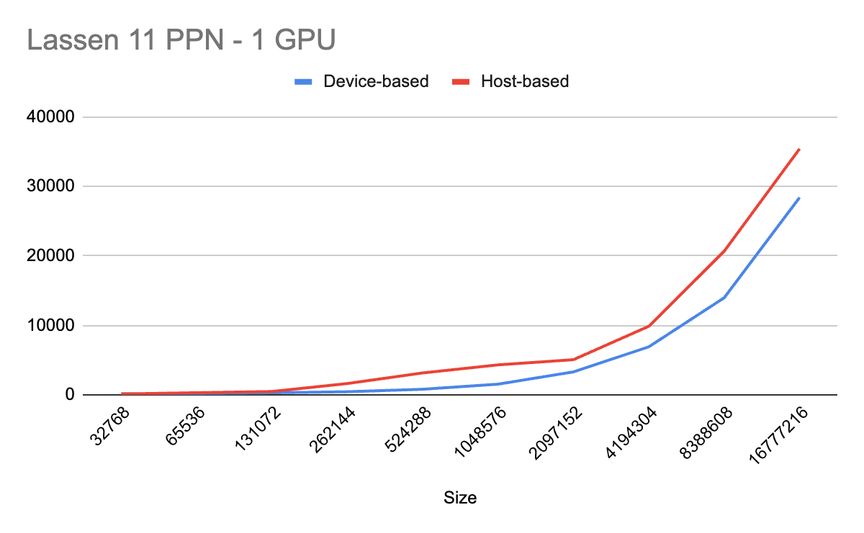
Performance results (1)
0.20x
2.75x
On MRI, device-based performs worse than host-based due to PCIe bottleneck
Conversely, on Lassen with NVlink, the trend is reversed.

Slide 25
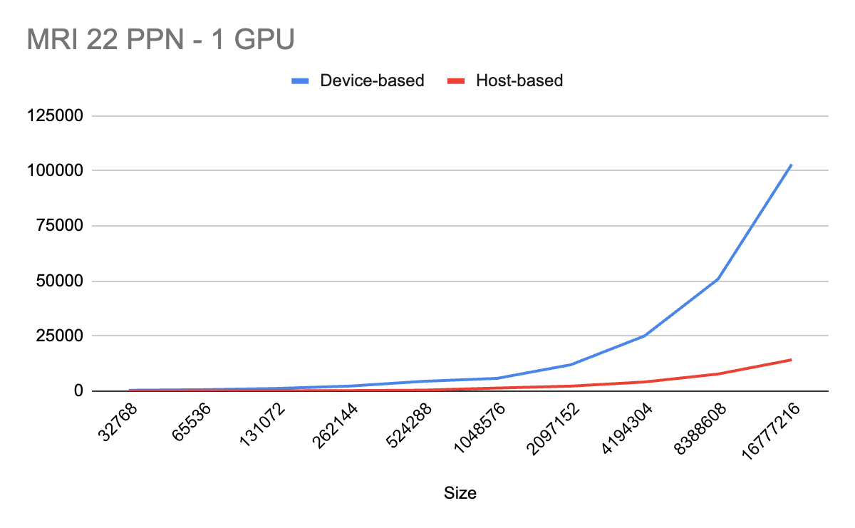
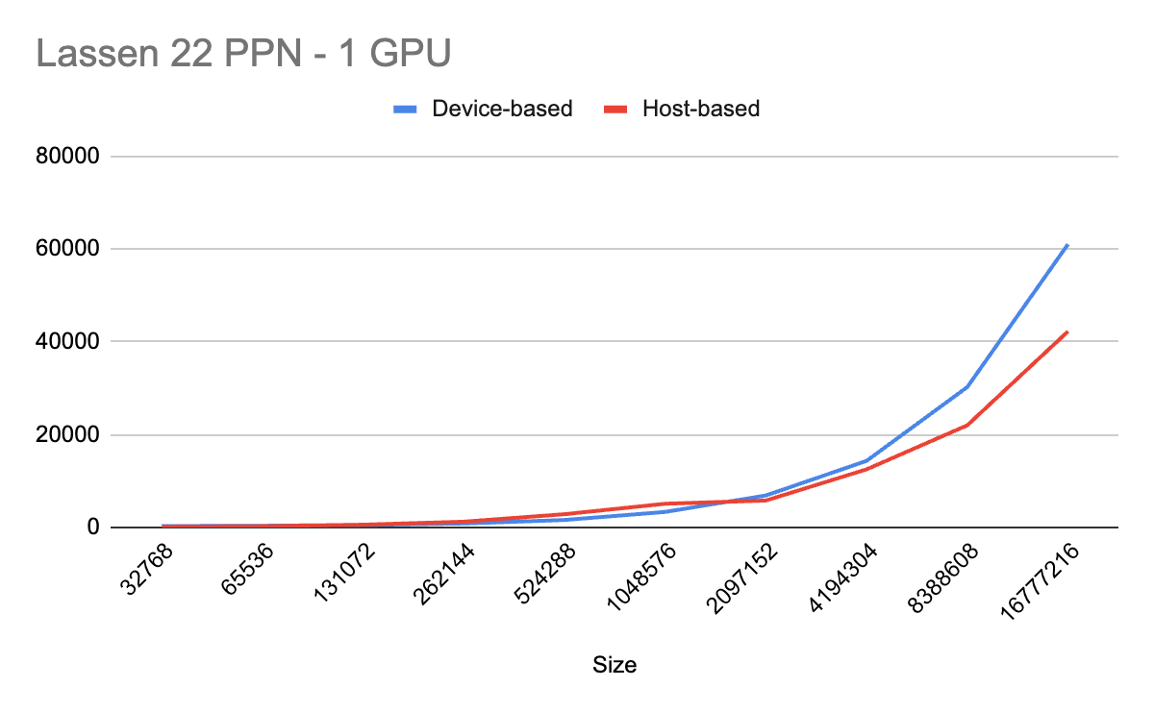
Performance results (2)
0.44x
6.25x
With more processes, the trend on MRI remains the same.
On Lassen, device-based is not able to beat host-based.

Slide 26
Designs for MPI_Allreduce : Overview
Take a reduce-scatter allgather algorithm as a case-study
  Very widely used for long vector reductions (>= 256KB)
  Implement a staging-based emulated design and study on two processes as a starting point
  Use MPI_SUM as the sample MPI operation (applicable to others as well)
Two phase algorithm
  Reduce-scatter phase results in every process having one “chunk” of the final reduced buffer
    Every step in the reduce-scatter involves a communication operation, followed by compute (example : sum)
  Allgather phase involves communication only and ensures that every process has all reduced chunks in the receive buffer
All send/recv operations are on DRAM buffers
Staging is done between DRAM and Optane

Slide 27






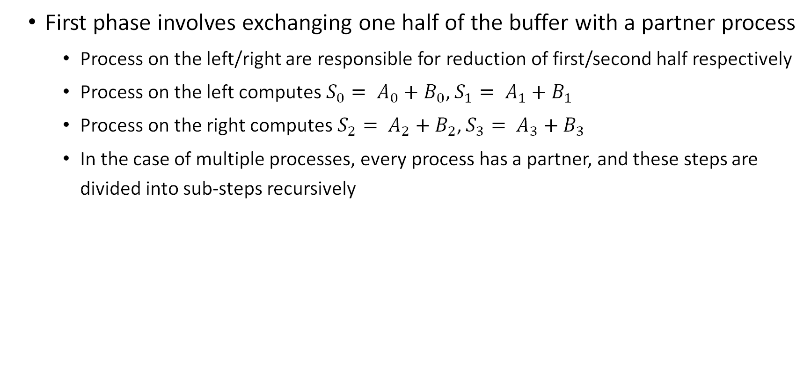









Designs for MPI_Allreduce : Reduce scatter
Process 0
Send($A_{2}$, $A_{3}$)
Process 1
Process 0
Process 1
$$A_{0}$$
$$A_{1}$$
$$A_{2}$$
$$A_{3}$$
$$B_{0}$$
$$B_{1}$$
$$B_{2}$$
$$B_{3}$$
Reduce
$$A_{3}$$
$$S_{0}$$
$$S_{1}$$
$$A_{2}$$
$$B_{0}$$
$$B_{1}$$
$$S_{2}$$
$$S_{3}$$
Send($B_{0}$, $B_{1}$)
First phase involves exchanging one half of the buffer with a partner process
  Process on the left/right are responsible for reduction of first/second half respectively
  Process on the left computes$S_{0}= A_{0}+B_{0}$, $S_{1}= A_{1}+B_{1}$
  Process on the right computes$S_{2}= A_{2}+B_{2}$, $S_{3}= A_{3}+B_{3}$
  In the case of multiple processes, every process has a partner, and these steps are divided into sub-steps recursively

Slide 28




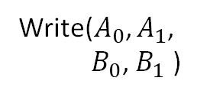


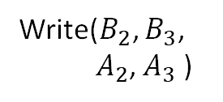



Designs for MPI_Allreduce : Emulate FPGA
$$A_{0}$$
$$A_{1}$$
$$A_{2}$$
$$A_{3}$$
$$B_{0}$$
$$B_{1}$$
$$B_{2}$$
$$B_{3}$$
Process 0
Process 1
Write($A_{0}$, $A_{1}$,
$B_{0}$, $B_{1}$ )
Read($S_{0}$, $S_{1}$)
Write($B_{2}$, $B_{3}$,
$A_{2}$, $A_{3}$ )
Read($S_{2}$ , $S_{3}$)
SCM
SCM
Start compute after staging operation is complete
  Measure “round-trip” time i.e., the staging overhead (to/from the SCM memory/optane)
  Measure compute time on the CPU
  To emulate FPGAs, we simply divide the measured CPU compute time in Allreduce by the expected speedup from the FPGAs
    In a real scenario, compute happens on the FPGA and the reduced buffer is read from the SCM memory on completion of compute --- the experiment above gives a close estimate

Slide 29






Designs for MPI_Allreduce : Allgather
Process 0
Send($S_{0}$, $S_{1}$)
Process 1
Process 0
Process 1
$$S_{0}$$
$$S_{1}$$
$$A_{2}$$
$$A_{3}$$
$$B_{0}$$
$$B_{1}$$
$$S_{2}$$
$$S_{3}$$
$$S_{0}$$
$$S_{1}$$
$$S_{2}$$
$$S_{3}$$
$$S_{0}$$
$$S_{1}$$
$$S_{2}$$
$$S_{3}$$
Send($S_{2}$, $S_{3}$)
Final phase involves an “allgather” to exchange sums
  This adds to the total communication time for allreduce
  Pure comm time = T(allgather) + T(reduce-scatter-comm)
  Compute time = T(compute)/expected_compute_improvement + staging_overhead
    For CPU only runs, staging_overhead = 0, expected_compute_improvement = 1

Slide 30
Experimental results
We run 1 process per node, 2 nodes on two different platforms with the Infiniband HDR-200 interconnect
  AMD EPYC 7713 64-Core Processor
Since AMD does not support Optane, we only measure compute/communication time on the platform and use staging overheads obtained on the intel platform
We compare CPU-only algorithms with emulated FPGAs
  Each 10X, 50X and 100X faster than the CPU respectively
Use representative long vector message range : 1M – 16M

Slide 31
Experimental results : Overall latency
AMD EPYC 7713 64-Core Processor
Staging to FPGA performs up to ~30% better than CPU based algorithm on AMD platforms for 4M and 8M messages
We are working closely on lowering host-to-SCM/FPGA latency and coming up with better near-memory reduction designs
A prototype HW implementation is underway

Slide 32



THANK YOU!
Network Based Computing
Laboratory
Network-Based Computing Laboratory
http://nowlab.cse.ohio-state.edu/
The High-Performance MPI/PGAS
Project
http://mvapich.cse.ohio-state.edu/
The High-Performance Big Data
Project
http://hibd.cse.ohio-state.edu/
The High-Performance Deep Learning
Project
http://hidl.cse.ohio-state.edu/

Slide 33
Experimental results - Alltoall
Run Alltoall up to 1GB on both nodes to form a baseline
Bigmem runs for larger messages due to higher capacity
Total memory consumed exceeds DRAM capacity
  Smallmem_28ppn
    Per process memory req. = 128 * 28 * 2 = 7168MB
    Total memory req. = 7168 * 28 ~ 200GB
    200GB exceeds DRAM size

Slide 34
Experimental results - Allgather
Run Allgather up to 1GB on both nodes to form a baseline
Bigmem runs for larger messages due to higher capacity
Total memory consumed exceeds DRAM capacity
  Smallmem_28ppn
    Per process memory req. = 256 * 28 ~ 7168MB
    Total memory req. = 7168 * 28 ~ 200GB
    200GB exceeds DRAM size

