Slide 1


Overview and Roadmap of the
High-Performance Big Data (HiBD) Project
High-Performance and Scalable Support for Big Data Stacks with MPI
Talk at OSU Booth SC ‘23
by
Follow us on
https://x.com/mvapich
Aamir Shafi and Mustafa Abduljabbar
The Ohio State University
E-mail: {shafi.16, abduljabbar.1}@osu.edu
https://cse.osu.edu/people/shafi.16
https://engineering.osu.edu/people/abduljabbar.1

Slide 2



Overview of Big Data Framework
Some of the popular Big Data processing frameworks include Apache Spark, Dask, Ray
Apache Spark is an in-memory data processing framework that is written in Scala and Java:
  Has support for Python using PySpark
Dask is a task-based distributed computing framework that scales Python applications from laptops to high-end systems
Motivation of this work:
  The support for efficient execution on high-speed interconnects is lagging:
    Vanilla Spark has no support (still relies on TCP/IP based sockets via Netty)
    Dask provides two communication devices: TCP/IP and UCX
The main goal of this work is to utilize the MVAPICH2 library for optimizing communication in Spark and Dask:
  This allows exploiting supported high-speed interconnects – like InfiniBand, Omni Path, Slingshot, and others – in Big Data ecosystems
Notes:
An in-memory data-processing framework
Iterative machine learning jobs
Interactive data analytics
Scala based Implementation
Standalone, YARN, Mesos

Slide 3
Presentation Outline
Overview, Design and Implementation
  MPI4Spark
  MPI4Dask
Performance Evaluation
  MPI4Spark
  MPI4Dask
Related Publications and Summary

Slide 4
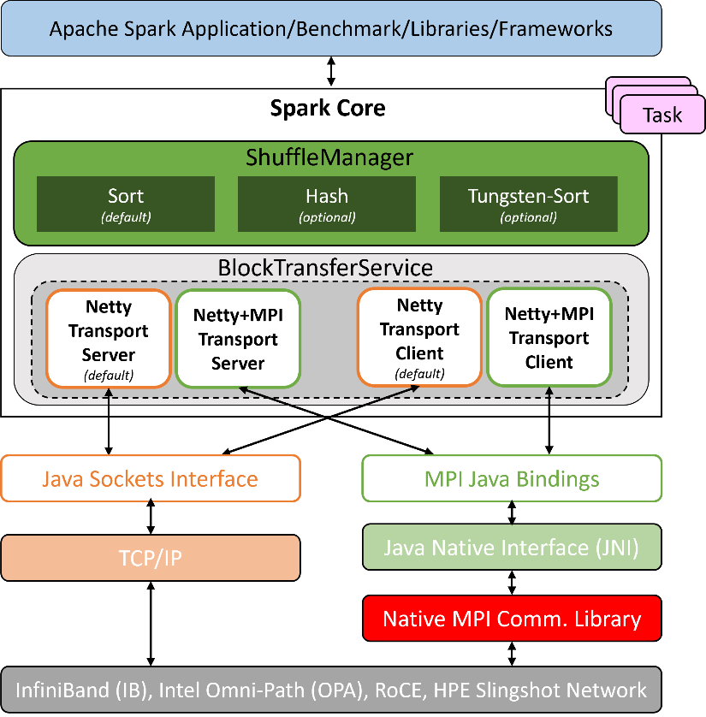
MPI4Spark: Using MVAPICH2 to Optimize Apache Spark
The main motivation of this work is to utilize the communication functionality provided by MVAPICH2 in the Apache Spark framework
  MPI4Spark relies on Java bindings of the MVAPICH2 library
Spark’s default Shuffle Manager relies on Netty for communication:
  Netty is a Java New I/O (NIO) client/server framework for event-based networking applications

Slide 5
MPI4Spark Interconnect Support
The current approach is different from its predecessor design, RDMA-Spark (http://hibd.cse.ohio-state.edu)
  RDMA-Spark supports only InfiniBand and RoCE
  Requires new designs for new interconnect
MPI4Spark supports multiple interconnects/systems through a common MPI library
  Such as InfiniBand (IB), Intel Omni-Path (OPA), HPE Slingshot, RoCE, and others
  No need to re-design the stack for a new interconnect as long as the MPI library supports it
MPI4Spark
RDMA-Spark
MVAPICH2-J
UCR
vs.
MVAPICH2
IB Verbs
Supported Interconnects
(InfiniBand, iWARP, RoCE, Omni-Path,
EFA, Rockport, Slingshot, etc.)
Supported Interconnects
(InfiniBand, RoCE)

Slide 6
Next MPI4Spark Release (v0.2)
MPI4Spark 0.2 release adds support for the YARN cluster manager:
  Will be available from: http://hibd.cse.ohio-state.edu
Features:
  Based on Apache Spark 3.3.0
  (NEW) Support for YARN cluster manager
  Compliant with user-level Apache Spark APIs and packages
  High performance design that utilizes MPI-based communication
    Utilizes MPI point-to-point operations
    Relies on MPI Dynamic Process Management (DPM) features for launching executor processes for the standalone cluster manager
    (NEW) Relies on Multiple-Program-Multiple-Data (MPMD) launcher mode for the YARN cluster manager
  Built on top of the MVAPICH2-J Java bindings for MVAPICH2 family of MPI libraries
  Tested with
    (NEW) OSU HiBD-Benchmarks, GroupBy and SortBy
    (NEW) Intel HiBench Suite, Micro Benchmarks, Machine Learning and Graph Workloads
    Mellanox InfiniBand adapters (EDR and HDR 100G and 200G)
    HPC systems with Intel OPA interconnects
    Various multi-core platforms

Slide 7
Presentation Outline
Overview, Design and Implementation
  MPI4Spark
  MPI4Dask
Performance Evaluation
  MPI4Spark
  MPI4Dask
Related Publications and Summary

Slide 8
MPI4Dask: MPI backend for Dask
Dask is a popular task-based distributed computing framework:
  Scales Python applications from laptops to high-end systems
  Builds a task-graph that is executed lazily on parallel hardware
Dask Distributed library historically had two communication backends:
  TCP: Tornado-based
  UCX: Built using a GPU-aware Cython wrapper called UCX-Py
Designed and implemented MPI4Dask communication device:
  MPI-based backend for Dask
  Implemented using mpi4py (Cython wrappers) and MVAPICH2
  Uses Dask-MPI to bootstrap execution of Dask programs

Slide 9
Dask Distributed Execution Model
Key characteristics:
  Scalability
  Elasticity
  Support for coroutines
  Serialization/De-serialization to data to/from GPU memory
Client
Cluster
Scheduler
Worker
Worker
Worker

Slide 10
MPI4Dask in the Dask Architecture
Dask
Dask Bag
Dask Array
Dask DataFrame
Delayed
Future
Task Graph
Dask-MPI
Dask-CUDA
Dask-Jobqueue
Distributed
Scheduler
Worker
Client
Comm Layer
tcp.py
ucx.py
MPI4Dask
UCX-Py
(Cython wrappers)
mpi4py
TCP
UCX
MVAPICH2
Laptops/
Desktops
High Performance Computing Hardware

Slide 11
MPI4Dask Release
MPI4Dask 0.3 was released in Feb ‘23 adding support for high-performance MPI communication to Dask:
  Can be downloaded from: http://hibd.cse.ohio-state.edu
Features:
  (NEW) Based on Dask Distributed 2022.8.1
  Compliant with user-level Dask APIs and packages
  Support for MPI-based communication in Dask for cluster of GPUs
    Implements point-to-point communication co-routines
    Efficient chunking mechanism implemented for large messages
  Built on top of mpi4py over the MVAPICH2-GDR library
  Supports starting execution of Dask programs using Dask-MPI
  Tested with
    Mellanox InfiniBand adapters (FDR, EDR, and HDR)
    (NEW) Various benchmarks used by the community (MatMul, Slicing, Sum Transpose, cuDF Merge, etc.)
    (NEW) Various multi-core platforms
    (NEW) NVIDIA V100 and A100 GPUs

Slide 12

Presentation Outline
Overview, Design and Implementation
  MPI4Spark
  MPI4Dask
Performance Evaluation
  MPI4Spark
  MPI4Dask
Related Publications and Summary

Slide 13
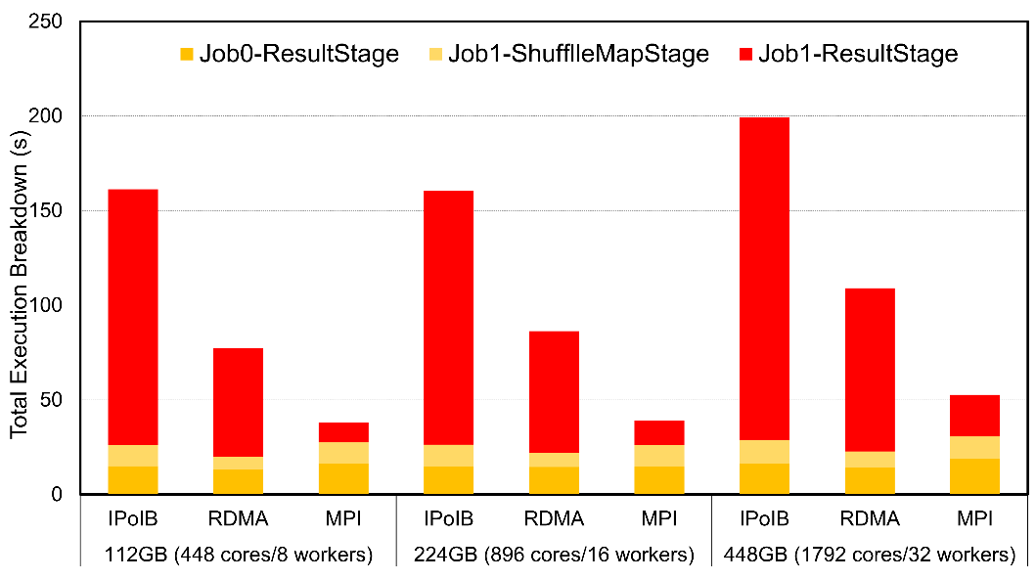
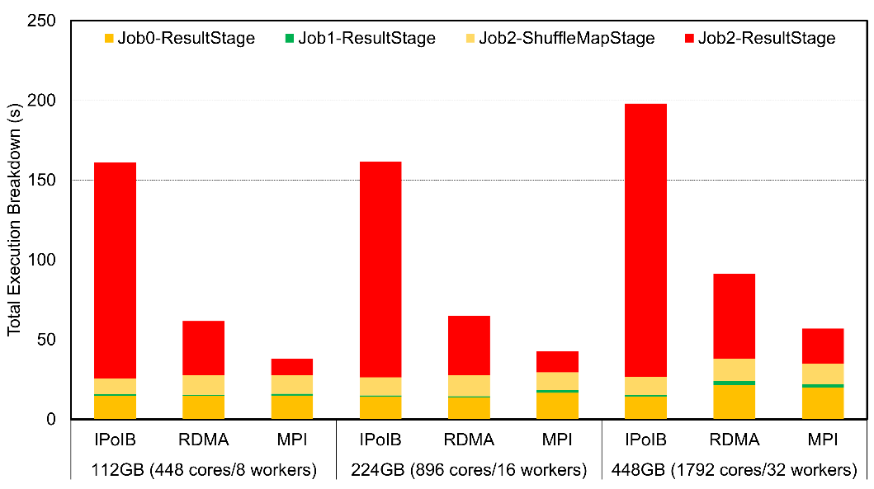
Weak Scaling Evaluation with OSU HiBD Benchmarks (OHB)
OHB GroupByTest
OHB SortByTest
3.8x
4.1x
2.2x
1.5x
The above are weak-scaling performance numbers of OHB benchmarks (GroupByTest and SortByTest) executed on the TACC Frontera system using the Standalone cluster manager in Spark
Speed-ups for the overall total execution time for 448GB with GroupByTest is 4.1x and 2.2x compared to IPoIB and RDMA, and for SortByTest the speed-ups are 3.8x and 1.5x, respectively
Speed-ups for the shuffle read stage for 112GB with GroupByTest are 13x compared with IPoIB and 5.6x compared to RDMA, while for SortByTest the speed-ups are 12.8x and 3.2x, respectively
K. Al Attar, A. Shafi, M. Abduljabbar, H. Subramoni, D. Panda, Spark Meets MPI: Towards High-Performance Communication Framework for Spark using MPI, IEEE Cluster '22, Sep 2022.
Notes:
For GroupByTest,
Job0-ResultStage represents the data generation stage
Job1-ShuffleMapStage is the stage for mapping the output data to local storage
Job1-ResultStage is the shuffle read stage where intensive communication takes place
The same is true for SortyByTest for Job0-ResultStage, Job2-ShuffleMapStage, and Job2-ResultStage

Slide 14
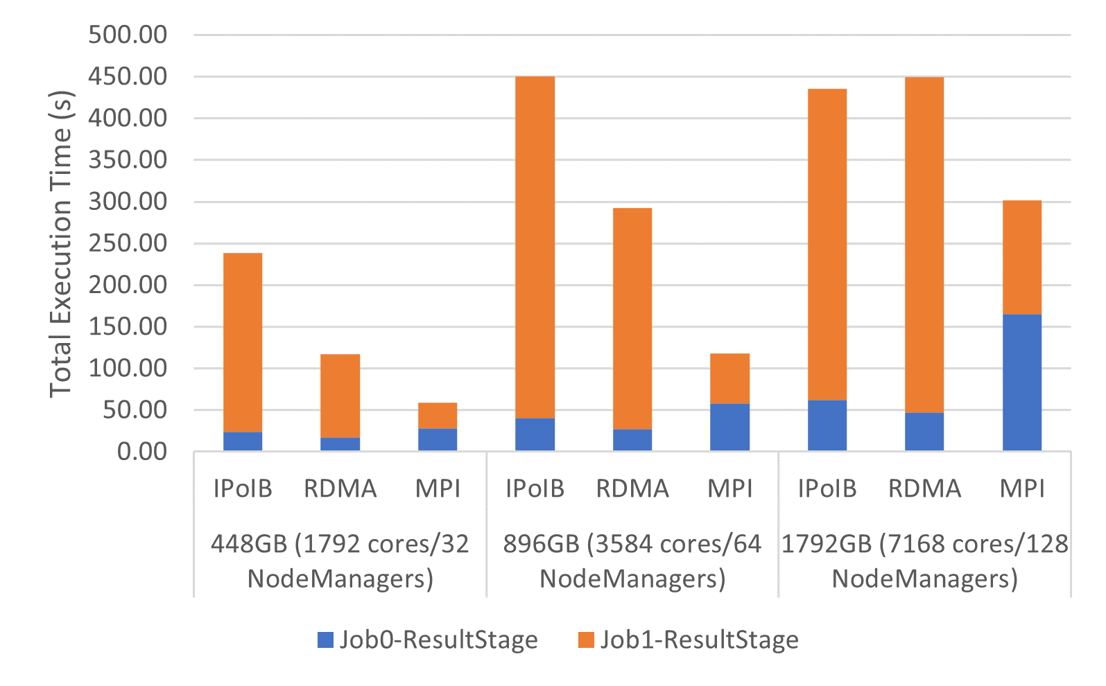
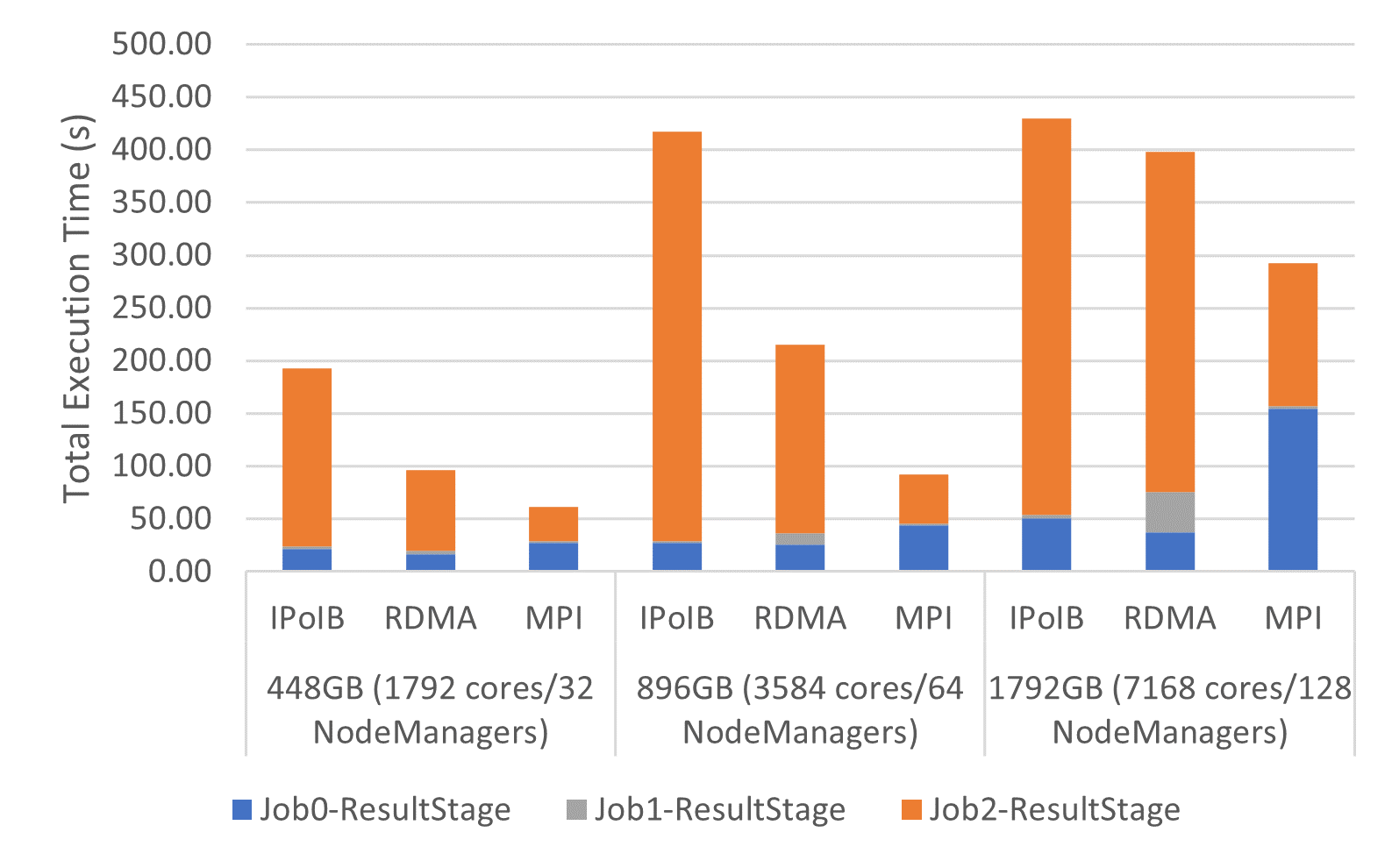
Weak Scaling Evaluation with OHB (YARN)
OHB GroupByTest
OHB SortByTest
4.5x
3.8x
2.3x
2.5x
The above are weak-scaling performance numbers of OHB benchmarks (GroupByTest and SortByTest) executed on the TACC Frontera system using the YARN cluster manager in Spark
Speed-ups for the overall total execution time for SortByTest, 64 NodeManagers, are 4.5x and 2.3x compared to IPoIB and RDMA, and for GroupByTest, also 64 NodeManagers, the speed-ups are 3.8x and 2.5x, respectively
Speed-ups for the shuffle read stage for 896GB with GroupByTest are 6.8x compared with IPoIB and 4.4x compared to RDMA, while for SortByTest the speed-ups are 8.4x and 3.9x, respectively

Slide 15
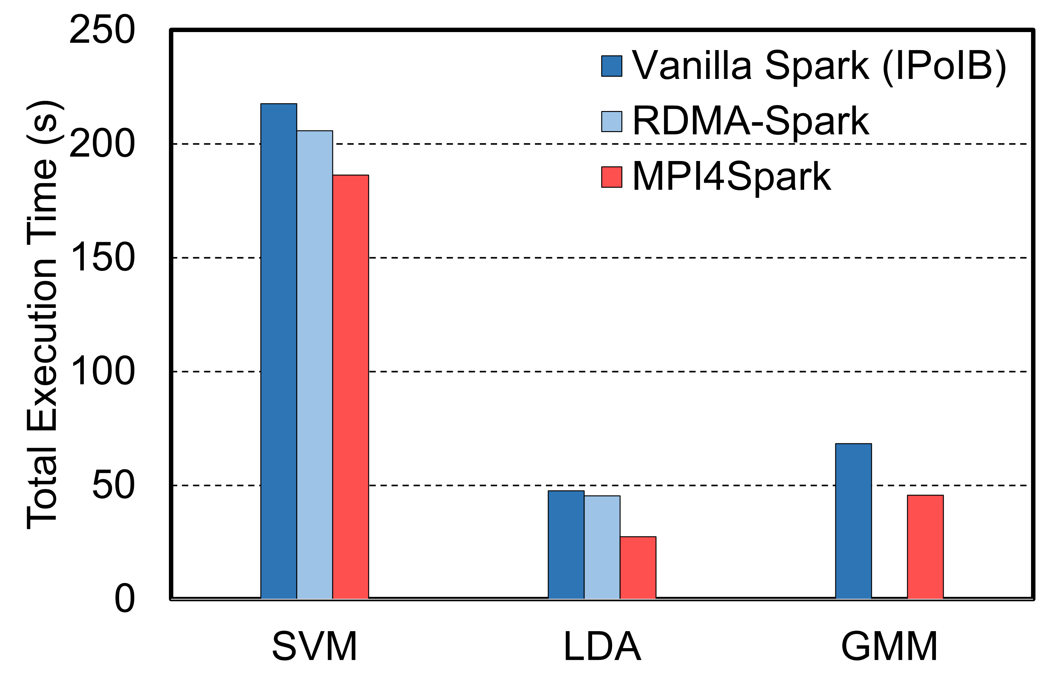
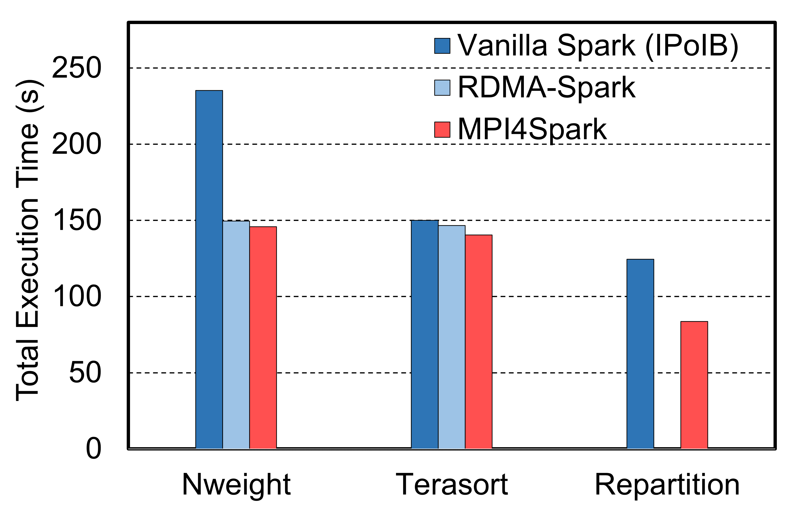
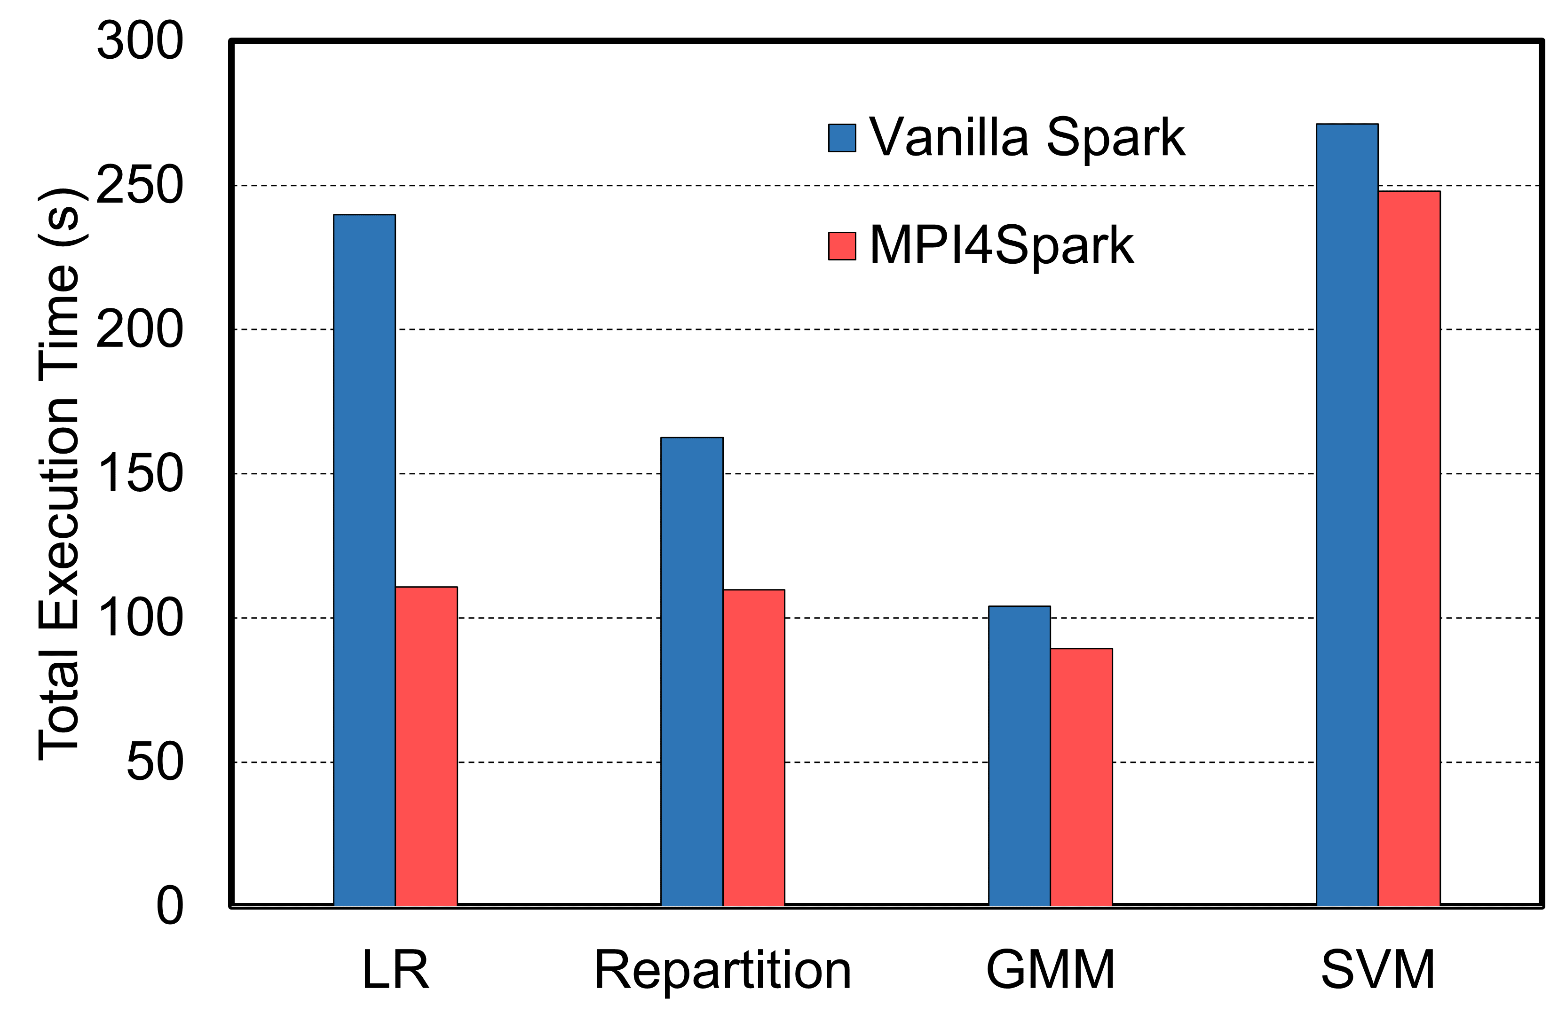
Performance Evaluation with Intel HiBench Workloads
1.4x on average than RDMA-Spark
1.5x on average than Vanilla Spark
1.5x on average than Vanilla Spark
1.4x on average than Vanilla Spark
Intel HiBench ML Workloads - Frontera
Intel HiBench Micro/Graph Workloads - Frontera
Intel HiBench Micro/ML Workloads - Stampede2
Omni-Path
Network
This evaluation was done on the TACC Frontera (IB) and the TACC Stampede2 (OPA) Systems
This illustrates the portability of MPI4Spark on different interconnects
We see a speed-up for the LR machine learning workload on Stampede2 of about 2.2x
Speed-ups for the LDA machine learning workload on Frontera are 1.7x for both IPoIB and RDMA
K. Al Attar, A. Shafi, M. Abduljabbar, H. Subramoni, D. Panda, Spark Meets MPI: Towards High-Performance Communication Framework for Spark using MPI, IEEE Cluster '22, Sep 2022.

Slide 16
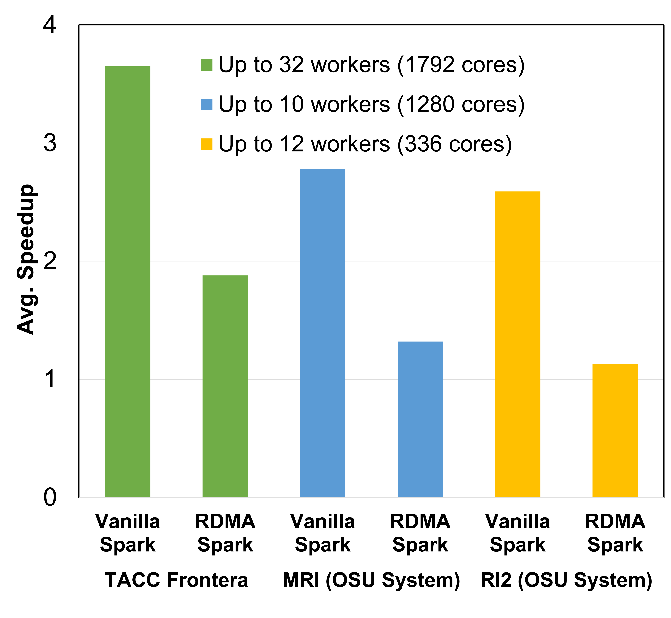
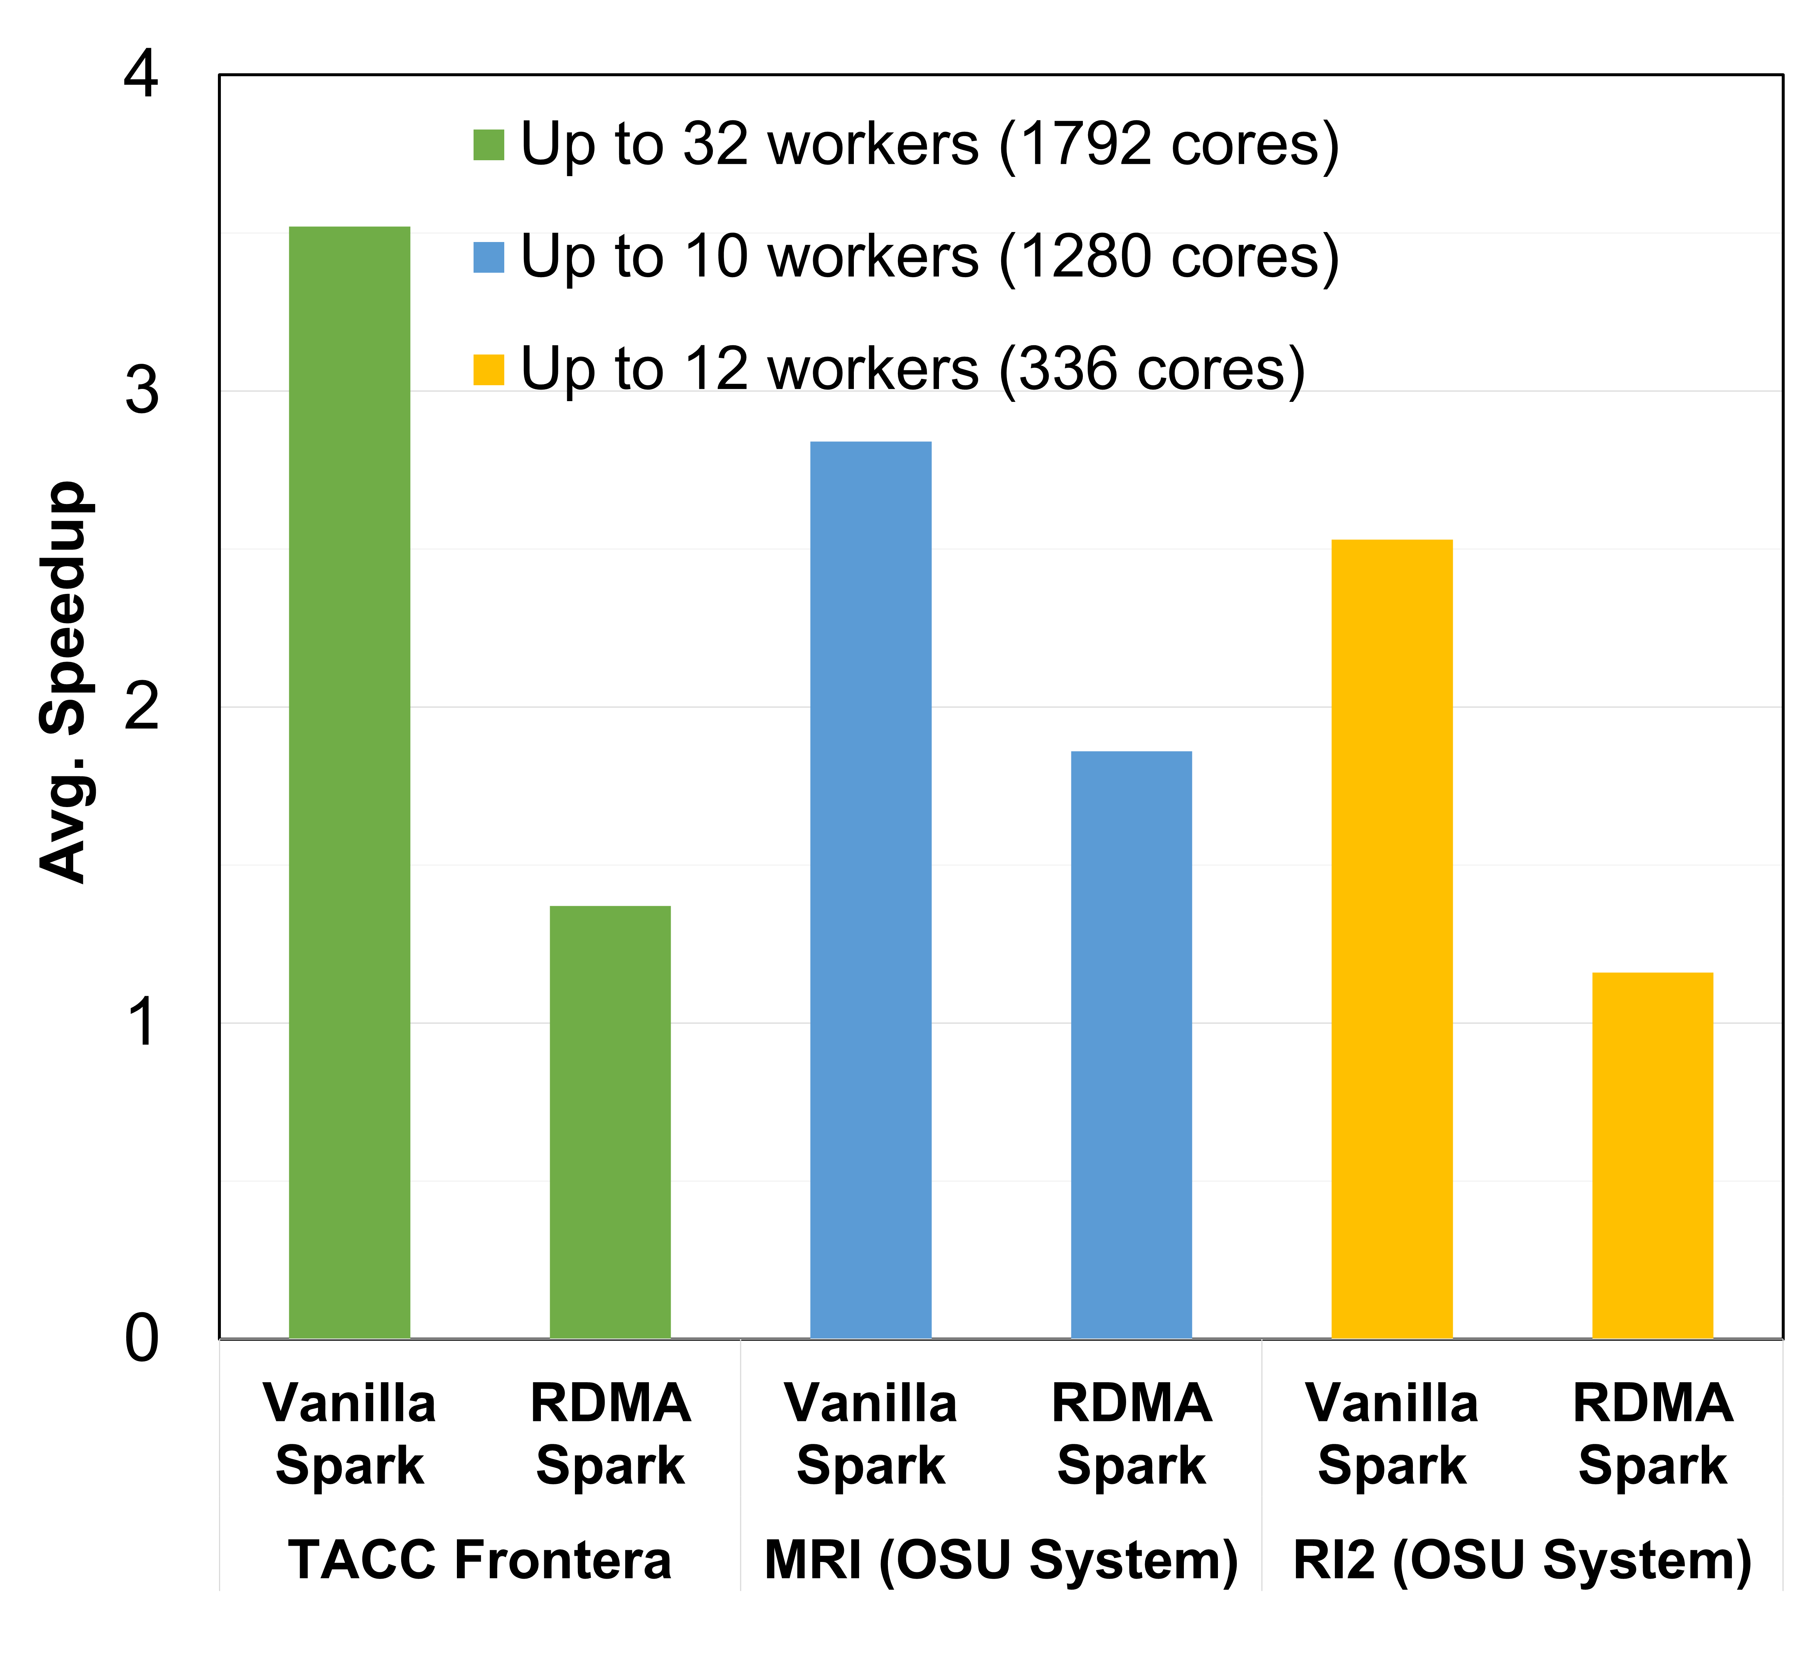
MPI4Spark: Relative Speedups to Vanilla Spark and RDMA-Spark on Three HPC Systems
System Name | Nodes Used | Processor | Cores Used | Sockets | Cores/socket | RAM | Interconnect
TACC Frontera | 34 | Xeon Platinum | 1792 | 2 | 28 | 192 GB | HDR (100G)
RI2 (OSU System) | 14 | Xeon Broadwell | 336 | 2 | 14 | 128 GB | EDR (100G)
MRI (OSU System) | 12 | AMD EPYC 7713 | 1280 | 2 | 64 | 264 GB | 200 Gb/sec (4X HDR)
OHB GroupByTest
OHB SortByTest
3.65x
3.52x
1.88x
1.86x

Slide 17
Presentation Outline
Overview, Design and Implementation
  MPI4Spark
  MPI4Dask
Performance Evaluation
  MPI4Spark
  MPI4Dask
Related Publications and Summary

Slide 18
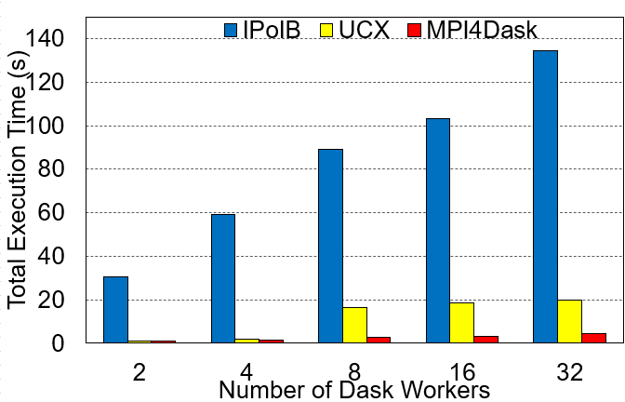
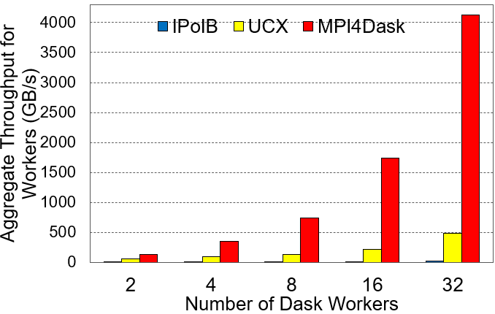
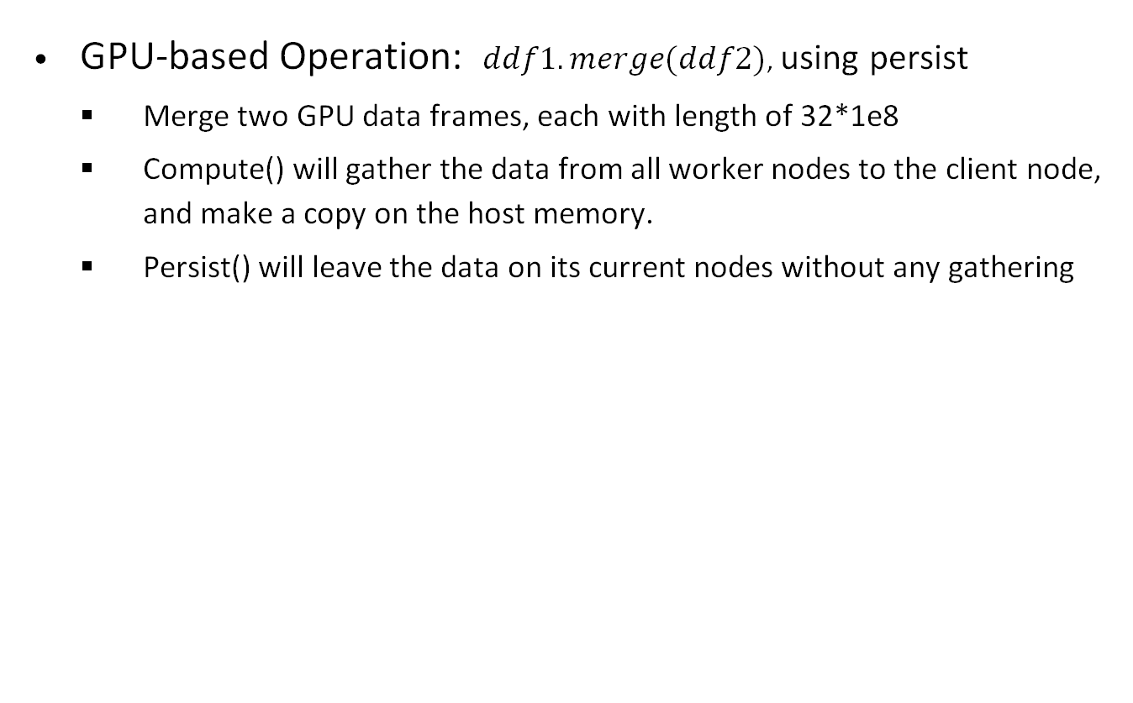
cuDF Merge Benchmark on the Cambridge Wilkes-3 System
GPU-based Operation: $ddf1.merge(ddf2)$, using persist
  Merge two GPU data frames, each with length of 32*1e8
  Compute() will gather the data from all worker nodes to the client node, and make a copy on the host memory.
  Persist() will leave the data on its current nodes without any gathering
Wilke3 GPU System:
80 nodes
2x AMD EPYC 7763 64-core Processors
1000 GiB RAM
Dual-rail Mellanox HDR200 IB
4x NVIDIA A100 SXM4 80 GB
Execution Time
Aggregated Throughput
On average, MPI4Dask is:
- 4.94x faster than UCX
- 26.85x faster than TCP
8.4x
7.1x
3.7x
5.0x
2.1x
MPI4Dask 0.3, Dask 2022.8.1, Distributed, 2022.8.1, MVAPICH2-3.0, UCX v1.13.1, UCX-py 0.27.00
Notes:
New

Slide 19
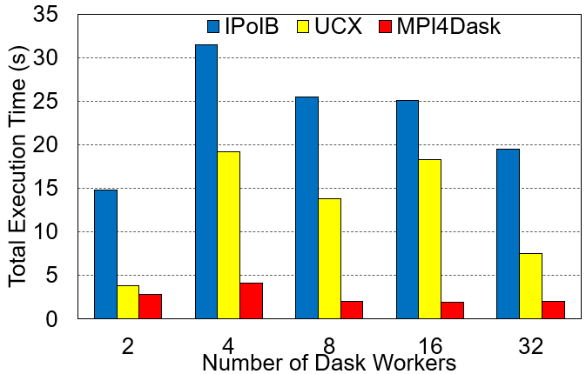
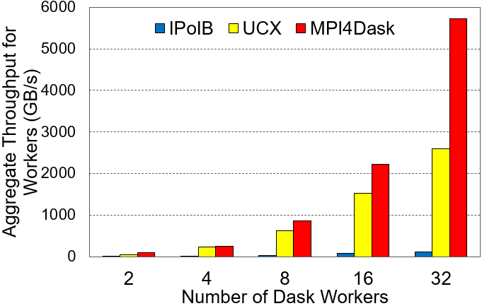
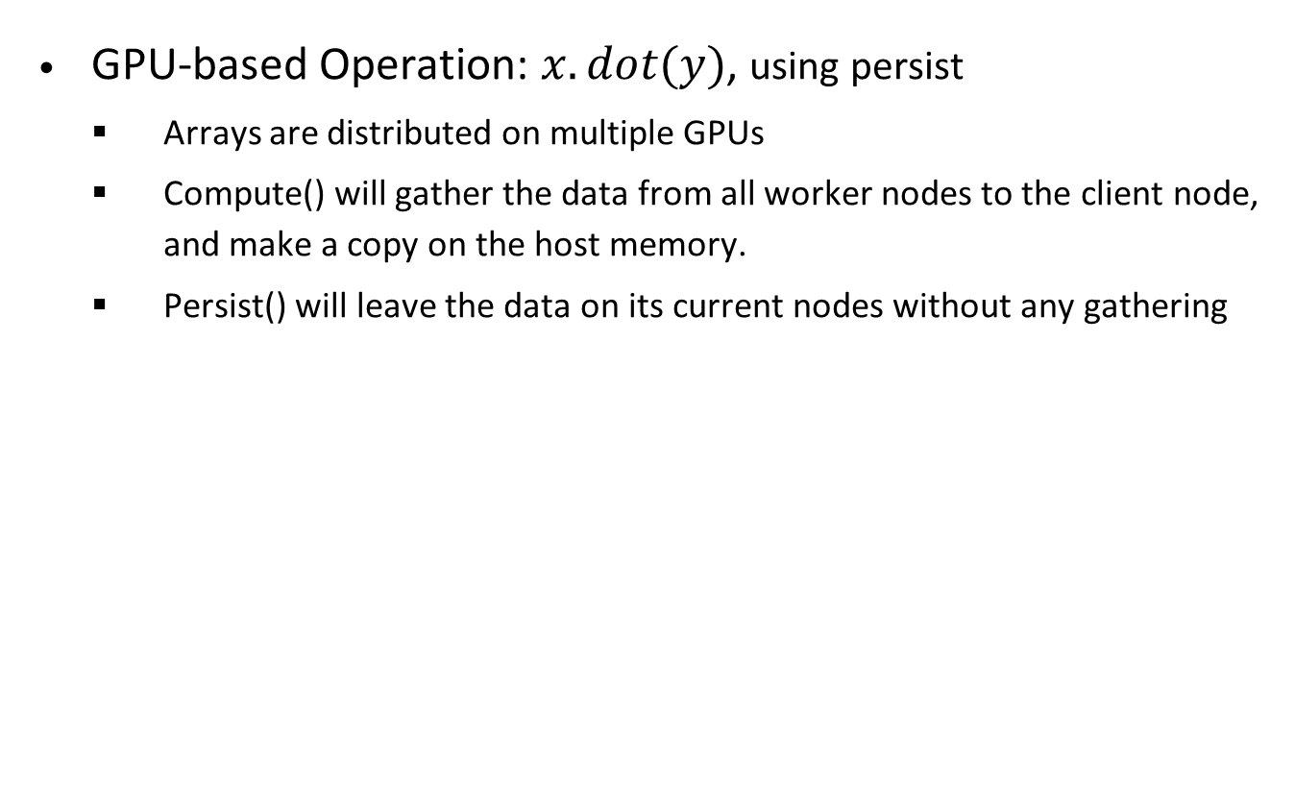
cupy GEMM Benchmark on the Cambridge Wilkes-3 System
GPU-based Operation: $x.dot(y)$, using persist
  Arrays are distributed on multiple GPUs
  Compute() will gather the data from all worker nodes to the client node, and make a copy on the host memory.
  Persist() will leave the data on its current nodes without any gathering
Wilke3 GPU System:
80 nodes
2x AMD EPYC 7763 64-core Processors
1000 GiB RAM
Dual-rail Mellanox HDR200 IB
4x NVIDIA A100 SXM4 80 GB
Execution Time
Aggregated Throughput
On average, MPI4Dask is:
- 3.83x faster than UCX
- 8.70x faster than TCP
2.1x
1.3x
MPI4Dask 0.3, Dask 2022.8.1, Distributed, 2022.8.1, MVAPICH2-3.0, UCX v1.13.1, UCX-py 0.27.00
Notes:
New

Slide 20
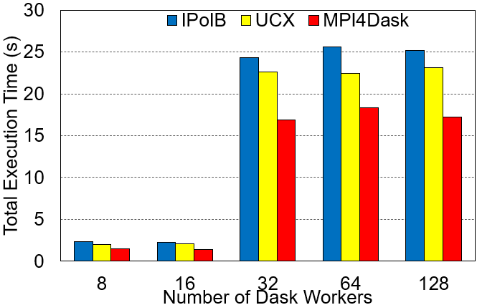
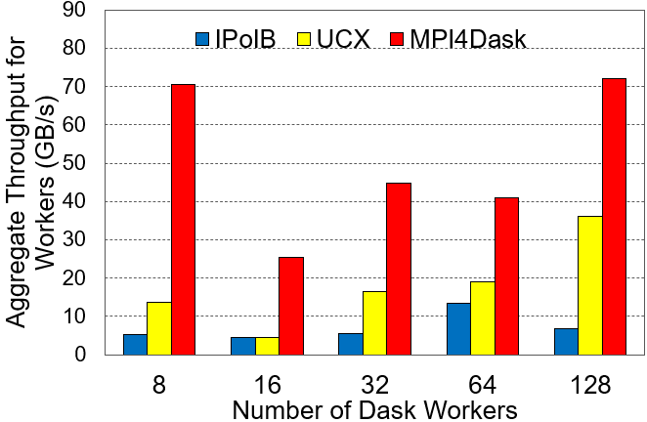
NumPy Array Slicing Benchmark on TACC Frontera CPU System
1.26x better on average
3.17x better on average
On average, MPI4Dask is:
- 1.37x faster than UCX
- 1.51x faster than TCP
5.2x
1.9x
2.6x
2.1x
5.3x
From 32 workers, we increase array size by 16 times
A. Shafi , J. Hashmi , H. Subramoni , and D. K. Panda, Efficient MPI-based Communication for GPU-Accelerated Dask Applications, CCGrid ‘21 https://arxiv.org/abs/2101.08878
MPI4Dask 0.3 release
(http://hibd.cse.ohio-state.edu)
Notes:
New

Slide 21
Presentation Outline
Overview, Design and Implementation
  MPI4Spark
  MPI4Dask
Performance Evaluation
  MPI4Spark
  MPI4Dask
Related Publications and Summary

Slide 22
Related Publications
Spark Meets MPI: Towards High-Performance Communication Framework for Spark using MPI K. Al Attar, A. Shafi, M. Abduljabbar, H. Subramoni, D. Panda IEEE Cluster '22, Sep 2022.
Towards Java-based HPC using the MVAPICH2 Library: Early Experiences K. Al Attar, A. Shafi, H. Subramoni, D. Panda HIPS '22 (IPDPSW), May 2022.
Efficient MPI-based Communication for GPU-Accelerated Dask Applications A. Shafi, J. Hashmi, H. Subramoni, D. Panda, The 21st IEEE/ACM International Symposium on Cluster, Cloud and Internet Computing, May 2021. https://arxiv.org/abs/2101.08878
Blink: Towards Efficient RDMA-based Communication Coroutines for Parallel Python Applications A. Shafi, J. Hashmi, H. Subramoni, D. Panda, 27th IEEE International Conference on High Performance Computing, Data, and Analytics, Dec 2020.

Slide 23
Summary
Apache Spark and Dask are two popular Big Data processing frameworks
There is existing support for parallel and distributed on HPC systems:
  One bottleneck is the lack of support for low-latency and high-bandwidth interconnects
This talk presented latest developments in the MPI4Dask (MPI-based Dask ecosystem) and MPI4Spark (MPI-based Spark ecosystem)
Provided an overview of issues, challenges, and opportunities for designing efficient communication runtimes
  Efficient, scalable, and hierarchical designs are crucial for Big Data/Data Science frameworks
  Co-design of communication runtimes and BigData/Data Science frameworks will be essential

Slide 24


Thank You!
{shafi.16, abduljabbar.1}@osu.edu
Network Based Computing
Follow us on
https://x.com/mvapich
Laboratory
Network-Based Computing Laboratory
http://nowlab.cse.ohio-state.edu/
The MVAPICH2 Project
http://mvapich.cse.ohio-state.edu/
The High-Performance Deep Learning Project
http://hidl.cse.ohio-state.edu/

Slide 25
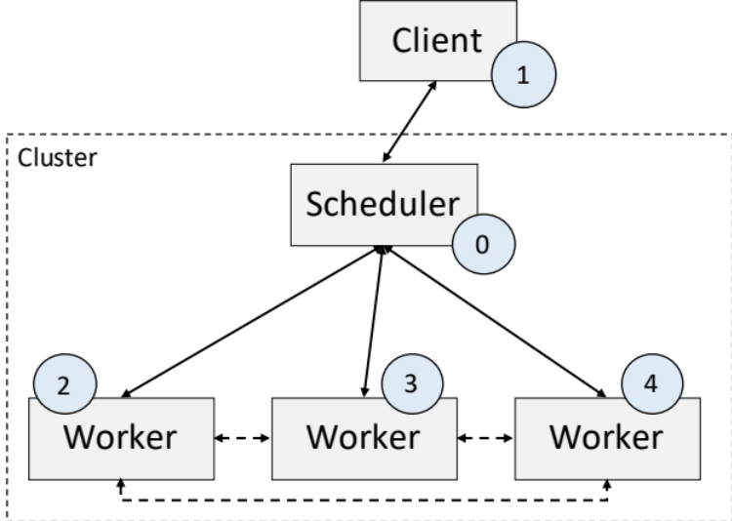
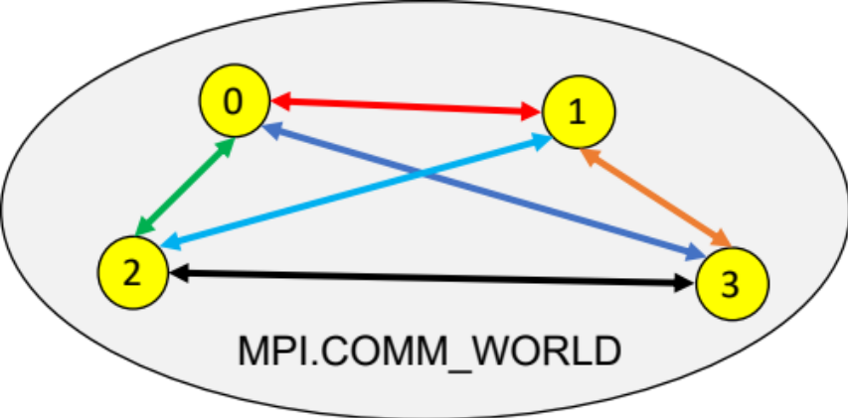
MPI4Dask: Bootstrapping and Dynamic Connectivity
Several ways to start Dask programs:
  Manual
  Utility classes:
    LocalCUDACluster, SLURMCluster, SGECluster, PBCCluster, and others
MPI4Dask uses the Dask-MPI to bootstrap execution of Dask programs
Dynamic connectivity is established using the asyncio package in MPI4Dask:
  Scheduler and workers listen for incoming connections by calling asyncio.start_server()
  Workers and client connect using asyncio.open_connection()
Notes:
Next we discuss the bootstrapping and dynamic connectivity support provided by MPI4Dask.
There are several ways to start a Dask program. The manual way is to run scheduler, followed by one or more workers and a client. There are some utility classes that allow facilitating the bootstrapping process using different job submission systems.
We use Dask-MPI to bootstrap execution of Dask programs that use MPI4Dask for communication. As the top figure shows, Dask-MPI assigns ranks 0 and 1 to scheduler and client respectively. All workers are assigned other ranks in a consecutive fashion.
The communication API provided by Dask Distributed requires different components like scheduler, workers, and client connect to one another dynamically. MPI4Dask fulfills this requirement using the asyncio package.
Using this package, scheduler and workers listen for incoming connections by starting a server -- they call the asyncio.start_server() function. Any process wanting to connect with the server can do so using asyncio.open_connection() function.

Slide 26
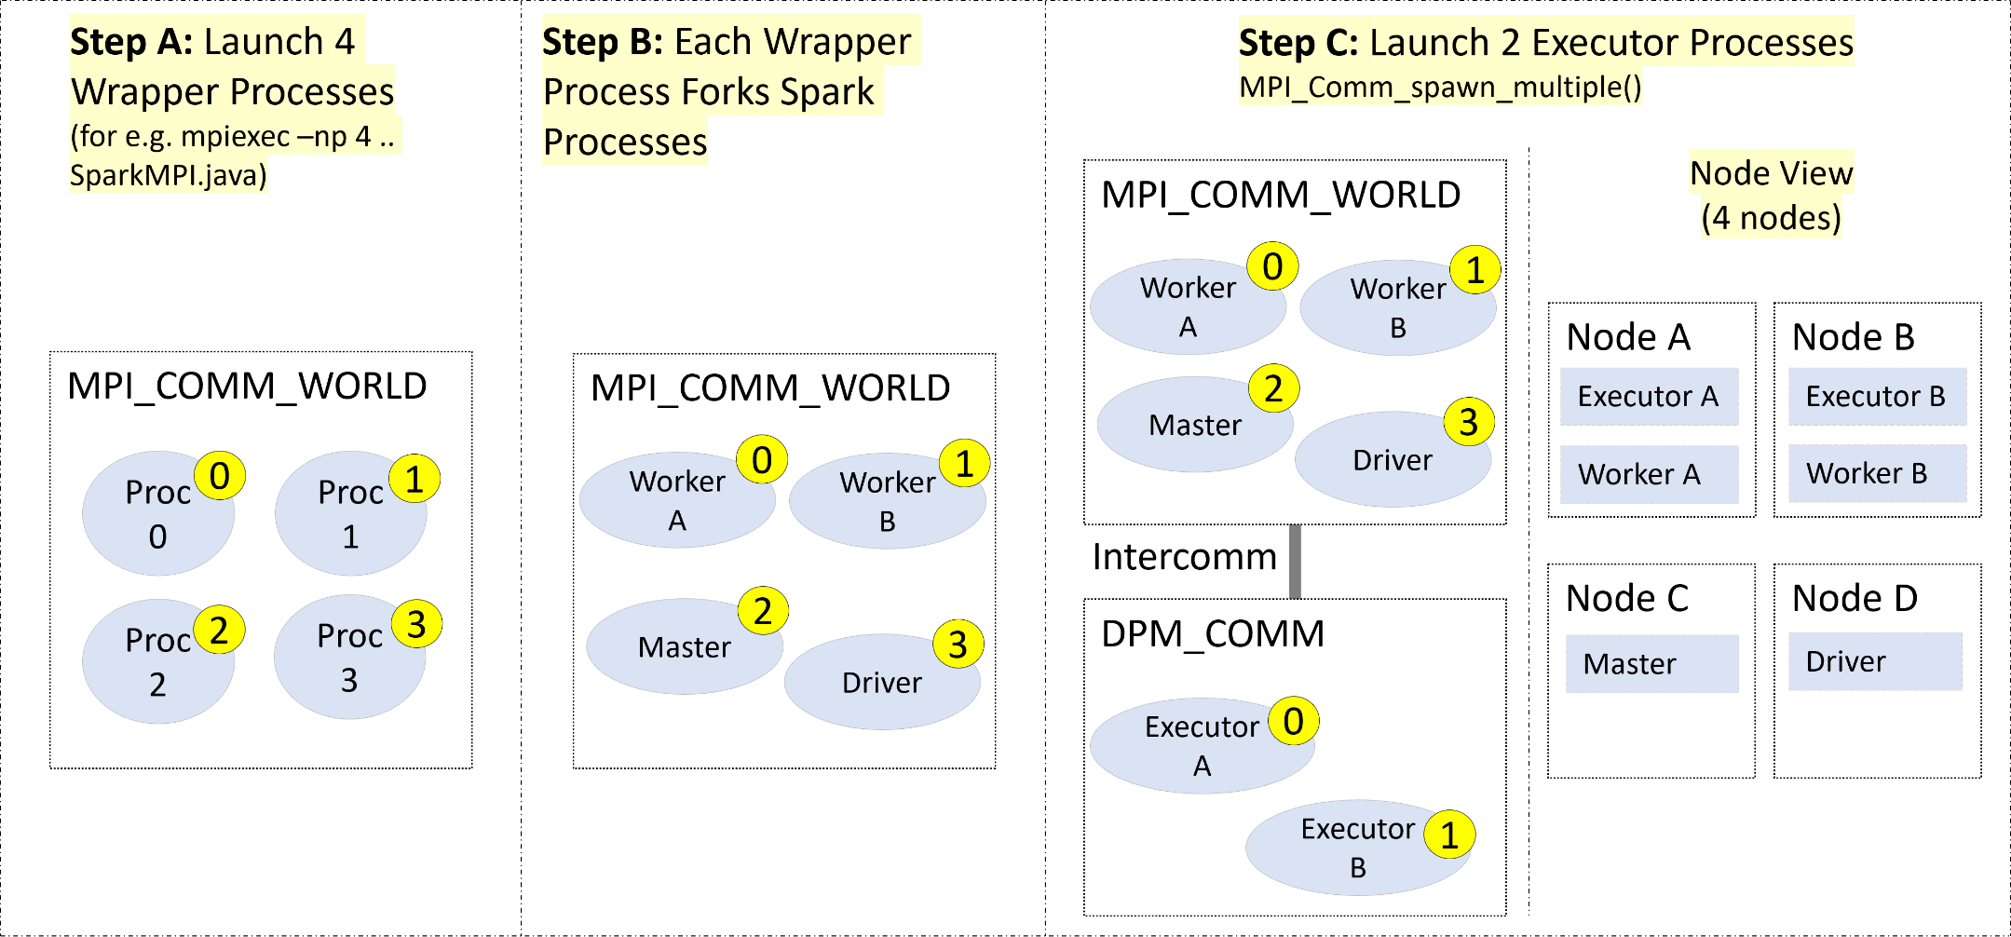
Launching Spark using MPI with Dynamic Process Management
Notes:
Approach: a Java wrapper program was used to launch the MPI processes using mpiexec on respective nodes. The MPI processes later fork Spark processes using the launcher scripts that Spark provides

Slide 27
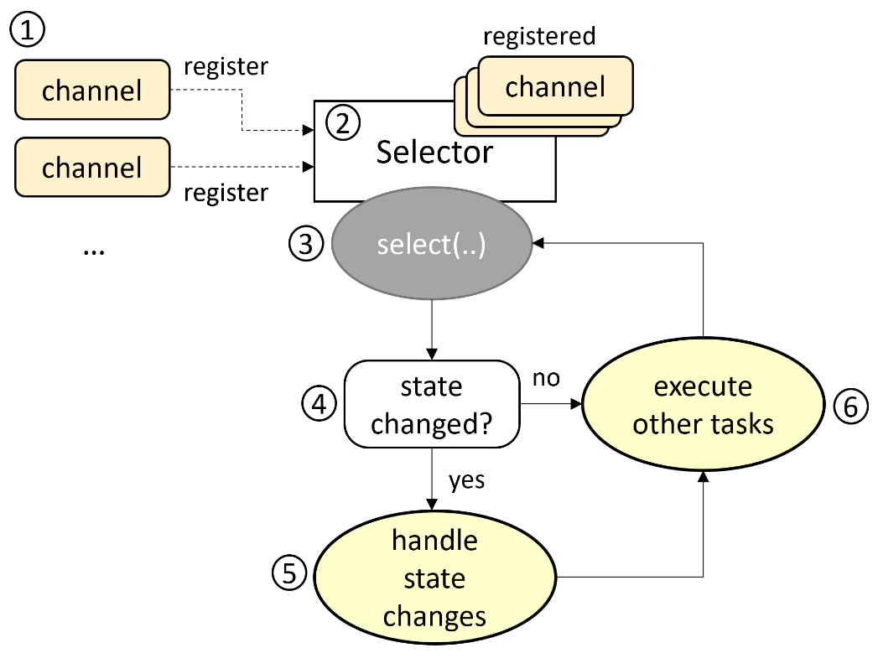
MPI4Spark-Basic Design
Modified the Netty NIO selector loop, which polls for channel state changes based on connection, read, or write events
Inside of the selector loop checks were implemented with MPI non-blocking probing method (MPI_Iprobe) for MPI_recv calls matching MPI_sends
Netty Channels or simply Java sockets were still being used but only for connection establishment
Too CPU-intensive, performed badly

Slide 28
Types of Messages Communicated by Spark
Message Type | Function
StreamRequest | A request to stream data from the remote end
StreamResponse* | A response to a StreamRequest when the stream has been successfully opened
RpcRequest | A request to perform a generic Remote Procedure Call (RPC)
RpcResponse | A response to a RpcRequest for a successful RPC
ChunkFetchRequest | A request to fetch a sequence of a single chunk of a stream
ChunkFetchSuccess* | A response to ChunkFetchRequest when a chunk exists and has been successfully fetched
OneWayMessage | A RPC that does not expect a reply

Slide 29
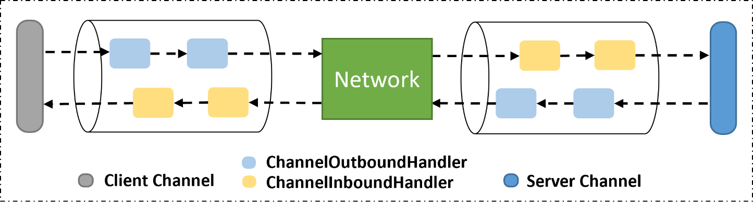
MPI4Spark-Optimized Design
The MPI4Spark-Optimized design avoids the pitfalls of the MPI4Spark-Basic design and is a lot simpler
In this design, we only target shuffle messages, Knowing that the shuffle phase was a performance bottleneck and can account for 80% of total execution time
  non-blocking MPI probes are avoided
  the idea was now to trigger MPI_recv calls by parsing the headers of shuffle messages inside of ChannelHandlers that reside in ChannelPipelines in Netty

Slide 30
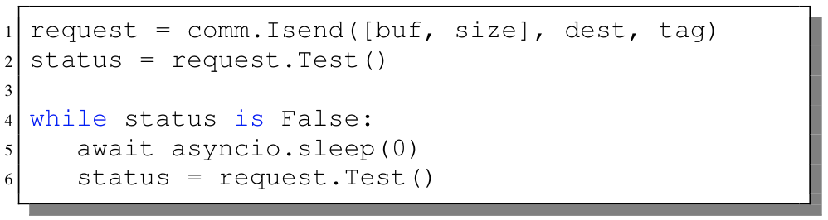
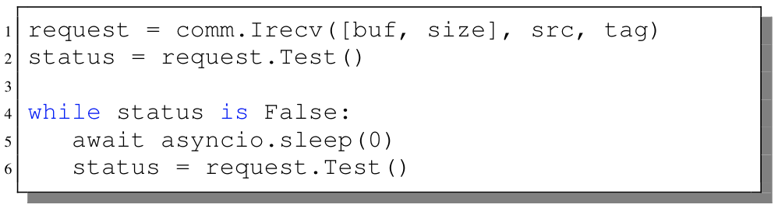
MPI4Dask: Point-to-point Communication Coroutines
Implements communication coroutines for point-to-point MPI functions:
  Using mpi4py (Cython wrappers) and MVAPICH2-GDR
mpi4py provides two flavors of point-to-point communication functions:
  Send()/Recv() – for exchanging data in buffers (faster and used in MPI4Dask)
  send()/recv() – for communicating Python objects (pickle/unpickle)
  GPU buffers implement the __cuda_array_interface__
Implemented chunking mechanism for large messages
The send and receive communication coroutines are as follows:
Notes:
This slide discusses the implementation of point-to-point communication coroutines for MPI4Dask. As mentioned earlier, MPI4Dask uses mpi4py to make use of non-blocking point-to-point functionality provided by MVAPICH2-GDR.
mpi4py provides two flavors of point-to-point functions. The first set of functions start with capital letters (like the highlighted Send() and Recv()) and communicate serialized data stored as raw bytes. The second option is to use functions starting with small letters and these are used to communicate Python objects. This incurs picking/unpickling overhead. MPI4Dask uses the first set of methods that exchange data stored in buffers like cuPy and numPy.
Dask Distributed can communicate very large messages. For this reason, we have implemented a chunking mechanism in MPI4Dask for large messages.
The send and receive coroutines are implemented using MPI's non-blocking send and receive method. After initiating the data exchange, each coroutine checks for completion using the Request.Test() method (on lines 2 and 6). Since this code is running as part of a coroutine, it is required to yield the CPU to other coroutines to avoid deadlock. We achieve this by calling asyncio.sleep() coroutine.

Slide 31

Overview of the MVAPICH Project
High Performance open-source Message Passing Interface (MPI) Library
Support for multiple interconnects
  InfiniBand, Omni-Path, Ethernet/iWARP, RDMA over Converged Ethernet (RoCE), AWS Elastic Fabric Adapter, Omni-Path Express, Broadcom RoCE, Intel Ethernet, Rockport Networks, Slingshot 10/11
Support for multiple platforms
  x86, OpenPOWER, ARM, Xeon-Phi, GPGPUs (NVIDIA and AMD)
Started in 2001, first open-source version demonstrated at SC ‘02
Supports the latest MPI-3.1 standard
http://mvapich.cse.ohio-state.edu
Additional optimized versions for different systems/environments:
  MVAPICH2-X (Advanced MPI + Partitioned Global Address Space), since 2011
  MVAPICH2-GDR with support for NVIDIA (since 2014) and AMD (since 2020) GPUs
  MVAPICH2-MIC with support for Intel Xeon-Phi, since 2014
  MVAPICH2-Virt with virtualization support, since 2015
  MVAPICH2-EA with support for Energy-Awareness, since 2015
  MVAPICH2-Azure for Azure HPC InfiniBand instances, since 2019
  MVAPICH2-X-AWS for AWS HPC+Elastic Fabric Adapter instances, since 2019
Tools:
  OSU MPI Micro-Benchmarks (OMB), since 2003
  OSU InfiniBand Network Analysis and Monitoring (INAM), since 2015
Used by more than 3,300 organizations in 90 countries
More than 1.66 Million downloads from the OSU site directly
Empowering many TOP500 clusters (Nov ‘22 ranking)
  7th , 10,649,600-core (Sunway TaihuLight) at NSC, Wuxi, China
  19th, 448, 448 cores (Frontera) at Texas Advanced Computing Center
  34th, 288,288 cores (Lassen) at Lawrence Livermore National Lab
  46th, 570,020 cores (Nurion) in South Korea and many others
Available with software stacks of many vendors and Linux Distros (RedHat, SuSE, OpenHPC, and Spack)
Partner in the 19th ranked TACC Frontera system
Empowering Top500 systems for more than 17 years

Slide 32
Architecture of MVAPICH2 Software Family for HPC, DL/ML, and Data Science
High Performance Parallel Programming Models
Message Passing Interface
(MPI)
PGAS
(UPC, OpenSHMEM, CAF, UPC++)
Hybrid --- MPI + X
(MPI + PGAS + OpenMP/Cilk)
High Performance and Scalable Communication Runtime
Diverse APIs and Mechanisms
Point-to-point Primitives
Collectives Algorithms
Job Startup
Energy-
Awareness
Remote Memory Access
I/O and
File Systems
Fault
Tolerance
Virtualization
Active Messages
Introspection & Analysis
Support for Modern Networking Technology
(InfiniBand, iWARP, RoCE, Omni-Path, EFA, Rockport, Slingshot)
Support for Modern Multi-/Many-core Architectures
(Intel-Xeon, AMD, OpenPOWER, ARM, GPU (NVIDIA, AMD), DPU)
Transport Protocols
Modern Features
Transport Mechanisms
Modern Features
RC
SRD
UD
DC
UMR
ODP
SR-IOV
Multi Rail
Shared Memory
CMA
IVSHMEM
XPMEM
Optane*
NVLink
CAPI*
* Upcoming

Slide 33
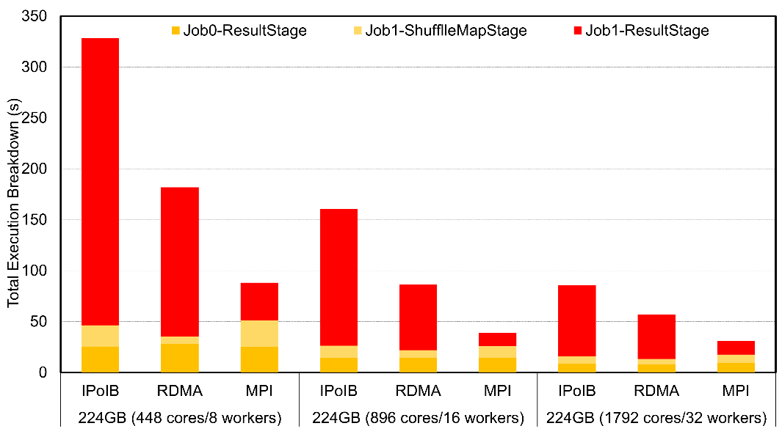
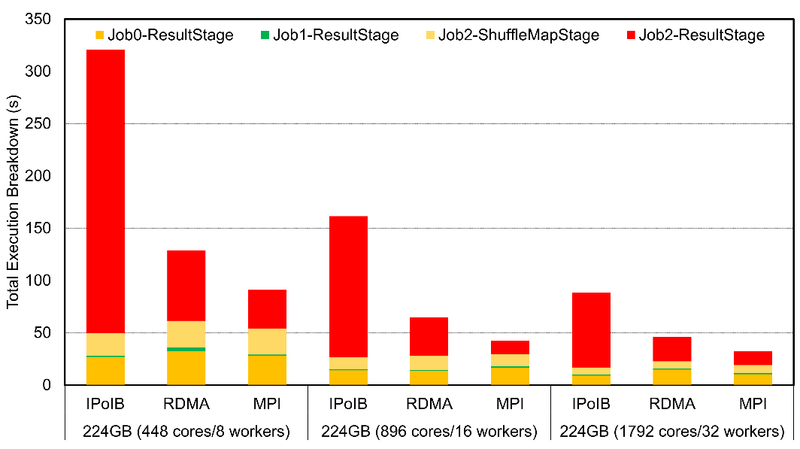
Strong Scaling Evaluation with OSU HiBD Benchmarks (OHB)
OHB GroupByTest
OHB SortByTest
3.5x
3.7x
2.1x
1.4x
The above are strong-scaling performance numbers of OHB benchmarks (GroupByTest and SortByTest) also executed on the TACC Frontera System
Speed-ups for the overall total execution time for 8 workers with GroupByTest is 3.7x and 2.1x compared to IPoIB and RDMA, and for SortByTest the speed-ups are 3.5x and 1.4x, respectively
Speed-ups for the shuffle read stage for 8 workers GroupByTest between MPI4Spark and IPoIB is 7.6x and between MPI4Spark and RDMA is 4x, while for SortByTest the speed-ups are 7.3x and 1.8x, respectively
K. Al Attar, A. Shafi, M. Abduljabbar, H. Subramoni, D. Panda, Spark Meets MPI: Towards High-Performance Communication Framework for Spark using MPI, IEEE Cluster '22, Sep 2022.

Slide 34
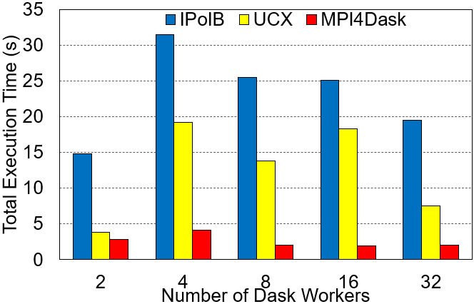

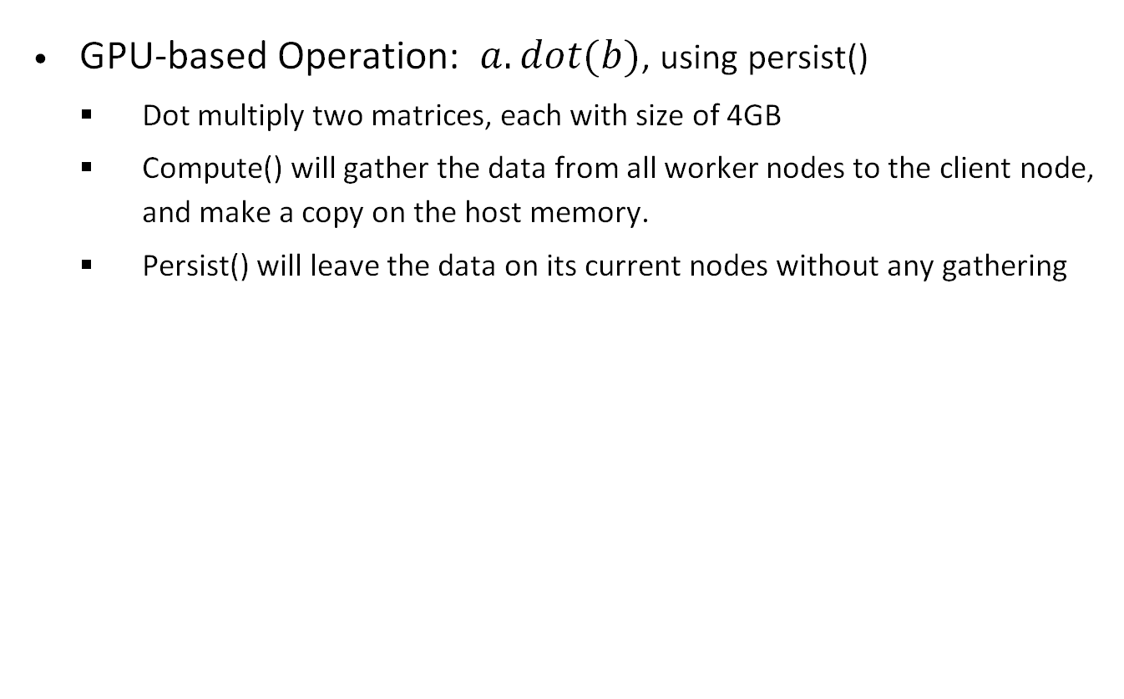
Matrix Dot Benchmark on the Cambridge Wilkes-3 System
GPU-based Operation: $a.dot(b)$, using persist()
  Dot multiply two matrices, each with size of 4GB
  Compute() will gather the data from all worker nodes to the client node, and make a copy on the host memory.
  Persist() will leave the data on its current nodes without any gathering
Wilke3 GPU System:
80 nodes
2x AMD EPYC 7763 64-core Processors
1000 GiB RAM
Dual-rail Mellanox HDR200 IB
4x NVIDIA A100 SXM4 80 GB
Execution Time
Multiplication Throughput
On average, MPI4Dask is:
- 5.20x faster than UCX
- 9.60x faster than TCP
2.2x
1.4x
1.3x
2.1x
1.1x
MPI4Dask 0.3, Dask 2022.8.1, Distributed, 2022.8.1, MVAPICH2-GDR 2.3.7, UCX v1.13.1, UCX-py 0.27.00
Notes:
New

Slide 35
Introduction to Dask
Dask is a popular task-based distributed computing framework:
  Scales Python applications from laptops to high-end systems
  Builds a task-graph that is executed lazily on parallel hardware
  Natively extends popular data processing libraries like numPy, Pandas
Dask Distributed library supports parallel and distributed execution:
  Built using the asyncio package that allows execution of asynchronous/non-blocking/concurrent operations called coroutines:
    These are defined using async and invoked using await
  Dask Distributed library originally had two communication backends:
    TCP: Tornado-based
    UCX: Built using a Cython wrapper called UCX-Py

Slide 36
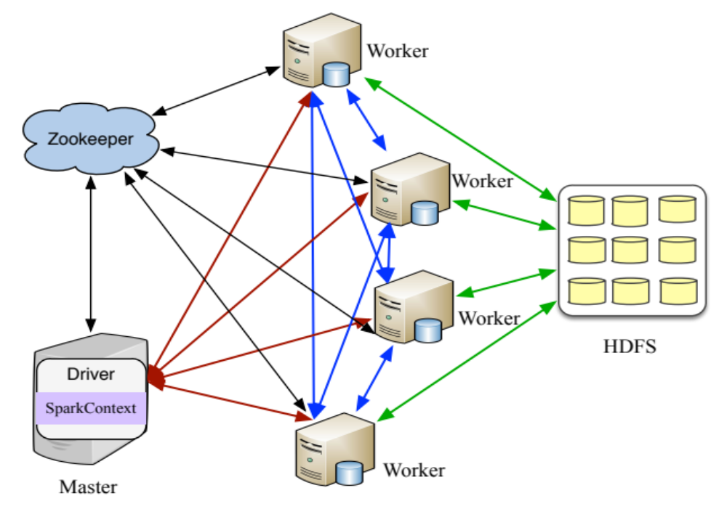
The Apache Spark Framework
An in-memory data-processing framework
  Iterative machine learning jobs
  Interactive data analytics
  Scala based Implementation
  Standalone, YARN, Mesos
A unified engine to support Batch, Streaming, SQL, Graph, ML/DL workloads
Scalable and communication intensive
  Wide dependencies between Resilient Distributed Datasets (RDDs)
  MapReduce-like shuffle operations to repartition RDDs
  Sockets based communication
BlinkDB
Spark Streaming
(real-time)
GraphX
(graph)
MLlib
(Machine Learning)
Caffe, TensorFlow, BigDL, etc.
(Deep Learning)
…
Spark
SQL
Spark
Standalone
Apache Mesos
YARN
  http://spark.apache.org

Slide 37
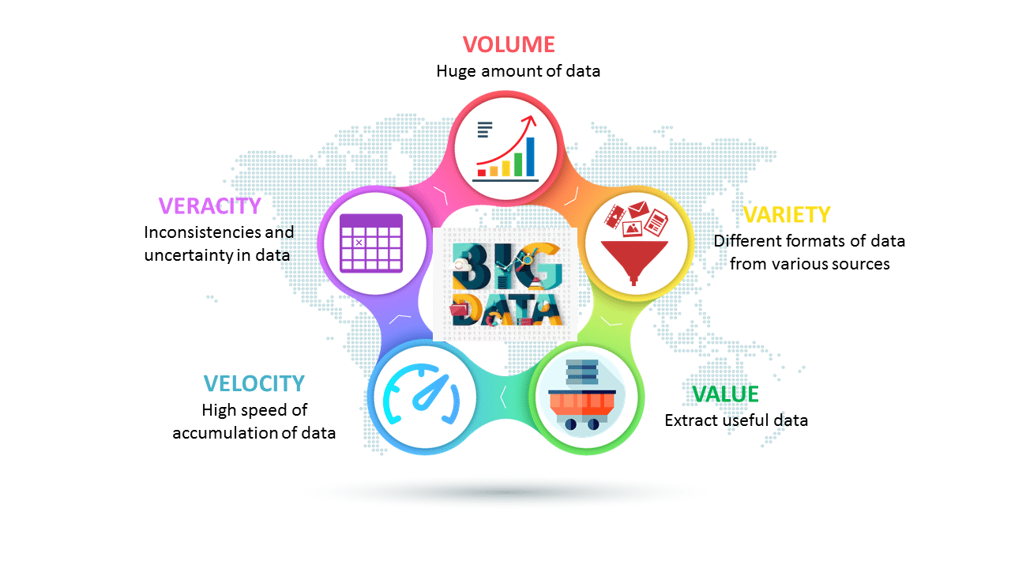
5V Characteristics of Big Data
Courtesy: https://www.edureka.co/blog/big-data-characteristics/
Notes:
http://api.ning.com/files/tRHkwQN7s-Xz5cxylXG004GLGJdjoPd6bVfVBwvgu*F5MwDDUCiHHdmBW-JTEz0cfJjGurJucBMTkIUNdL3jcZT8IPfNWfN9/dv1.jpg

Slide 38
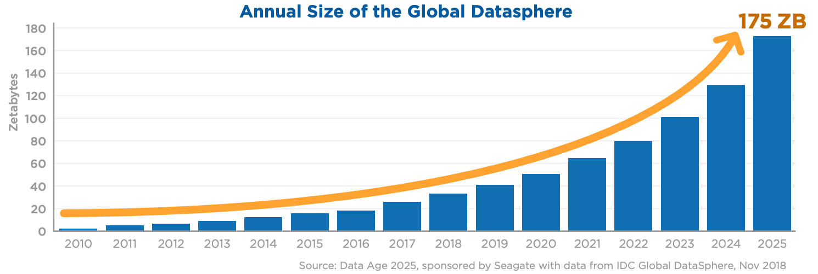
Big Volume of Data Forecast until 2025
David Reinsel, John Gantz, and John Rydning. The Digitization of the World From Edge to Core An IDC White Paper. https://www.seagate.com/files/www-content/our-story/trends/files/idc-seagate-dataage-whitepaper.pdf

Slide 39


MVAPICH enabling life-changing NASA's DART mission
Near-Earth asteroids (NEAs) have caused recent and ancient global catastrophes
  LLNL scientists research ways to prevent NEAs using methods known as asteroid deflection
  Joint NASA-LLNL research modelled various asteroid deflection methods (NASA's DART mission)
MVAPICH2 lived at the core of the (NASA-DART mission) and enabled scalability
  Underneath large-scale hydrodynamical and gravitational simulations required to compute the impact such as Spheral models
https://twitter.com/NASA/status/1574539270987173903?s=20&t=u_4wIV9Cui2xyn9QLj286Q
https://www.cbsnews.com/sanfrancisco/news/i-just-could-not-believe-it-livermore-team-celebrates-nasas-historic-strike-on-distant-asteroid/
http://mug.mvapich.cse.ohio-state.edu/static/media/mug/presentations/18/moody-mug-18.pdf

Slide 40

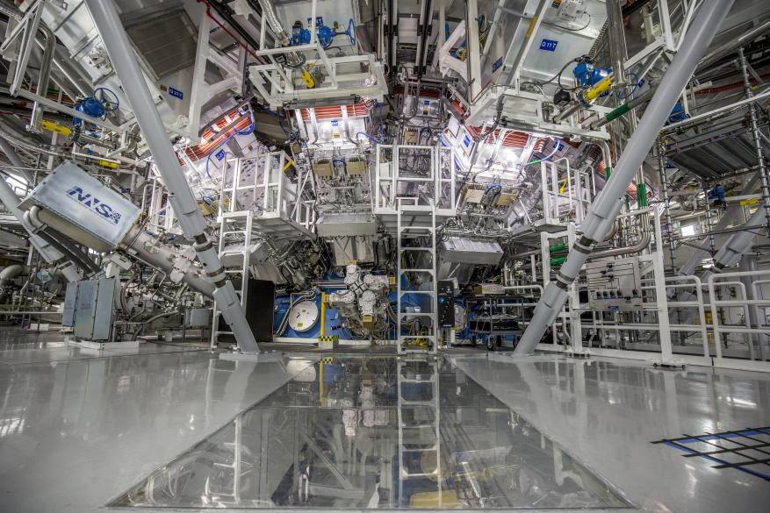

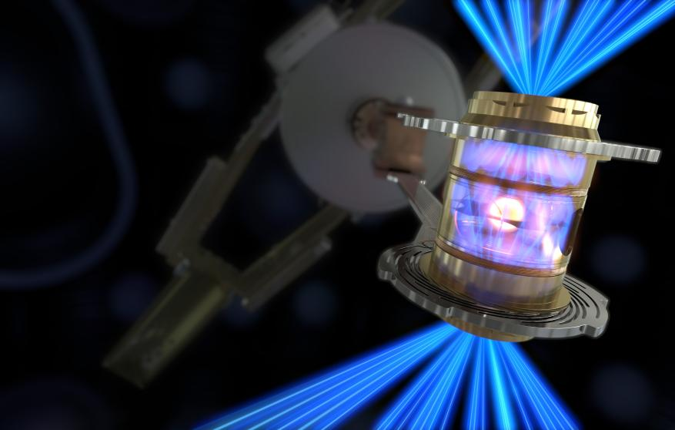
MVAPICH enabling Nuclear Fusion Research
LLNL’s National Ignition Facility (NIF) conducted the first controlled fusion experiment in history![1]
MVAPICH, being the default MPI library on the LLNL systems, has been enabling the thousands of simulation jobs that have led to this amazing achievement!
[1] https://www.llnl.gov/news/national-ignition-facility-achieves-fusion-ignition
The target chamber of LLNL’s National Ignition Facility, where 192 laser beams delivered more than 2 million joules of ultraviolet energy to a tiny fuel pellet to create fusion ignition on Dec. 5, 2022.
The hohlraum that houses the type of cryogenic target used to achieve ignition on Dec. 5, 2022, at LLNL’s National Ignition Facility.
To create fusion ignition, the National Ignition Facility’s laser energy is converted into X-rays inside the hohlraum, which then compress a fuel capsule until it implodes, creating a high temperature, high pressure plasma.

Slide 41
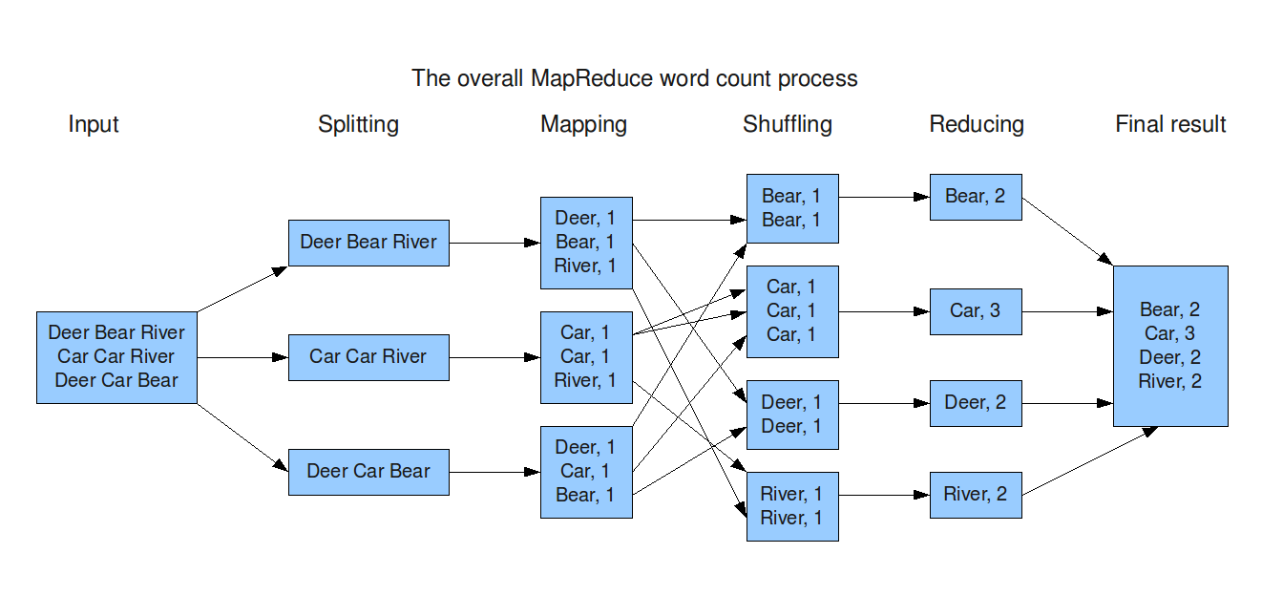
MapReduce and the Apache Hadoop Software
MapReduce and Google File System were pioneered by Google (around 2003)
  The Apache Hadoop software is an open-source implementation of MapReduce programming model
The overall execution process of WordCount example
MapReduce: Simplified Data Processing on Large Clusters, https://research.google/pubs/pub62/
The Google File System, https://static.googleusercontent.com/media/research.google.com/en//archive/gfs-sosp2003.pdf

Slide 42
Running Dask Programs
Dask way: Using Cluster Objects
MPI way: Using dask-mpi
Clusters are pre-defined utility classes to help with bootstrapping Dask on different environments:
  Dask-CUDA provides LocalCUDACluster, DGX
  Dask-Jobqueue provides SLURMCluster, LSFCluster, KubeCluster, ECSCluster, YARNCluster
Steps
  Step 1: Start the Cluster
  Step 2: Start client
  Step 3: Submit work to workers through client
Using dask-mpi, start an MPI job where:
  Scheduler (rank 0)
  Client (rank 1)
  Workers (>= 2)
1
Client
Cluster
Scheduler
0
2
3
4
Worker
Worker
Worker

Slide 43
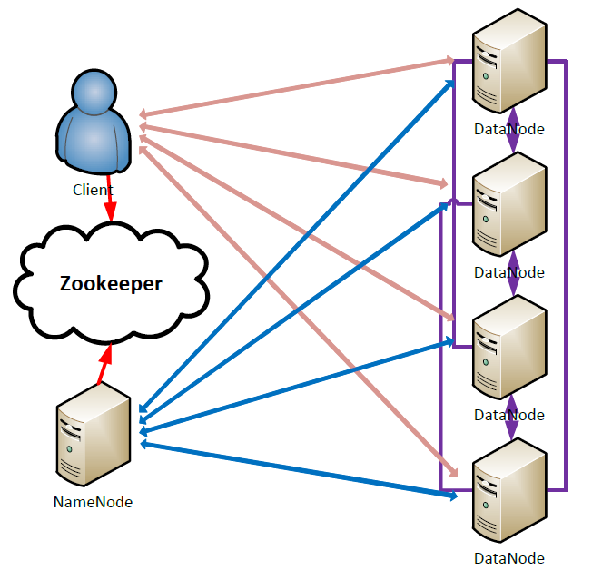
Hadoop Distributed File System (HDFS)
Primary storage of Hadoop; highly reliable and fault-tolerant
Adopted by many reputed organizations
  eg: Facebook, Yahoo!
NameNode: stores the file system namespace
DataNode: stores data blocks
Developed in Java for platform-independence and portability
Uses sockets for communication!
Client
RPC
RPC
RPC
RPC
(HDFS Architecture)

Slide 44
MPI4Spark: Relative Speedups to Vanilla Spark and RDMA-Spark on Three HPC Systems
System Name | Nodes Used | Processor | Cores Used | Sockets | Cores/socket | RAM | Interconnect
TACC Frontera | 34 | Xeon Platinum | 1792 | 2 | 28 | 192 GB | HDR (100G)
RI2 (OSU System) | 14 | Xeon Broadwell | 336 | 2 | 14 | 128 GB | EDR (100G)
MRI (OSU System) | 12 | AMD EPYC 7713 | 1280 | 2 | 64 | 264 GB | 200 Gb/sec (4X HDR)
OHB GroupByTest
OHB SortByTest
3.65x
3.52x
1.88x
1.86x

Slide 45
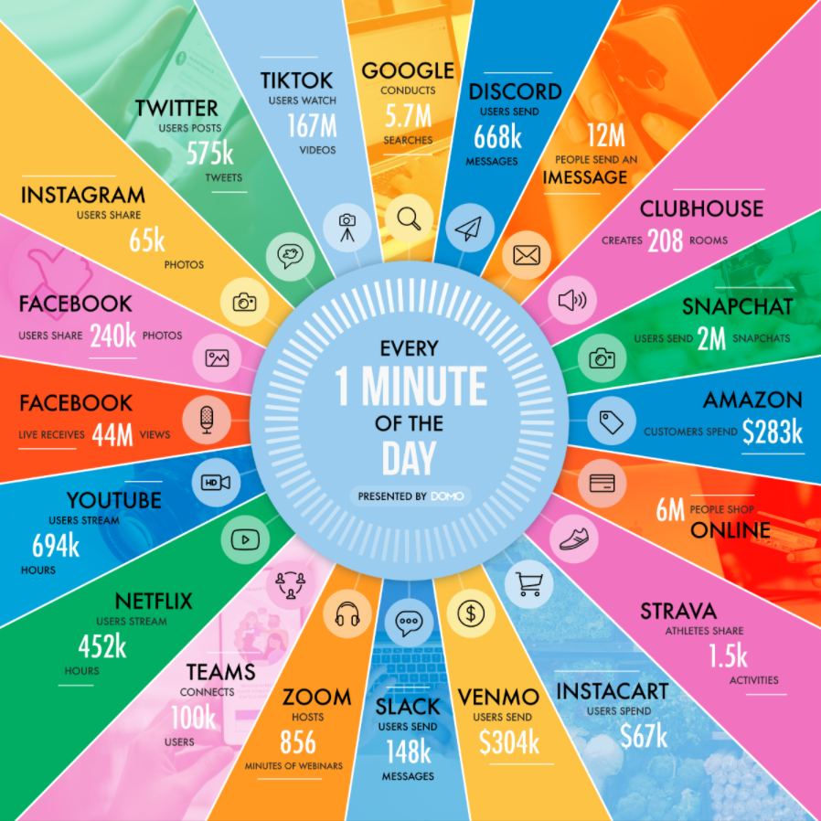
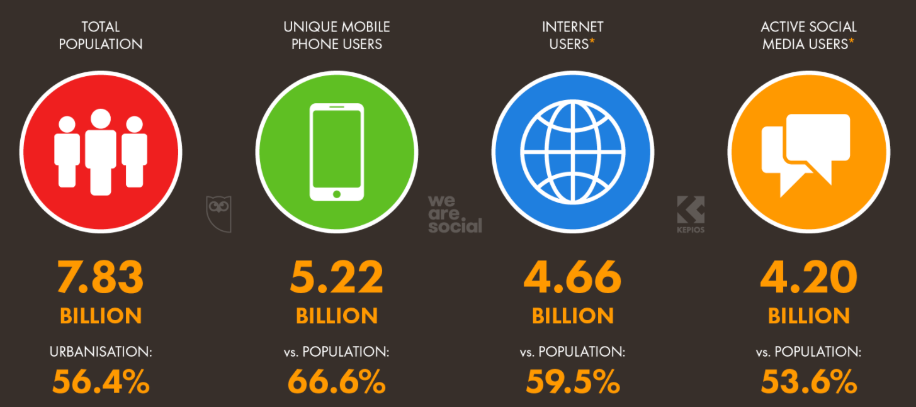
Big Velocity – How Much Data Is Generated Every Minute on the Internet?
The global Internet population grew 10% (in July 2021) from Jan 2021 and now represents
5.17 Billion People.
Courtesy: https://www.domo.com/blog/data-never-sleeps-9/

Slide 46
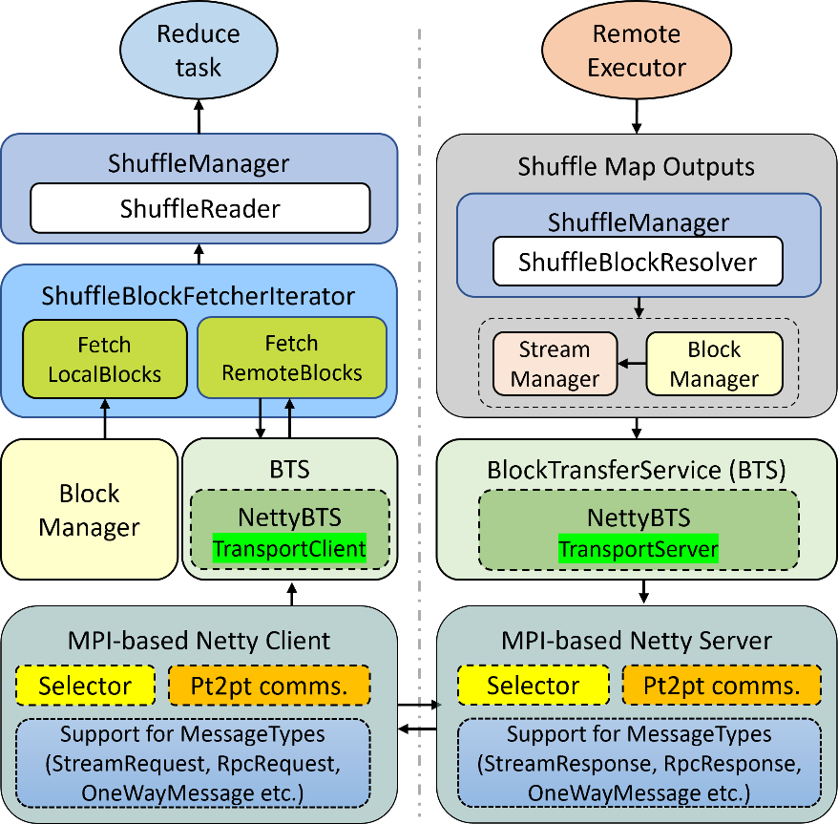
MPI4Spark: Optimizing the Communication (Shuffle) Phase
Dataflow for two executors
  One of the executors performs a reduce task that requires fetching of remote blocks
The reduce task starts with reading records inside of ShuffleReader
ShuffleBlockFetcherIterator is used to fetch data blocks locally or remotely
When remote fetches take place, the ShuffleBlockFetcherIterator will send requests to the underlying NettyBlockTransferService
MPI-based Netty will then be used to communicate the remote data block using the ShuffleBlockResolver
1
2
4
3

Slide 47
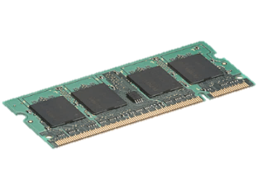
Data Sharing Problems in MapReduce
HDFS
read
HDFS
write
HDFS
read
HDFS
write
iter. 1
iter. 2
. . .
Input
Slow due to replication, serialization, and disk IO
In-Memory?
iter. 1
iter. 2
. . .
Input
10-100× faster than network and disk
Notes:
Each iteration is, for example, a MapReduce job

Slide 48
RDD Operations
Transformations (define a new RDD)
map filter sample union groupByKey reduceByKey sortByKey join …
Actions (return a result to driver)
reduce collect count first Take countByKey saveAsTextFile saveAsSequenceFile …
More Information:
https://spark.apache.org/docs/latest/programming-guide.html#transformations
https://spark.apache.org/docs/latest/programming-guide.html#actions

Slide 49
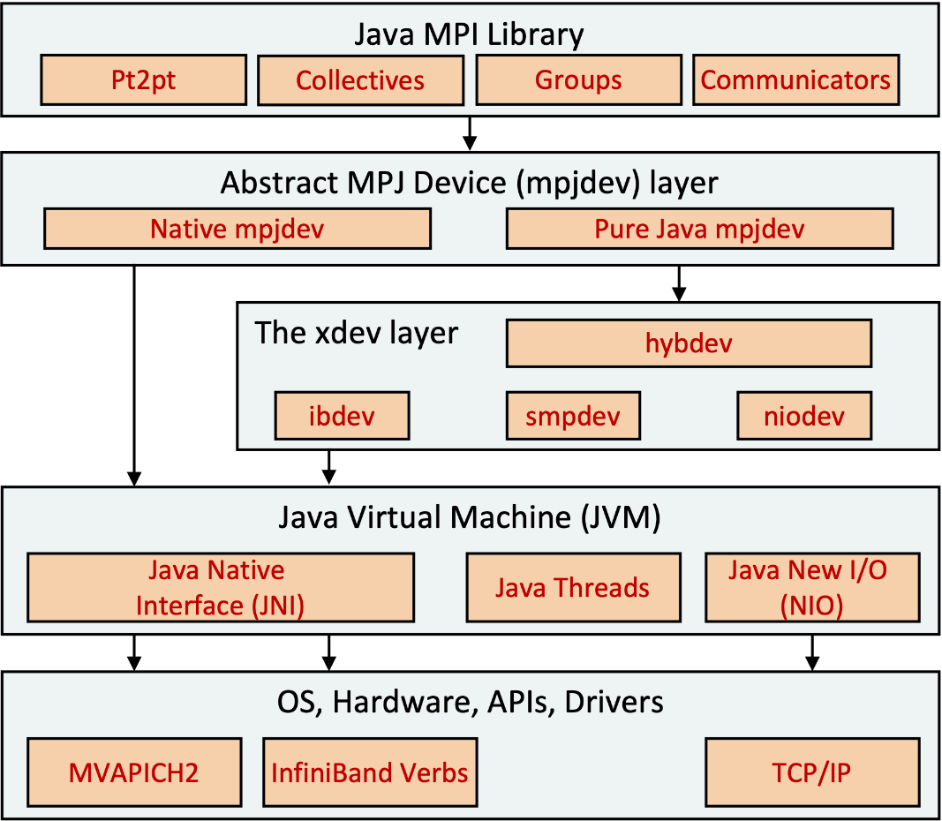
MVAPICH2-J: Java Bindings to MVAPICH2
We have recently added Java bindings to the MVAPICH2 library:
  Allows writing HPC applications in the Java programming language
The library currently implements a subset of the MPI API:
  Our bindings follow the same API as Open MPI Java bindings
MVAPICH2-J currently supports:
  blocking/non-blocking point-to-point functions
  blocking collective functions
  blocking vectored collective functions
Motivation:
  Enhance communication infrastructure of BigData frameworks, written in Scala/Java, using MPI
MVAPICH2-J 2.3.7 is recently released:
  Userguide: https://mvapich.cse.ohio-state.edu/userguide/mv2j/
K. Al Attar, A. Shafi, H. Subramoni, D. Panda, Towards Java-based HPC using the MVAPICH2 Library: Early Experiences, HIPS '22 (IPDPSW), May 2022.
Notes:
Historically, there has been interest in using MPI to scale parallel and distributed Java applications on HPC systems
MPI continues to dominate the landscape of HPC applications
Java remains popular and relevant for its:
Portability
Widespread adoption in the software industry and Big Data community
Advanced features such as garbage collectio

Slide 50
Introduction
The NVIDIA RAPIDS framework is a collection of open-source software libraries that aims to enable end-to-end data science pipelines on GPUs:
  Hides the low-level complexities of the CUDA framework
Dask is a Big Data computation frameworks that allows processing large amounts of data
  Dask applications can scale from laptops to high-end parallel computing systems
  NVIDIA RAPIDS and Dask are integrated to enable Multi-Node Multi-GPU (MNMG) deployment of user applications
This talk focuses on using MVAPICH2—a Message Passing Interface (MPI) standard compliant library—to optimize communication, including GPU-to-GPU, needed by Dask on clusters of GPUs

Slide 51
A cuPy Benchmark and running it using MPI4Dask
Sum of cuPy Array and its Transpose Benchmark
# protocol for Dask Distributed. Options include ['mpi', 'tcp']
DASK_PROTOCOL = 'mpi'
...
async def run():
async with Client(asynchronous=True) as client:
rs = da.random.RandomState(RandomState=cupy.random.RandomState)
a = rs.normal(100, 1, (int(10000), int(10000)), chunks=(int(5000), int(5000)))
x = a + a.T
xx = await client.compute(x)
if __name__ == "__main__":
initialize(
interface=DASK_INTERFACE,
protocol=DASK_PROTOCOL,
...
)
asyncio.run(run())
Execution using MPI4Dask
$MPILIB/bin/mpirun_rsh -np 4 python cupy_bench.py
1
Client
Cluster
Scheduler
0
2
3
Worker
Worker

Slide 52
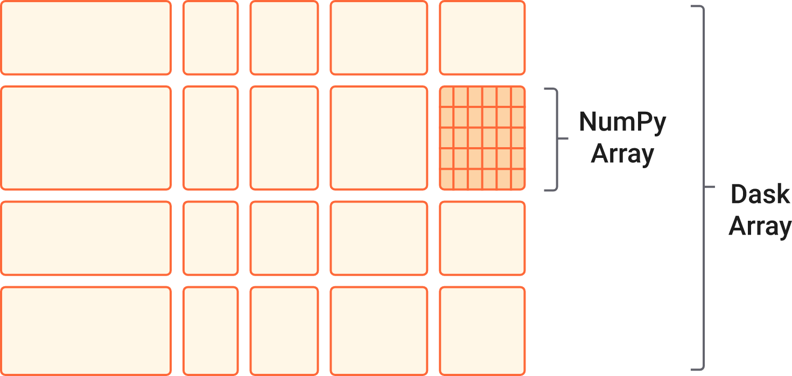
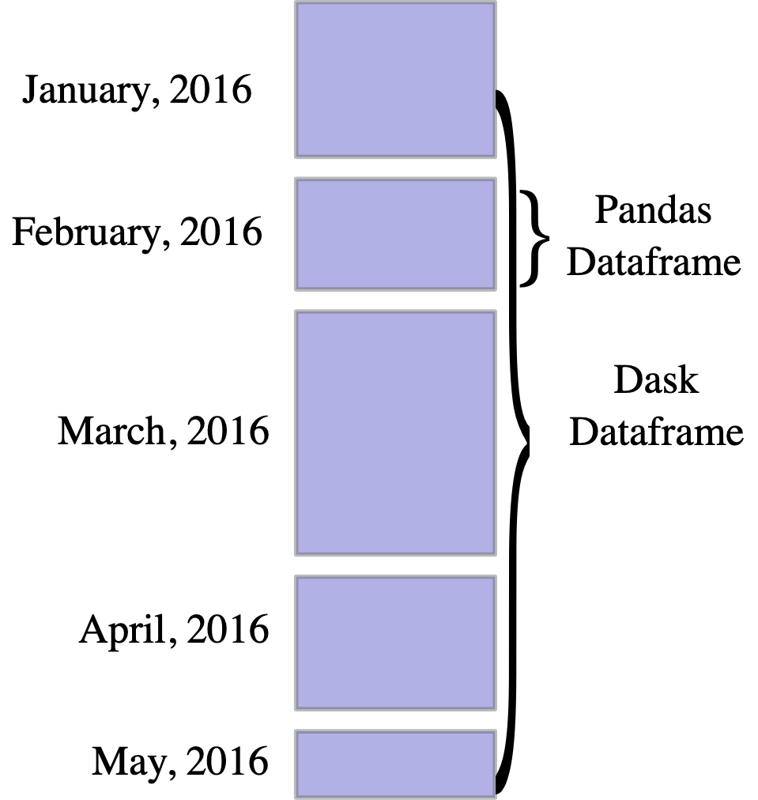
High-level Collections and Schedulers
High level collections: Dask’s high-level collections are alternatives to NumPy and Pandas for large datasets.
  These operate in parallel on datasets that don’t fit into memory.
Low Level schedulers: Dask provides dynamic task schedulers that execute task graphs in parallel
  Dask’s schedulers are an alternative to direct use of threading or multiprocessing libraries
Courtesy: http://dask.org

Slide 53
Dask Architecture
Dask
Dask Bag
Dask Array
Dask DataFrame
Delayed
Future
Task Graph
Dask-MPI
Dask-CUDA
Dask-Jobqueue
Distributed
Scheduler
Worker
Client
Comm Layer
tcp.py
ucx.py
UCX-Py
(Cython wrappers)
TCP
UCX
Laptops/
Desktops
High Performance Computing Hardware

Slide 54
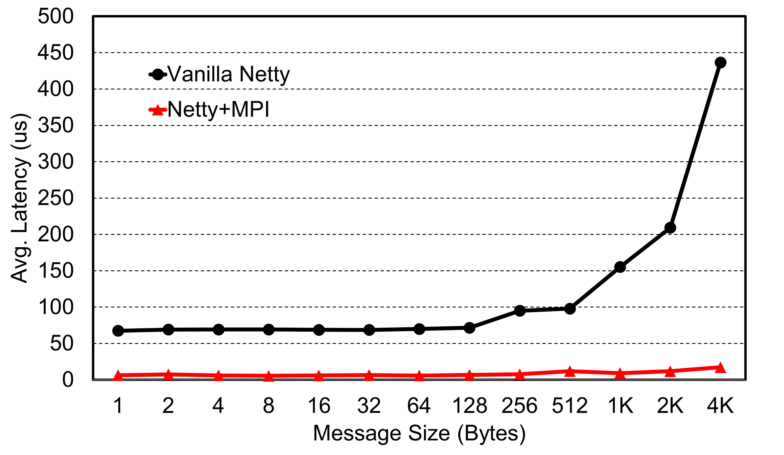
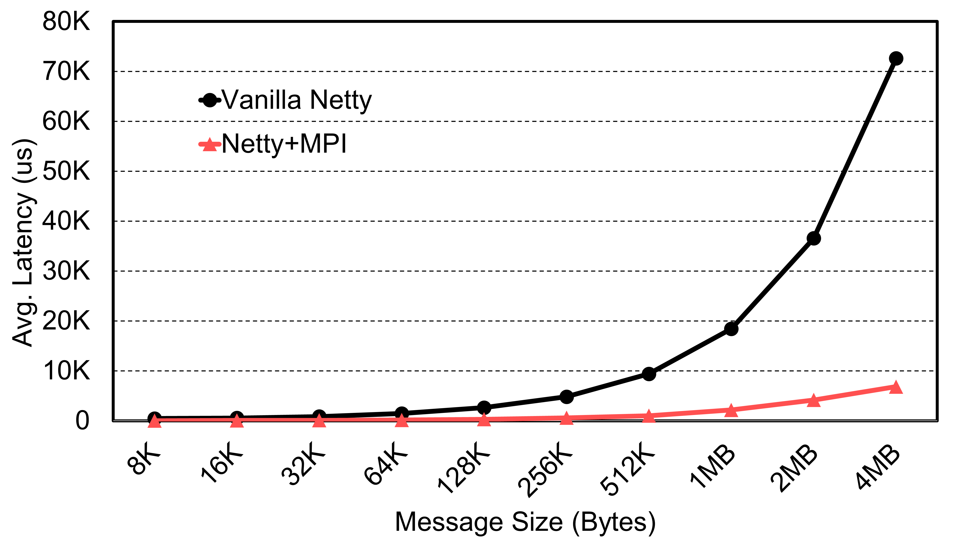
MPI4Spark: Performance of MPI-based Netty
These figures represent the latency numbers for small and large message sizes
The performance was analyzed using a ping pong Netty benchmark
For small messages, we see a speed-up of 25x at 4K
For large messages, we see a speed-up of 9x at 4MB
9x
25x
K. Al Attar, A. Shafi, M. Abduljabbar, H. Subramoni, D. Panda, Spark Meets MPI: Towards High-Performance Communication Framework for Spark using MPI, IEEE Cluster '22, Sep 2022.
Notes:
K. Al Attar, A. Shafi, M. Abduljabbar, H. Subramoni, D. Panda, Spark Meets MPI: Towards High-Performance Communication Framework for Spark using MPI, IEEE Cluster '22, Sep 2022.

Slide 55
Acknowledgments to all the Heroes (Past/Current Students and Staffs)
Current Students (Graduate)
  N. Alnaasan (Ph.D.)
  Q. Anthony (Ph.D.)
  C.-C. Chun (Ph.D.)
  N. Contini (Ph.D.)
  A. Jain (Ph.D.)
  Current Research Scientists
  M. Abduljabbar
  A. Shafi
  Current Faculty
  H. Subramoni
  K. S. Khorassani (Ph.D.)
  P. Kousha (Ph.D.)
  B. Michalowicz (Ph.D.)
  B. Ramesh (Ph.D.)
  K. K. Suresh (Ph.D.)
  A. H. Tu (Ph.D.)
  S. Xu (Ph.D.)
  Q. Zhou (Ph.D.)
  K. Al Attar (M.S.)
  L. Xu (Ph.D.)
  H. Ahn (Ph.D.)
  G. Kuncham (Ph.D.)
  R. Vaidya (Ph.D.)
  J. Yao (Ph.D.)
  M. Han (M.S.)
  A. Guptha (M.S.)
  Current Software Engineers
  B. Seeds
  N. Pavuk
  N. Shineman
  M. Lieber
  Current Students (Undergrads)
  V. Shah
  T. Chen
Past Students
  A. Awan (Ph.D.)
  A. Augustine (M.S.)
  P. Balaji (Ph.D.)
  M. Bayatpour (Ph.D.)
  R. Biswas (M.S.)
  S. Bhagvat (M.S.)
  A. Bhat (M.S.)
  D. Buntinas (Ph.D.)
  L. Chai (Ph.D.)
  B. Chandrasekharan (M.S.)
  S. Chakraborthy (Ph.D.)
  N. Dandapanthula (M.S.)
  V. Dhanraj (M.S.)
  C.-H. Chu (Ph.D.)
  T. Gangadharappa (M.S.)
  K. Gopalakrishnan (M.S.)
  J. Hashmi (Ph.D.)
  W. Huang (Ph.D.)
  W. Jiang (M.S.)
  J. Jose (Ph.D.)
  M. Kedia (M.S.)
  S. Kini (M.S.)
  M. Koop (Ph.D.)
  K. Kulkarni (M.S.)
  R. Kumar (M.S.)
  S. Krishnamoorthy (M.S.)
  K. Kandalla (Ph.D.)
  M. Li (Ph.D.)
  P. Lai (M.S.)
  J. Liu (Ph.D.)
  M. Luo (Ph.D.)
  A. Mamidala (Ph.D.)
  G. Marsh (M.S.)
  V. Meshram (M.S.)
  A. Moody (M.S.)
  S. Naravula (Ph.D.)
  R. Noronha (Ph.D.)
  X. Ouyang (Ph.D.)
  S. Pai (M.S.)
  S. Potluri (Ph.D.)
  K. Raj (M.S.)
  R. Rajachandrasekar (Ph.D.)
  D. Shankar (Ph.D.)
  G. Santhanaraman (Ph.D.)
  N. Sarkauskas (B.S. and M.S)
  N. Senthil Kumar (M.S.)
  A. Singh (Ph.D.)
  J. Sridhar (M.S.)
  S. Srivastava (M.S.)
  S. Sur (Ph.D.)
  H. Subramoni (Ph.D.)
  K. Vaidyanathan (Ph.D.)
  A. Vishnu (Ph.D.)
  J. Wu (Ph.D.)
  W. Yu (Ph.D.)
  J. Zhang (Ph.D.)
  Current Research Specialist
  R. Motlagh
  Past Research Scientists
  K. Hamidouche
  S. Sur
  X. Lu
  Past Senior Research Associate
  J. Hashmi
  Past Programmers
  A. Reifsteck
  D. Bureddy
  J. Perkins
  Past Post-Docs
  D. Banerjee
  X. Besseron
  M. S. Ghazimeersaeed
  Past Research Specialist
  M. Arnold
  J. Smith
  H.-W. Jin
  J. Lin
  M. Luo
  A. Ruhela
  J. Vienne
  H. Wang
  E. Mancini
  K. Manian
  S. Marcarelli

Slide 56
RDD Programming Model in Spark
Key idea: Resilient Distributed Datasets (RDDs)
  Immutable distributed collections of objects that can be cached in memory across cluster nodes
  Created by transforming data in stable storage using data flow operators (map, filter, groupBy, …)
  Manipulated through various parallel operators
  Automatically rebuilt on failure
    rebuilt if a partition is lost
Interface
  Clean language-integrated API in Scala (Python & Java)
  Can be used interactively from Scala console

Slide 57
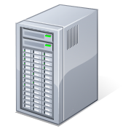
Example: Log Mining
Load error messages from a log into memory, then interactively search for various patterns
Base RDD
Cache 1
lines = spark.textFile(“hdfs://...”)
errors = lines.filter(_.startsWith(“ERROR”))
messages = errors.map(_.split(‘\t’)(2))
cachedMsgs = messages.cache()
Transformed RDD
Worker
results
tasks
Block 1
Driver
Action
Lazy Execution
cachedMsgs.filter(_.contains(“foo”)).count
cachedMsgs.filter(_.contains(“bar”)).count
Action
Cache 2
Worker
. . .
Cache 3
Result: scaled to 1 TB data in 5-7 sec
(vs 170 sec for on-disk data)
Worker
Block 2
Full-text search of Wikipedia, 60GB on 20 EC2 machines, 0.5 sec vs. 20s for on-disk
Block 3
Courtesy: https://spark.apache.org/
Notes:
Add “variables” to the “functions” in functional programming

Slide 58
MVAPICH2 Software Family
Requirements | Library
MPI with IB, iWARP, Omni-Path, and RoCE | MVAPICH2
Advanced MPI Features/Support, OSU INAM, PGAS and MPI+PGAS with IB, Omni-Path, and RoCE | MVAPICH2-X
MPI with IB, RoCE & GPU and Support for Deep/Machine Learning | MVAPICH2-GDR
HPC Cloud with MPI & IB | MVAPICH2-Virt
Energy-aware MPI with IB, iWARP and RoCE | MVAPICH2-EA
MPI Energy Monitoring Tool | OEMT
InfiniBand Network Analysis and Monitoring | OSU INAM
Microbenchmarks for Measuring MPI and PGAS Performance | OMB

Slide 59
MVAPICH-3.0a MVAPICH-Plus 3.0a
Released on 08/15/2022
Based on MPICH 3.4.3
Added support for the ch4:ucx and ch4:ofi devices
Support for MVAPICH2 enhanced collectives over OFI and UCX
Added support for the Cray Slingshot 11 interconnect over OFI
  Supports Cray Slingshot 11 network adapters
Added support for the Cornelis OPX library over OFI
  Supports Intel Omni-Path adapters
Added support for the Intel PSM3 library over OFI
  Supports Intel Columbiaville network adapters
Added support for IB verbs over UCX
  Supports IB and RoCE network adapters
Released on 11/11/2022
Based on MVAPICH 3.0
Advanced MPI with unified MVAPICH2-GDR and MVAPICH2-X features
Support for both OFI and UCX
Support for NVIDIA and AMD GPUs
Support for all HPC interconnects
  InfiniBand, Omni-Path, ROCE, Slingshot
Optimized designs for HPC, DL, ML, Big Data and Data Science applications
Unify MVAPICH2-GDR and MVAPICH2-X
Exploit the benefits of in-network computing capabilities in UCX and OFI transparently

