Slide 1
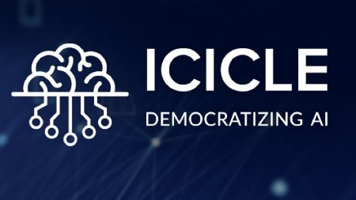
HARVEST: High-Performance Artificial Vision Framework for Expert Labeling using Semi-Supervised Training
Presentation at SC ’23
by
Nawras Alnaasan
The Ohio State University
alnaasan.1@osu.edu
https://engineering.osu.edu/people/alnaasan.1

Slide 2
Presentation Outline
Overview of the ICICLE Institute
Background
  Machine/Deep Learning Paradigms
Motivation and Challenges
  Broad Challenge
  The Data Labeling Challenge
  The Computing Challenge
  The Application Domain Challenge
Proposed Methods
Evaluation

Slide 3


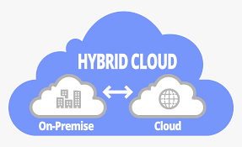
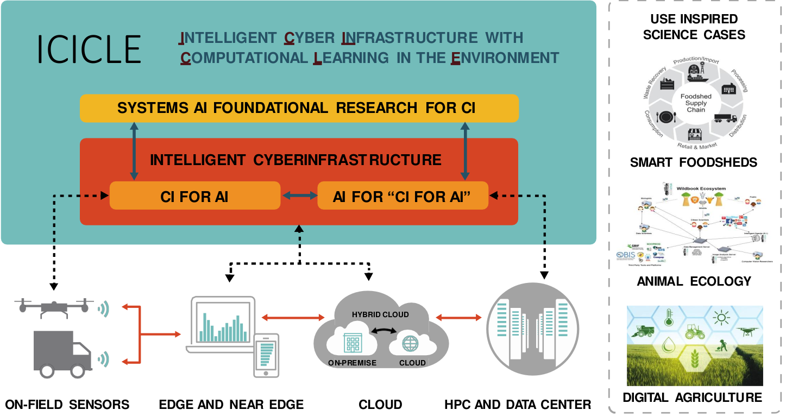
Designing High-Performance and Scalable Middleware for Computing Continuum
Computing Continuum
2. Big Data & Data Science
1. Scientific Computing
3. Artificial Intelligence
Edge & Near Edge
Clouds
On Field Sensors
HPC Systems & Data Centers

Slide 4


Follow us
http://icicle.ai
NSF-Funded AI Institute
($20M USD for Five Years)
@icicleai
Intelligent CyberInfrastructure
With Computational Learning
in the Environment (ICICLE)

Slide 5
Outline
Overview of the ICICLE Institute
Background
  Machine/Deep Learning Paradigms
Motivation and Challenges
  Broad Challenge
  The Data Labeling Challenge
  The Computing Challenge
  The Application Domain Challenge
Proposed Methods
Evaluation

Slide 6
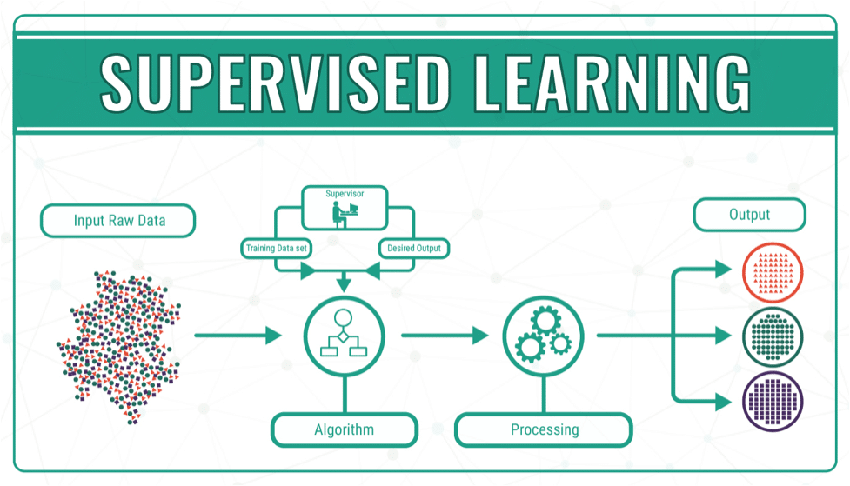
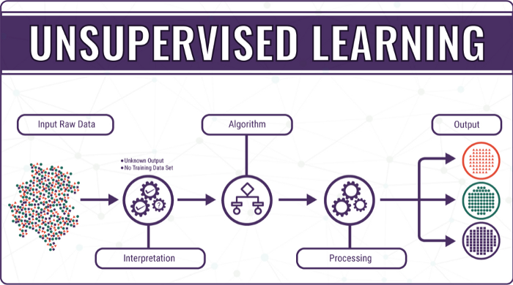
Types of Learning
Learning
Supervised
Unsupervised
Courtesy: https://bigdata-madesimple.com/machine-learning-explained-understanding-supervised-unsupervised-and-reinforcement-learning/
Notes:
Learning in AI applications is mainly divided into two ctagories. Suprvised and unsupervised.
There are multiple differences between these two, in terms of the type of data we use, and the task that we want to perform.
For supervised learning. The data samples must be labeled. To do the training and testing. And we usually perform tasks like classification or regression.
On the other hand, with unsupervised learning we don’t have this luxury of labeled datasets. In fact, in most cases our knowledge about the data is limited before we starting the learning. Therefore, the nature of the tasks of unsupervised learning is usually slightly different, and it is mainly to interpret the data or extract useful information out of it, rather than say classifying it like in the case of supervised learning.

Slide 7
Types of Learning
Learning
Supervised
Unsupervised
Useful when each of the available data samples is associated with a label.
Useful when datasets are unlabeled. Usually used for analysis purposes.
 | Supervised | Unsupervised
Data | Labeled | Unlabeled
Tasks | Classification, Regression | Clustering, Association
Algorithms | Linear Regression, Radom Forest, SVM, Deep Learning | PCA, k-means, Hierarchical Clustering, Deep Learning
Notes:
So to summarize,
supervised learning is useful when each of the available data samples is associated with a respective label.
And unsupervised learning is useful when the dataset is unlabeled, and it’s usually used for analytical purposes.
In terms of downstream tasks, supervised is used for classification and regression. Unsupervised is used for clustering and association, or anomaly detection.
Algorithms used for supervised are linear regression, random forest, SVM, and deep learning.
Whereas for unsupervised there’s PCA(principal component analysis), k-means, hierarchical clustering, and deep learning as well.

Slide 8
Types of Learning
Learning
Supervised
Unsupervised
Semi-Supervised
Useful when we can obtain a small subset of labeled data and large number of unlabeled data samples.
 | Supervised | Semi-Supervised | Unsupervised
Data | Labeled | Only some data is labeled | Unlabeled
Tasks | Classification, Regression | ← Both → | Clustering, Association
Algorithms | Linear Regression, Radom Forest, SVM, Deep Learning | Self-Training, generative models, MixMatch | PCA, k-means, Hierarchical Clustering, Deep Learning
Notes:
So we can see that there are advantages and disadvantages for each type of these learning approachs.
With supervised, we can train very strong and accurate models using labeled data, but data labeling is often expensive or infeasible for huge and frequent datasets.
With unsupervised learning, we can work with unlabeled data, but we cannot perform tasks like classification or regression, and we are mostly limited to clustering and analysis tasks.
The good news is that it’s not an either-or choice. We can find a middle ground. And That is semi-supervised learning.
SSL is useful, when we can obtain a small subset of labeled data and large number of unlabeled data samples.
SSL can perform both supervised and unsupervised tasks. And some example algorithms are self-training, generative models, and mixmatch.

Slide 9
Presentation Outline
Overview of the ICICLE Institute
Background
  Machine/Deep Learning Paradigms
Motivation and Challenges
  The Data Labeling Challenge
  The Computing Challenge
  The Application Domain Challenge
  Broad Challenge
Proposed Methods
Evaluation

Slide 10
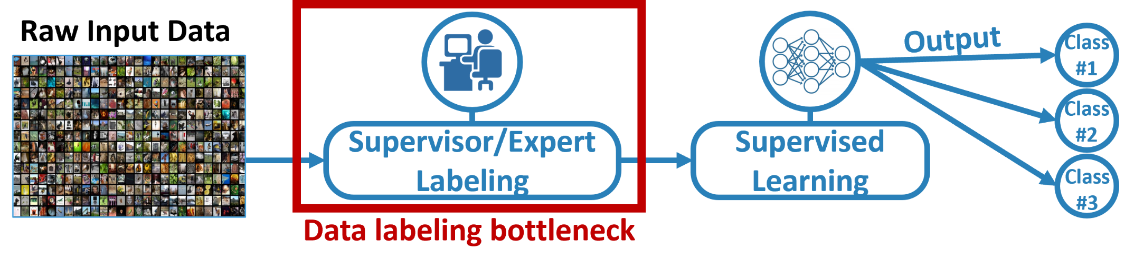
The Data Labeling Challenge
Challenge:
Data samples need to be fully labeled by an expert for training and evaluation.
Datasets may be collected frequently and in large volumes (millions of unlabeled images).
Labeling data by experts is a significant bottleneck.
Supervised learning can be time-consuming, costly, and infeasible for certain applications

Slide 11
The Computing Challenge
Why do we need Parallel Training?
Larger and Deeper models are being proposed
  Language Models: RNNs -> Transformers -> BERT – GPT-(1,2,3,4)
  Vision Models: AlexNet -> ResNet -> NASNet – AmoebaNet → Vision Transformers
  DNNs require a lot of memory and a lot of computation
  Larger models cannot fit a GPU’s memory
Single GPU training cannot keep up with ever-larger models
Community has moved to multi-GPU training
Multi-GPU in one node is good but there is a limit to Scale-up (8-16 GPUs)
Multi-node (Distributed or Parallel) Training is necessary!!

Slide 12
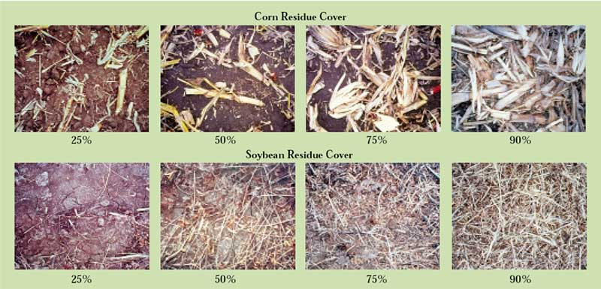
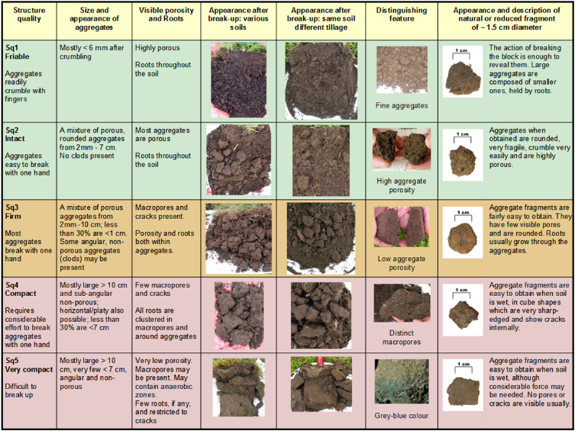
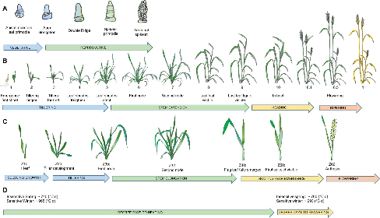
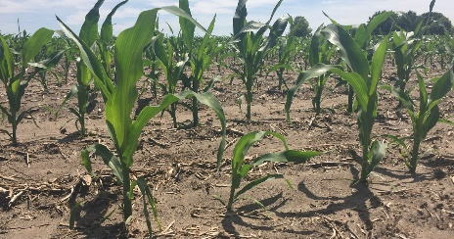
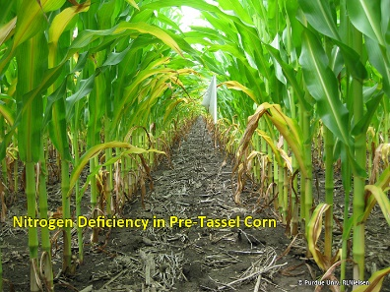
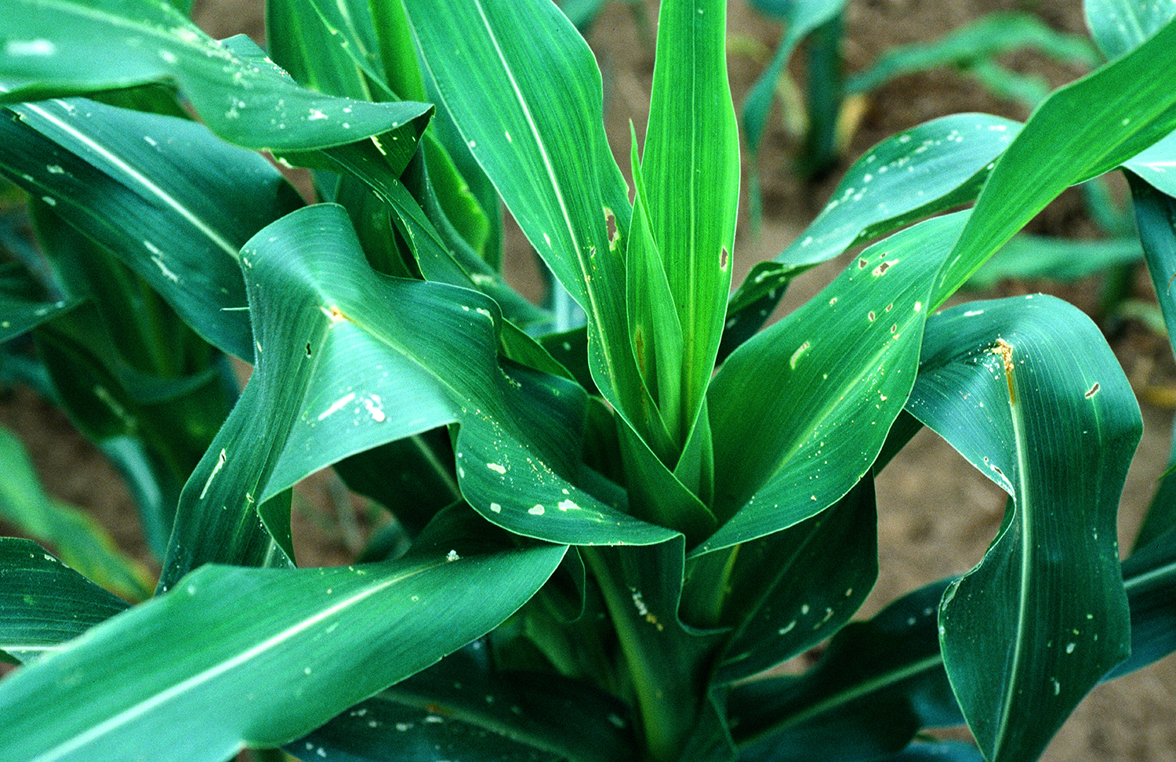
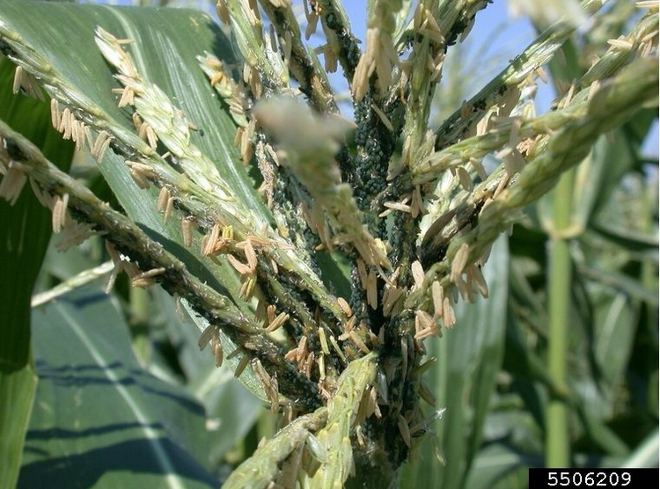
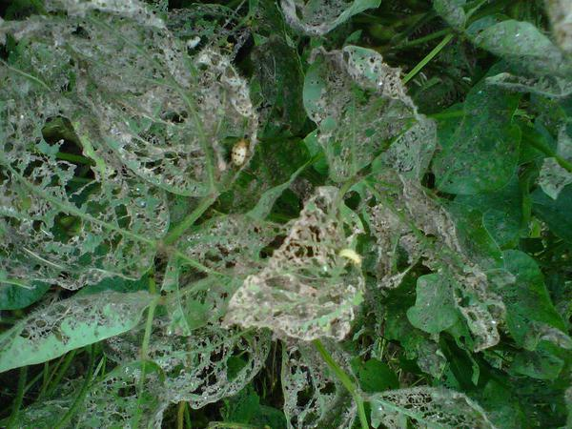
The Application Domain Challenge (Digital Agriculture)
Computer Vision (CV) based classification scenarios are ubiquitous in use-inspired science domains such as Digital Agriculture
Residue Cover on Soil Surface
Soil Aggregate Size
Wheat Development
Non-Uniform Emergence
Nitrogen Deficiency
European corn borer
Corn leaf aphid
Mexican bean beetle defoliation

Slide 13
Broad Challenge:
Design a high-performance framework using SSL techniques, alleviating the data labeling bottleneck and allowing domain experts with no prior DL or HPC knowledge to train robust models quickly?

Slide 14
Presentation Outline
Overview of the ICICLE Institute
Background
  Machine/Deep Learning Paradigms
Motivation and Challenges
  The Data Labeling Challenge
  The Computing Challenge
  The Application Domain Challenge
  Broad Challenge
Proposed Methods
Evaluation

Slide 15

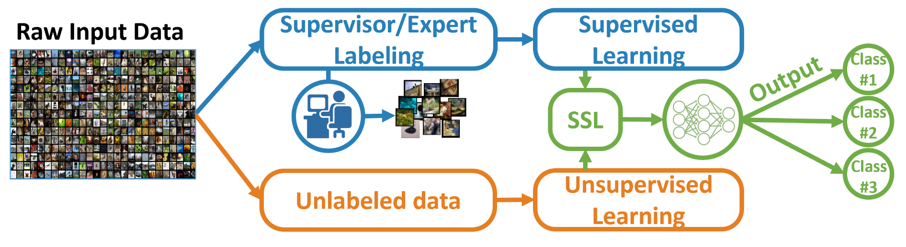
Supervised and Semi-supervised Learning Workflows
Supervised:
SSL:

Slide 16
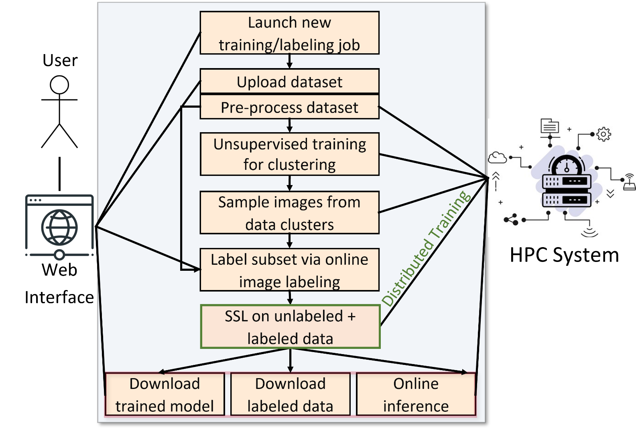
Proposed High-Performance Expert Labeling
Design a workflow for domain experts with no prior DL or HPC experience.
Employ state-of-the-art SSL solutions for computer vision applications.
Train accurate DL models using only a small fraction of labeled data.
Accelerate training using distributed training on HPC systems.
Enable an intuitive and user-friendly interface linked to HPC systems.
Support any user-defined use case.

Slide 17
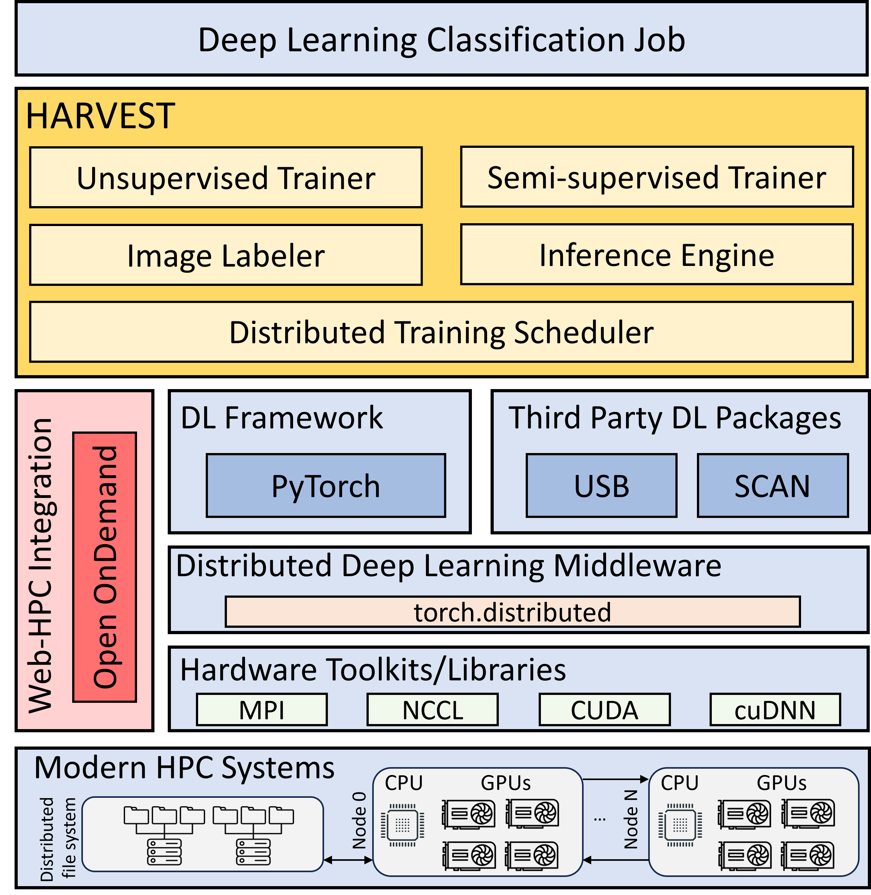
HARVEST Overview

Slide 18
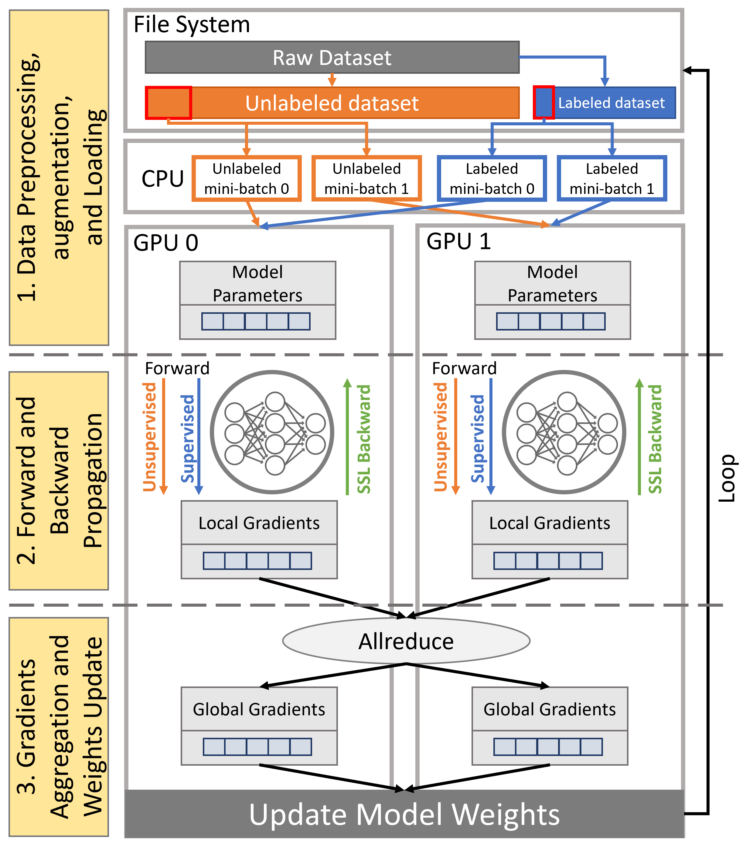
Data Parallel Training for SSL
DDP Scaling Analysis on Multi-node

Slide 19

Interactive Interface (Demo)

Slide 20
Presentation Outline
Overview of the ICICLE Institute
Background
  Machine/Deep Learning Paradigms
Motivation and Challenges
  The Data Labeling Challenge
  The Computing Challenge
  The Application Domain Challenge
  Broad Challenge
Proposed Methods
Evaluation

Slide 21
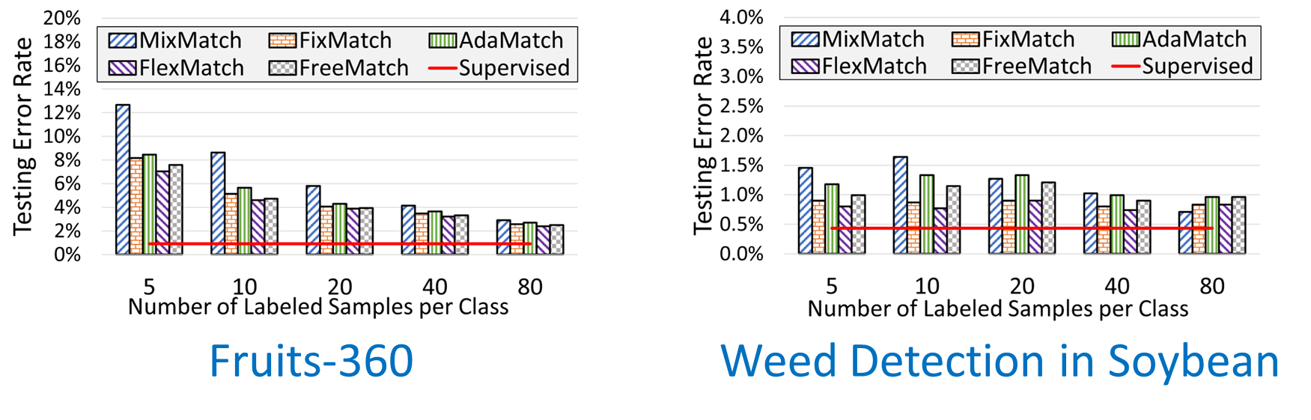
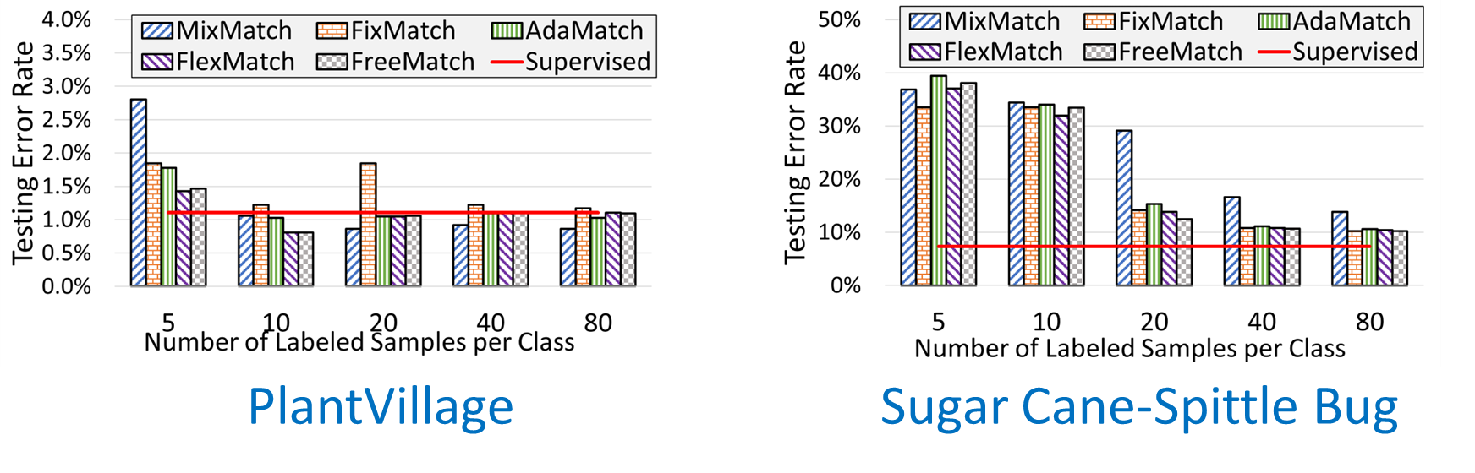
Evaluation Digital Agriculture Datasets
N. Alnaasan, M. Lieber, A. Shafi, H. Subramoni, S. Shearer, and DK Panda, “HARVEST: High-Performance Artificial Vision Framework for Expert Labeling using Semi-Supervised Training”, 2023 IEEE International Conference on Big Data, December 2023

Slide 22
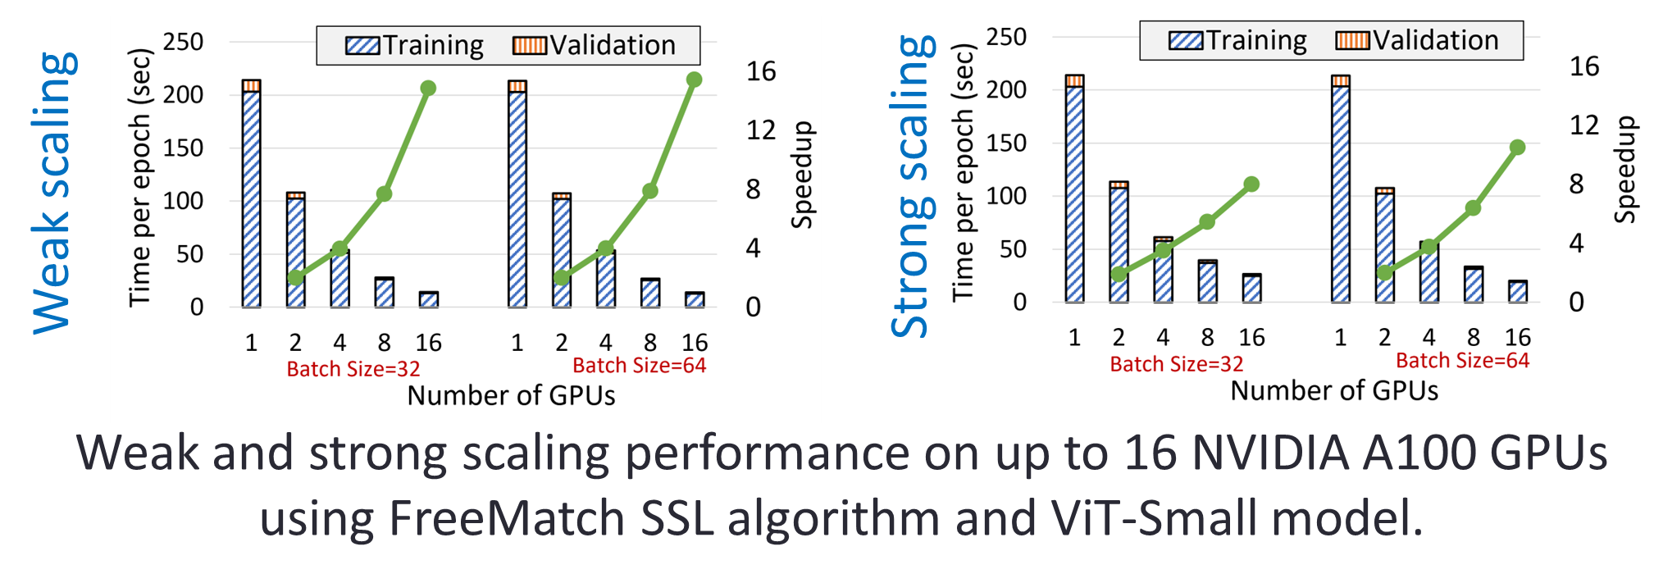
DDP Scaling Analysis on Multi-node
N. Alnaasan, M. Lieber, A. Shafi, H. Subramoni, S. Shearer, and DK Panda, “HARVEST: High-Performance Artificial Vision Framework for Expert Labeling using Semi-Supervised Training”, 2023 IEEE International Conference on Big Data, December 2023

Slide 23
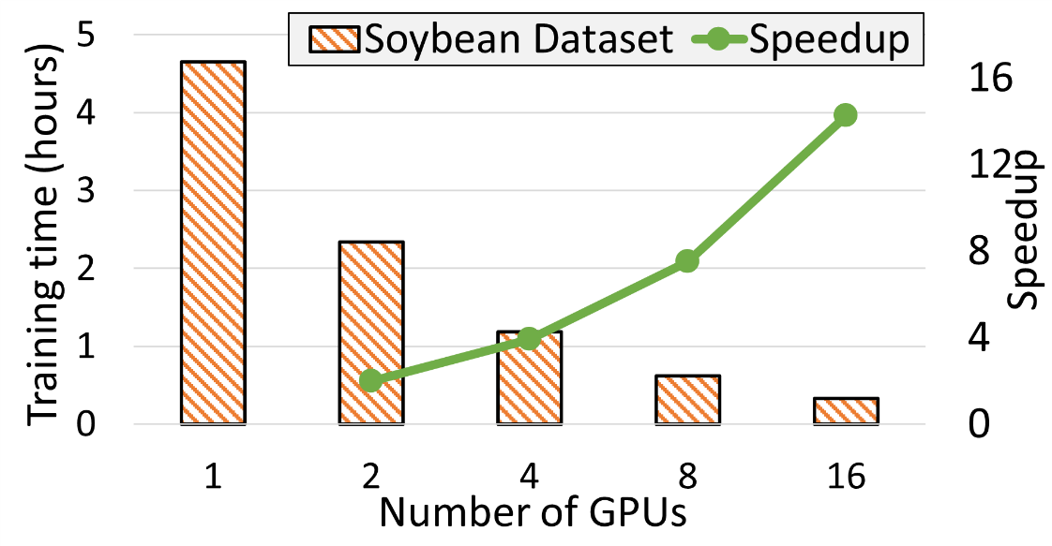
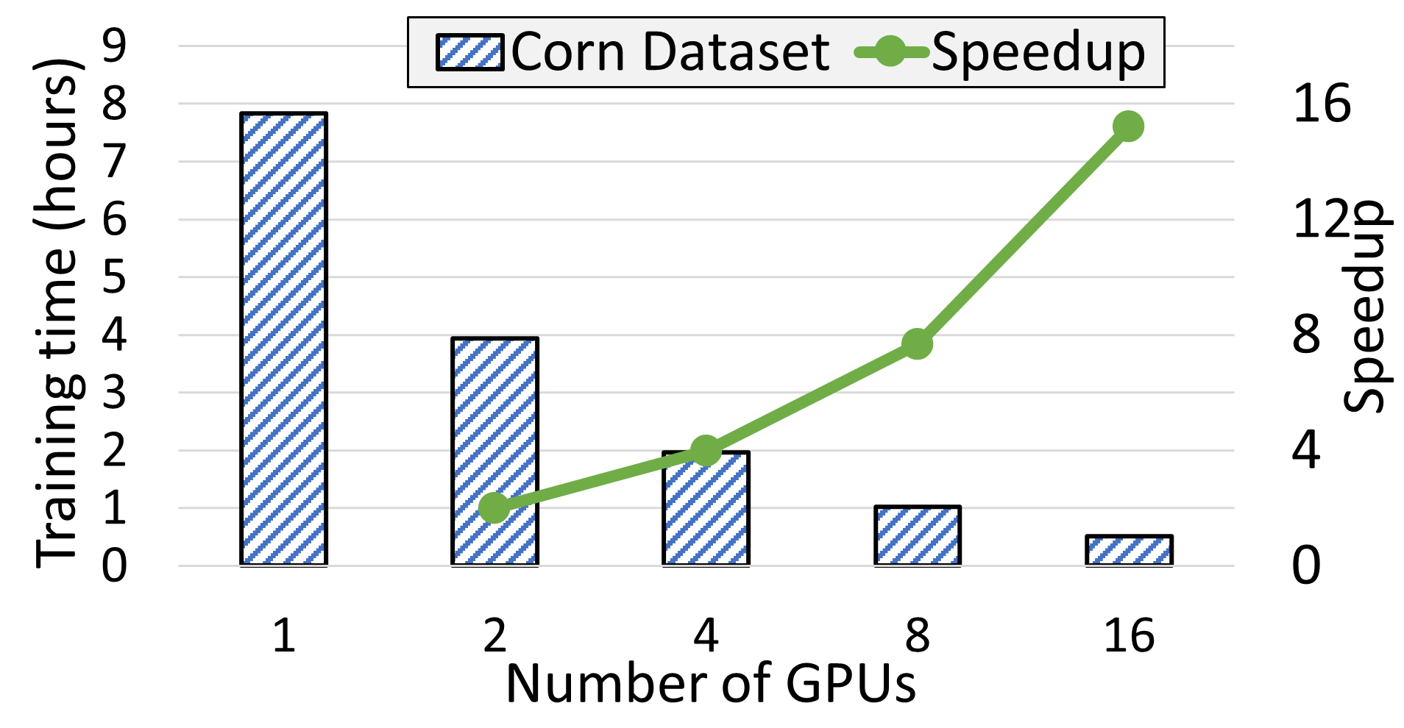
Evaluation on Real Digital Agriculture Use Cases
Use case: Plant stress identification for protecting crops through the growing season.
Datasets: 1) Corn crops (9558 samples, 12 classes) 2) Soybean crops (5636 samples, 6 Classes)
Achieved 97% and 93% accuracies for the Corn and Soybean datasets using only 80 labeled samples per class.
Accelerated the training by 15.19x on 16 NVIDIA A100 GPUs reducing the training time from 7.8 hours to 31 minutes.
Dataset | Accuracy | Precision | Recall | F1 Score
Corn Dataset | 97.08% | 91.77% | 95.43% | 92.61%
Soybean Dataset | 93.07% | 88.64% | 92.40% | 89.61%
N. Alnaasan, M. Lieber, A. Shafi, H. Subramoni, S. Shearer, and DK Panda, “HARVEST: High-Performance Artificial Vision Framework for Expert Labeling using Semi-Supervised Training”, 2023 IEEE International Conference on Big Data, December 2023

Slide 24
Conclusion
HARVEST is a computer vision framework that:
Offers a comprehensive workflow for distributed labeling/training for DL image classification.
Employs state-of-the-art (SSL) techniques requiring only a small subset of labeled data.
Implements distributed data parallelism (DDP) for SSL to reduce the training time of DL models.
Provides an intuitive interface that enables domain experts with no prior DL or HPC knowledge to create customized DL solutions.

Slide 25
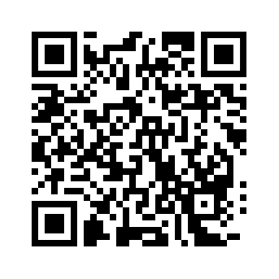
Want to see more talks at the OSU Booth?
Follow this QR Code!!
Talks all day, every day, Tuesday-Thursday!!

Slide 26
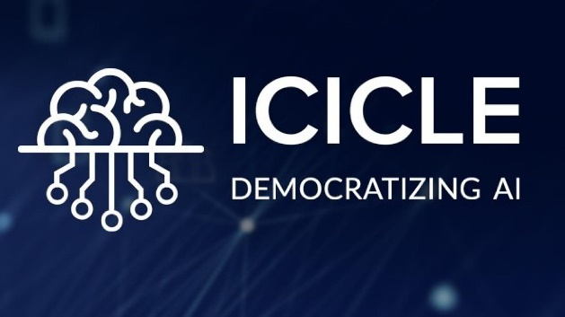
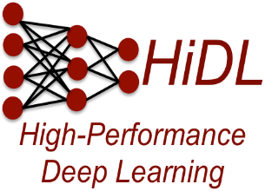
Thank You!
Network Based Computing
Laboratory
Network-Based Computing Laboratory
http://nowlab.cse.ohio-state.edu/
Follow us
@icicleai
The ICICLE Project
https://icicle.osu.edu/
The High-Performance Deep Learning Project
http://hidl.cse.ohio-state.edu/

