Slide 1
Follow us on
https://twitter.com/mvapich
Overview and Roadmap of the High-Performance Deep Learning (HiDL) Project
Presentation at SC ’23
by
Nawras Alnaasan
The Ohio State University
alnaasan.1@osu.edu
https://engineering.osu.edu/people/alnaasan.1
Notes:
Need to add this demo as well.
https://microsoft.github.io/onnxjs-demo/#/resnet50

Slide 2
Outline
Introduction
Machine Learning Solutions
Deep Learning
  Deep Neural Networks
  Distributed Deep Learning
  DL Solutions
Conclusion

Slide 3
What is Machine Learning and Deep Learning?
Machine Learning (ML)
  “the study of computer algorithms to improve automatically through experience and use of data”
Deep Learning (DL) – a subset of ML
  Uses Deep Neural Networks (DNNs)
  Perhaps, the most revolutionary subset!
Based on learning data representation
DNN Examples: Convolutional Neural Networks, Recurrent Neural Networks, Hybrid Networks
Data Scientist or Developer Perspective for using DNNs
  Identify DL as solution to a problem
  Determine Data Set
  Select Deep Learning Algorithm to Use
  Use a large data set to train an algorithm
Courtesy: https://hackernoon.com/difference-between-artificial-intelligence-machine-learning-and-deep-learning-1pcv3zeg, https://blog.dataiku.com/ai-vs.-machine-learning-vs.-deep-learning, https://en.wikipedia.org/wiki/Machine_learning

Slide 4

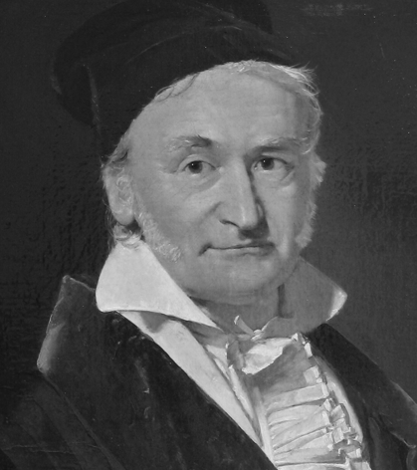
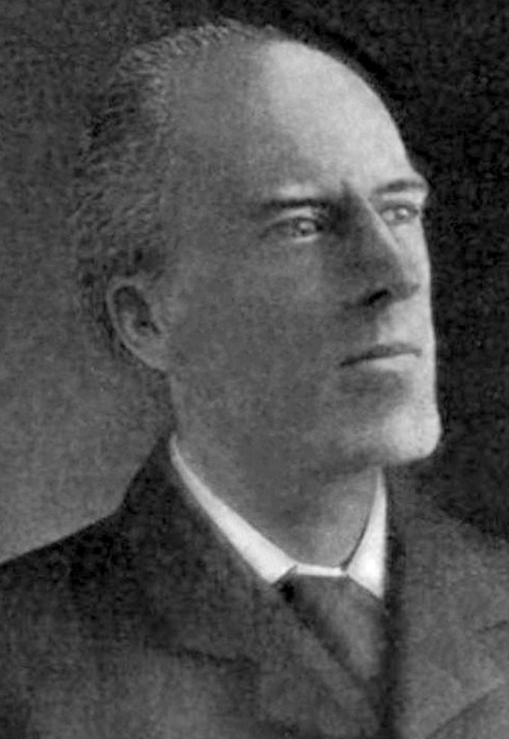
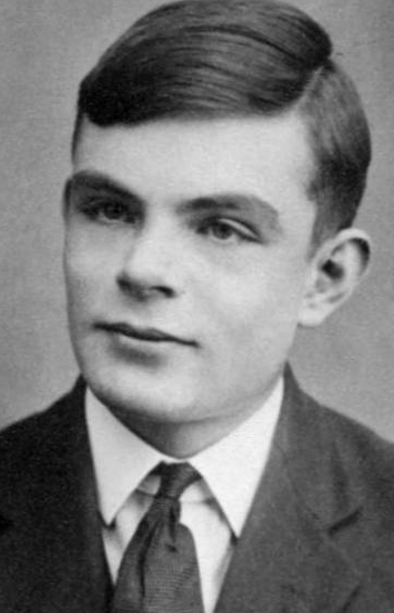
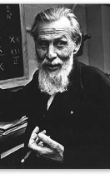
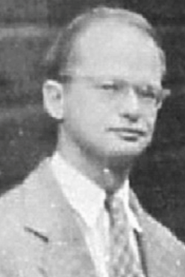
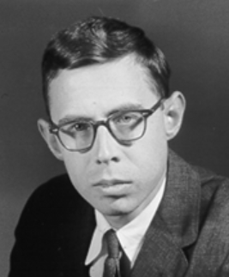
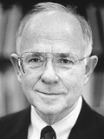
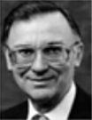
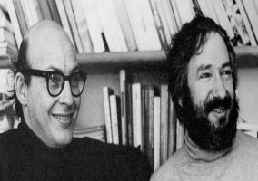
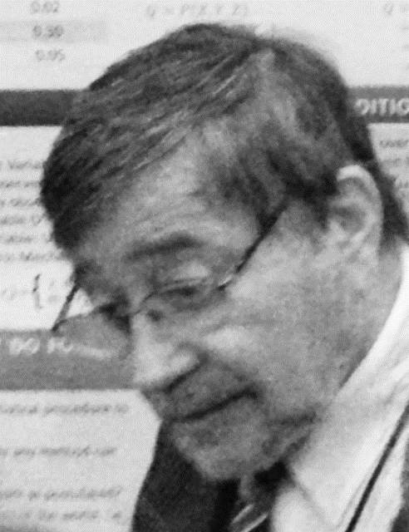

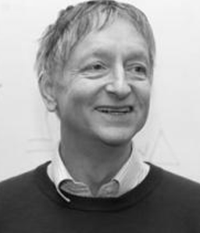

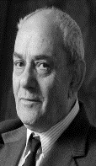





History: Milestones in the Development of ML/DL
XOR
Problem
Multi-layered
Perceptron
(Backpropagation)
AlexNet
ADALINE
WGAN
Perceptron
ResNet
Dark Age
(“AI Winter”)
DBN
Transformers
GPT
Golden
Age
Electronic
Brain
BERT
1943
1957
1960
1969
1986
2006
2012
2015
2017
2018
1800 1900
….
1940 1950 1960 1970 1980 1990 2000 2010 2020
1805
1901
1936
1954
1965
1967
1979
1985
1995
2000
2014
2017
Bayesian Network
Deep Forest
Linear Regression
K-Means
Turing Machine
KNN
SVM
XGBoost
PCA
Evolutionary Algorithms
Decision Trees
Random Forest
CatBoost
A. Legendre – J. Gauss
K. Pearson
A. Turing
S. McCulloch – W. Pitts
F. Rosenblatt
B. Widrow – M. Hoff
M. Minsky – S. Papert
J. Pearl
D. Rumelhart – G. Hinton – R. Wiliams
V. Vapnik– C. Cortes
A. Krizhevsky
A. Ng
Y. LeCun
Y. Bengio
Notes:
AI winter – Started with XOR problem. Earlier versions of Neural Networks were not able to map nonlinear relationships.
Ended with Multi-layered Perceptron which basically added multiple layers with activation function, but these networks were harder to train because of computational requirement. Therefore, we saw resurgence when compute power became available

Slide 5
Outline
Introduction
Machine Learning Solutions
Deep Learning
  Deep Neural Networks
  Distributed Deep Learning
  DL Solutions
Conclusion

Slide 6




Support for Parallel and Distributed Execution
Scikit-learn:
  Supports execution via Joblib (https://joblib.readthedocs.io/en/latest/)
  Joblib supports multi-threaded and multi-process execution (on multiple nodes)
XGBoost:
  Multiple ways to run on cluster of nodes:
    Dask (http://dask.org)
    Ray (https://ray.io/)
    AWS YARN
    Apache Spark (https://spark.apache.org/) using XGBoost4J-Spark
cuML:
  Execution is supposed on multiple nodes using Dask (http://dask.org) and NVIDIA’s NCCL

Slide 7
Accelerating cuML with MVAPICH2-GDR
Utilize MVAPICH2-GDR (with mpi4py) as communication backend during the training phase (the fit() function) in the Multi-node Multi-GPU (MNMG) setting over cluster of GPUs
Communication primitives:
  Allreduce
  Reduce
  Broadcast
Exploit optimized collectives
Python
Dask
Cython
UCX-Py
mpi4py
UCX
CUDA/C/C++
cuML Algorithms
cuML Primitives
NCCL
MVAPICH2-GDR
MPI4cuML 0.5 release
(http://hidl.cse.ohio-state.edu)
CUDA Libraries
CUDA

Slide 8
MPI4cuML 0.5 Release - MPI-Driven ML Training
cuML is a distributed machine learning training framework with a focus on GPU acceleration and distributed computing. MVAPICH2-GDR provides many features to augment distributed training with cuML on GPUs
(NEW) Based on cuML 22.02.00
  Include ready-to-use examples for KMeans, Linear Regression, Nearest Neighbors, and tSVD
(NEW) MVAPICH2 support for RAFT 22.02.00
  (NEW) Enabled cuML’s communication engine, RAFT, to use MVAPICH2-GDR backend for Python and C++ cuML applications
  KMeans, PCA, tSVD, RF, LinearModels
  Added switch between available communication backends (MVAPICH2 and NCCL)
Built on top of mpi4py over the MVAPICH2-GDR library
Tested with
  Mellanox InfiniBand adapters (FDR and HDR)
  (NEW) NVIDIA GPU A100, V100 and, P100
  Various x86-based multi-core platforms (AMD and Intel)
http://hidl.cse.ohio-state.edu/

Slide 9
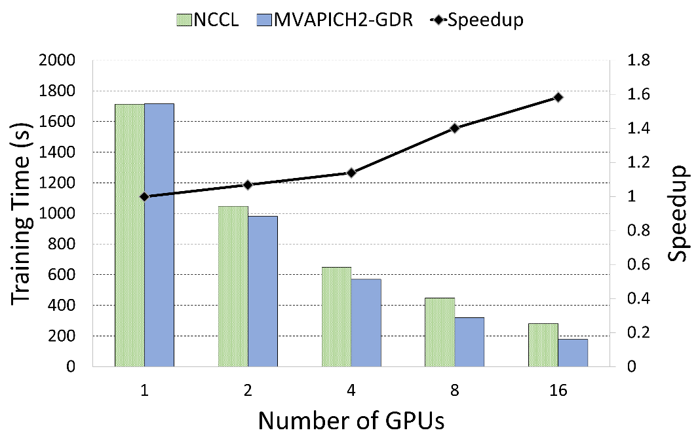
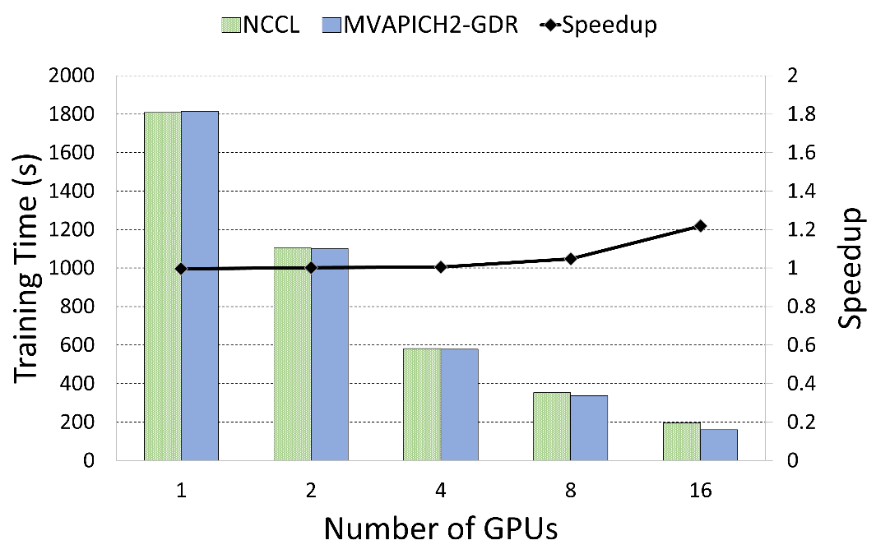
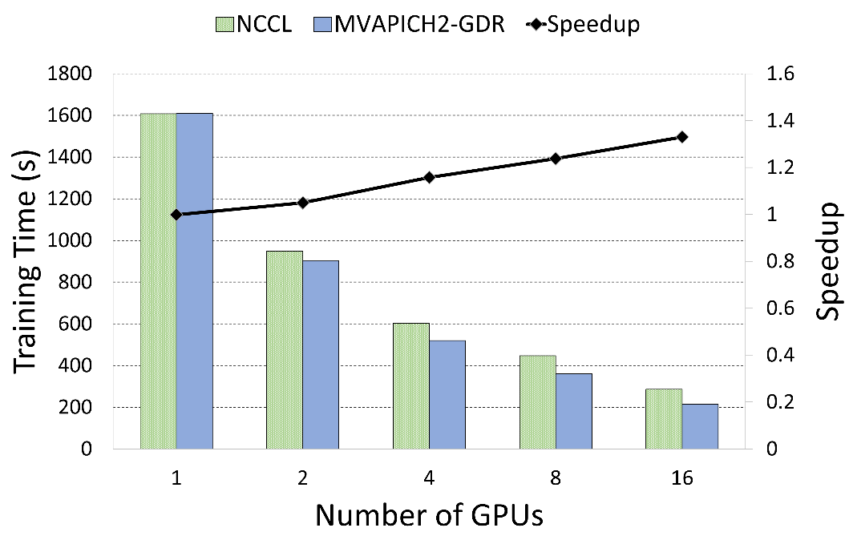
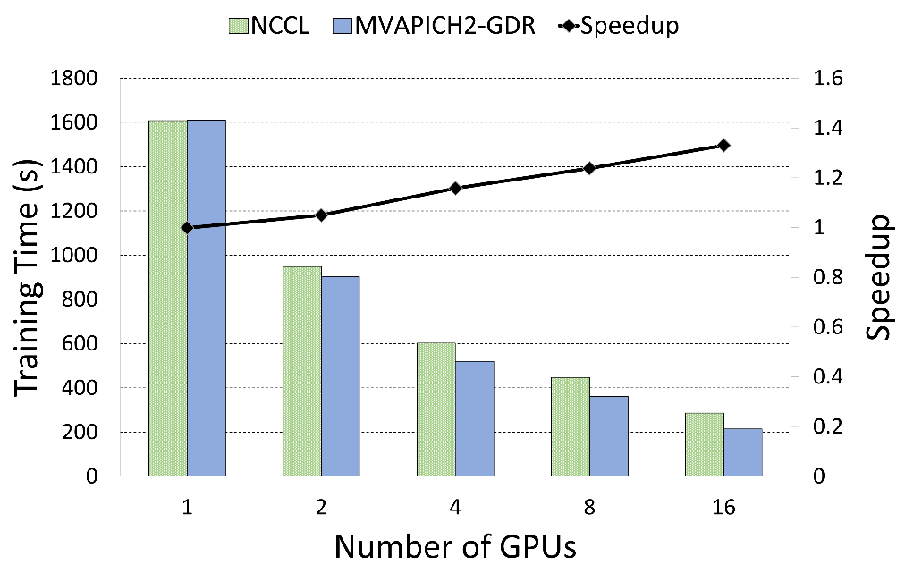
K-Means
Linear Regression
1.6x
MPI4cuML 0.5
1.23x
Expanse GPU System
CPU Model | Intel Xeon Gold 6248
CPU Core Info | 2x20 @ 2.5Ghz
Memory | 384 GB
Interconnect | Infiniband HDR (200 Gbps)
OS | Rocky Linux 8.5
GPU | NVIDIA V100 (4/Node)
CUDA | CUDA 11.2
Nearest Neighbors
Truncated SVD
1.35x
1.38x
  M. Ghazimirsaeed , Q. Anthony , A. Shafi , H. Subramoni , and D. K. Panda, Accelerating GPU-based Machine Learning in Python using MPI Library: A Case Study with MVAPICH2-GDR, MLHPC Workshop, Nov 2020

Slide 10
Outline
Introduction
Machine Learning Solutions
Deep Learning
  Deep Neural Networks
  Distributed Deep Learning
  DL Solutions
Conclusion

Slide 11
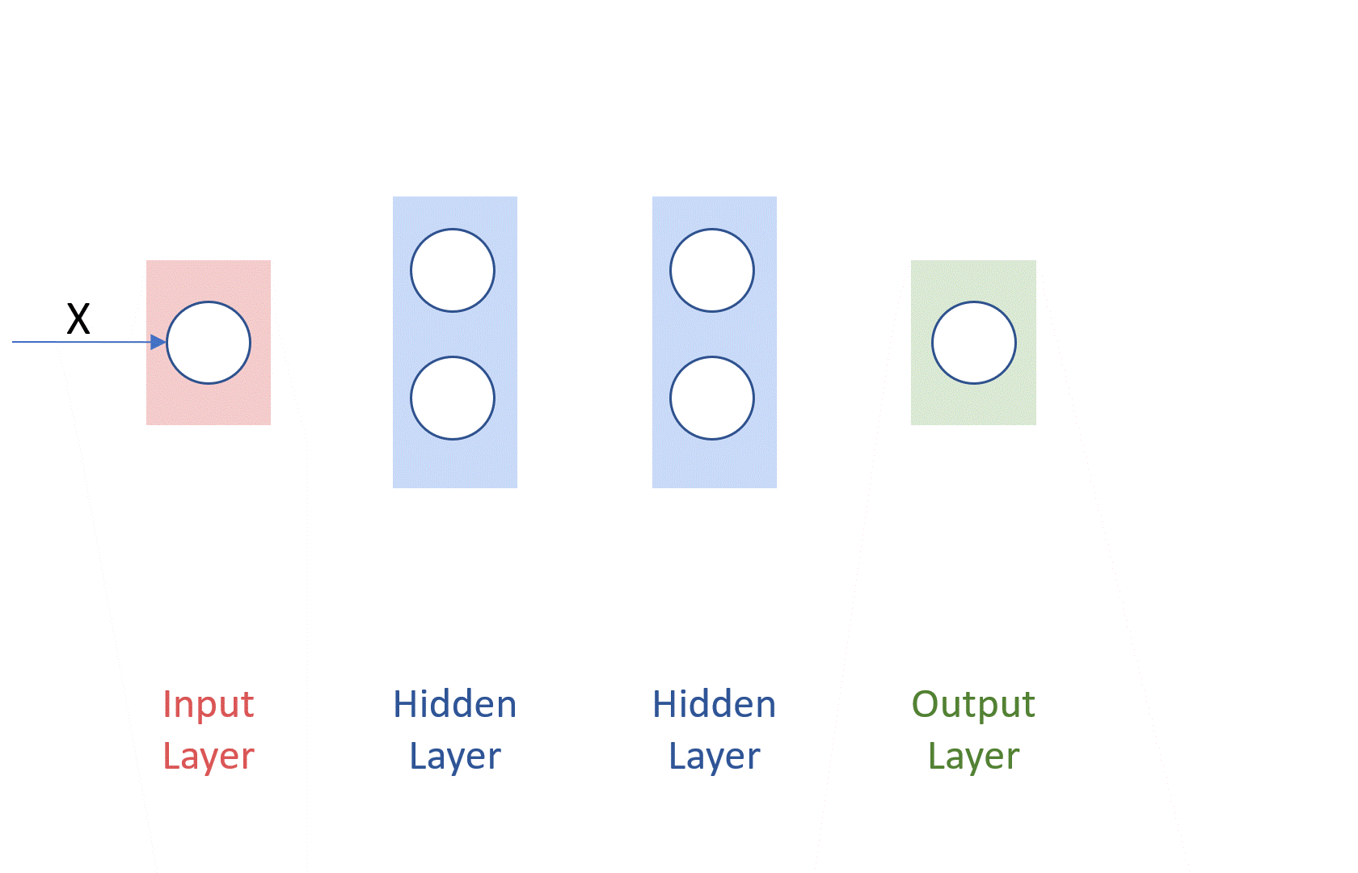
Understanding the Deep Neural Network Concepts
Example of a 3-layer Deep Neural Network (DNN) – (input layer is not counted)
Courtesy: http://cs231n.github.io/neural-networks-1/
Notes:
Courtesy: http://cs231n.github.io/neural-networks-1/

Slide 12
Essential Concepts: Learning Rate (α)
Courtesy: https://www.jeremyjordan.me/nn-learning-rate/

Slide 13
Essential Concepts: Batch Size
Batched Gradient Descent
  Batch Size = N
Stochastic Gradient Descent
  Batch Size = 1
Mini-batch Gradient Descent
  Somewhere in the middle
  Common:
    Batch Size = 64, 128, 256, etc.
Finding the optimal batch size will yield the fastest learning.
N
Batch Size
One full pass over N is called an epoch of training
Courtesy: https://www.jeremyjordan.me/gradient-descent/

Slide 14
Outline
Introduction
Machine Learning Solutions
Deep Learning
  Deep Neural Networks
  Distributed Deep Learning
  DL Solutions
Conclusion

Slide 15
The Need for Parallel and Distributed Training
Why do we need Parallel Training?
Larger and Deeper models are being proposed
  Language Models: RNNs -> Transformers -> BERT – GPT-(1,2,3,4)
  Vision Models: AlexNet -> ResNet -> NASNet – AmoebaNet → Vision Transformers
  DNNs require a lot of memory and a lot of computation
  Larger models cannot fit a GPU’s memory
Single GPU training cannot keep up with ever-larger models
Community has moved to multi-GPU training
Multi-GPU in one node is good but there is a limit to Scale-up (8-16 GPUs)
Multi-node (Distributed or Parallel) Training is necessary!!

Slide 16
Parallelization Strategies
Some parallelization strategies..
  Data Parallelism or Model Parallelism
  Hybrid Parallelism
Model Parallelism
Hybrid (Model and Data) Parallelism
Data Parallelism
Courtesy: http://engineering.skymind.io/distributed-deep-learning-part-1-an-introduction-to-distributed-training-of-neural-networks

Slide 17
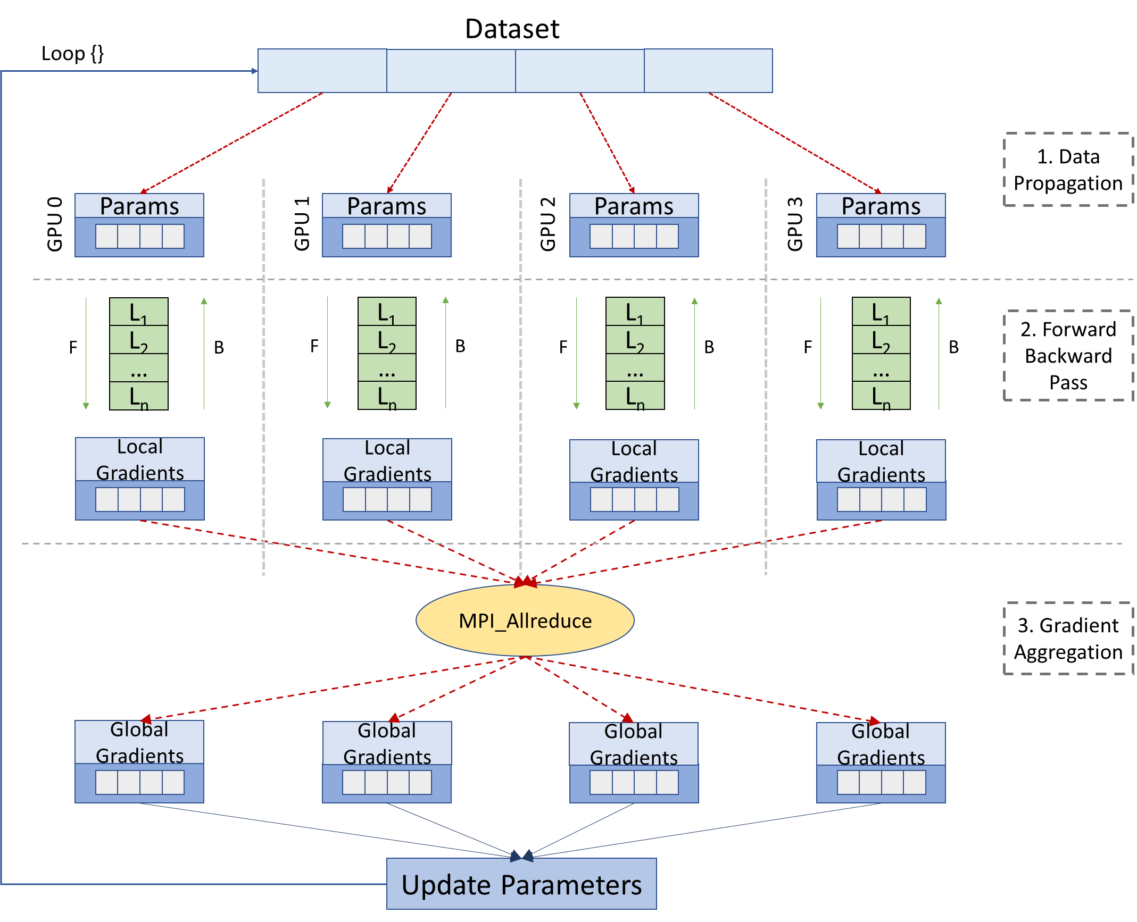
Data Parallelism and MPI Collectives
Batch
Step1: Data Propagation
  Distribute the Data among GPUs
Step2: Forward Backward Pass
  Perform forward pass and calculate the prediction
  Calculate Error by comparing prediction with actual output
  Perform backward pass and calculate gradients
Step3: Gradient Aggregation
  Call MPI_Allreduce to reduce the local gradients
  Update parameters locally using global gradients

Slide 18
Outline
Introduction
Machine Learning Solutions
Deep Learning
  Deep Neural Networks
  Distributed Deep Learning
  DL Solutions
Conclusion

Slide 19
MVAPICH2 (MPI)-driven Infrastructure for ML/DL Training
ML/DL Applications
ML/DL Applications
TensorFlow
PyTorch
MXNet
PyTorch
Horovod
Torch.distributed
DeepSpeed
MVAPICH2 or MVAPICH2-X for CPU Training
MVAPICH2-GDR for
GPU Training
MVAPICH2 or MVAPICH2-X for CPU Training
MVAPICH2-GDR for
GPU Training
More details available from: http://hidl.cse.ohio-state.edu

Slide 20
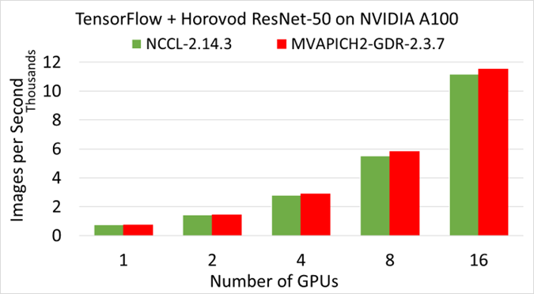
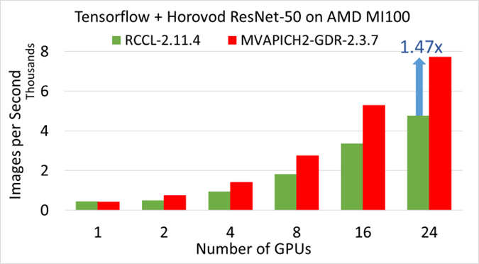
HiDL Software Stack Release v1.0
Based on Horovod
Optimized support for MPI controller in deep learning workloads
Efficient large-message collectives (e.g. Allreduce) on various CPUs and GPUs
GPU-Direct algorithms for collective operations (including those commonly used for data- and model-parallelism, e.g. Allgather and Alltoall)
Support for fork safety
Exploits efficient large message collectives
Compatible with
  Mellanox InfiniBand adapters (EDR, FDR, HDR)
  Various x86-based multi-core CPUs (AMD and Intel)
  NVIDIA A100, V100, P100, Quadro RTX 5000 GPUs
  CUDA [9.x, 10.x, 11.x] and cuDNN [7.5.x, 7.6.x, 8.0.x, 8.2.x, 8.4.x]
  AMD MI100 GPUs
  ROCm [5.1.x]
For more details: http://hidl.cse.ohio-state.edu/userguide/horovod/

Slide 21
Solutions and Case Studies: Exploiting HPC for DL
Deep Learning and Machine Learning Frameworks
CNTK
LBANN
FlexFlow
TensorFlow
PyTorch
Data Parallelism
Model-Parallelism
Major Computation and Communication Phases in DL Frameworks
Model Propagation
Forward
Backward
Gradient Aggregation
Co-Design
Opportunities
Communication Runtimes (MPI/NCCL/Gloo/MLSL)
Point-to-Point
Operations
CUDA-Awareness
Large-message Collectives
HPC Platforms
CPU
InfiniBand
GPU
Notes:
http://research.baidu.com/bringing-hpc-techniques-deep-learning/

Slide 22
Distributed TensorFlow on ORNL Summit (1,536 GPUs)
ResNet-50 Training using TensorFlow benchmark on SUMMIT -- 1536 Volta GPUs!
1,281,167 (1.2 mil.) images
Time/epoch = 3 seconds
Total Time (90 epochs) = 3 x 90 = 270 seconds = 4.5 minutes!
ImageNet-1k has 1.2 million images
MVAPICH2-GDR reaching ~0.42 million images per second for ImageNet-1k!
Platform: The Summit Supercomputer (#2 on Top500.org) – 6 NVIDIA Volta GPUs per node connected with NVLink, CUDA 10.1
Notes:
Time is calculated based on the images/second performance. It might be different when actual training happens.

Slide 23
Distributed TensorFlow on TACC Frontera (2048 CPU nodes)
Scaled TensorFlow to 2048 nodes on Frontera using MVAPICH2 and IntelMPI
MVAPICH2 delivers close to the ideal performance for DNN training
Report a peak of 260,000 images/sec on 2048 nodes
On 2048 nodes, ResNet-50 can be trained in 7 minutes!
  A. Jain, A. A. Awan, H. Subramoni, DK Panda, “Scaling TensorFlow, PyTorch, and MXNet using MVAPICH2 for High-Performance Deep Learning on Frontera”, DLS ’19 (SC ’19 Workshop).
Notes:
Why performance degrades for BS 64 for PPN8

Slide 24
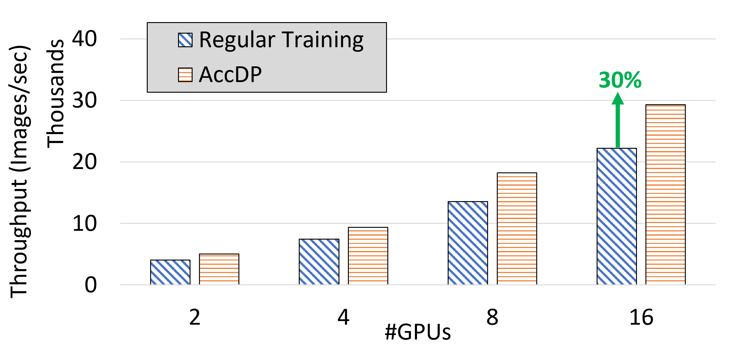
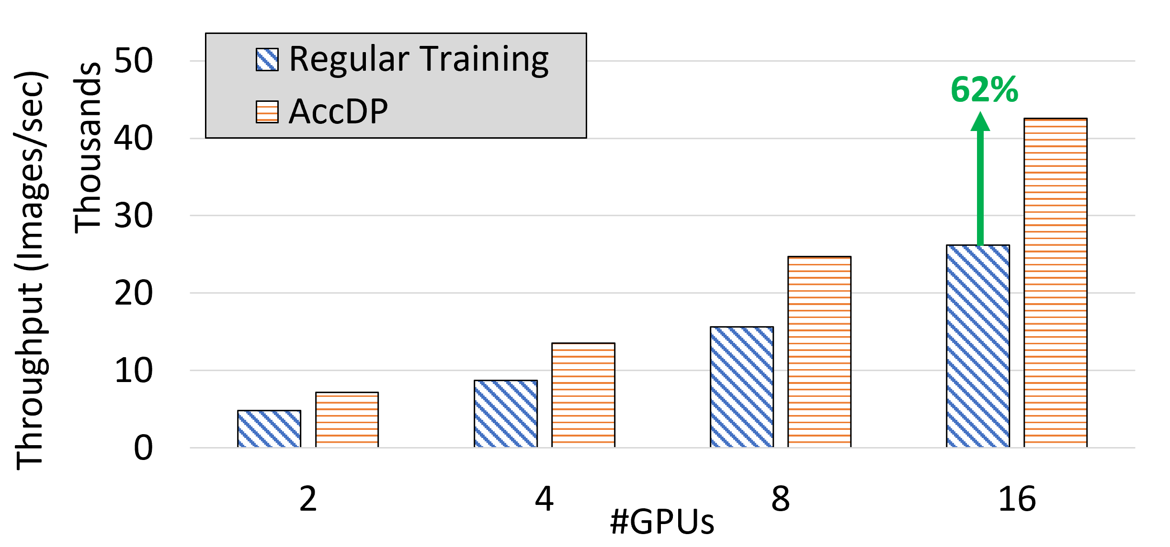
AccDP: Exploiting Data Parallelism
Multi node with ResNet18
Multi node with ShuffleNet
ResNet18 training throughput comparison between regular training and AccDP (proposed design) for different DNN models on up to 8 nodes 2 GPUs per node (16 GPUs) with 4 MPS clients per GPU
ShuffleNet training throughput comparison between regular training and AccDP (proposed design) for different DNN models on up to 8 nodes 2 GPUs per node (16 GPUs) with 4 MPS clients per GPU.
  N. Alnaasan, A. Jain, A. Shafi, H. Subramoni, and DK Panda, “AccDP: Accelerated Data-Parallel Distributed DNN Training for Modern GPU-Based HPC Clusters”, HiPC’22.

Slide 25
Solutions and Case Studies: Exploiting HPC for DL
Deep Learning and Machine Learning Frameworks
CNTK
LBANN
FlexFlow
TensorFlow
PyTorch
Data Parallelism
Model-Parallelism
Major Computation and Communication Phases in DL Frameworks
Model Propagation
Forward
Backward
Gradient Aggregation
Co-Design
Opportunities
Communication Runtimes (MPI/NCCL/Gloo/MLSL)
Point-to-Point
Operations
CUDA-Awareness
Large-message Collectives
HPC Platforms
CPU
InfiniBand
GPU
Notes:
http://research.baidu.com/bringing-hpc-techniques-deep-learning/

Slide 26
Exploiting Model Parallelism in AI-Driven Digital Pathology
Pathology whole slide image (WSI)
  Each WSI = 100,000 x 100,000 pixels
  Can not fit in a single GPU memory
  Tiles are extracted to make training possible
Two main problems with tiles
  Restricted tile size because of GPU memory limitation
  Smaller tiles loose structural information
Reduced training time significantly
  GEMS-Basic: 7.25 hours (1 node, 4 GPUs)
  GEMS-MAST: 6.28 hours (1 node, 4 GPUs)
  GEMS-MASTER: 4.21 hours (1 node, 4 GPUs)
  GEMS-Hybrid: 27 mins (32 nodes, 128 GPUs)
  Overall 15x reduction in training time!!!!
Courtesy: https://blog.kitware.com/digital-slide-archive-large-image-and-histomicstk-open-source-informatics-tools-for-management-visualization-and-analysis-of-digital-histopathology-data/
22x
12x
7x
3.6x
1.9x
1x
  A. Jain, A. Awan, A. Aljuhani, J. Hashmi, Q. Anthony, H. Subramoni, D. K. Panda, R. Machiraju, and A. Parwani, “GEMS: GPU Enabled Memory Aware Model Parallelism System for Distributed DNN Training”, Supercomputing (SC ‘20).
Scaling ResNet­110 v2 on 1024×1024 image tiles
us­ing histopathology data

Slide 27
MPI4DL v0.6
MPI4DL v0.6 is a distributed, accelerated and memory efficient training framework for very high-resolution images that integrates Spatial Parallelism, Bidirectional Parallelism, Layer Parallelism, and Pipeline Parallelism.
Features:
Based on PyTorch
Support for training very high-resolution images
Distributed training support for:
Support for different image sizes and custom datasets.
Exploits collective features of MVAPICH2-GDR
Model Parallelism
  Layer Parallelism (LP)
  Pipeline Parallelism (PP)
Spatial Parallelism for High Resolution Images
  Spatial and Layer Parallelism (SP+LP)
  Spatial and Pipeline Parallelism (SP+PP)
Memory Efficient Bidirectional Parallelism (GEMS)
  Bidirectional and Layer Parallelism (GEMS+LP)
  Bidirectional and Pipeline Parallelism (GEMS+PP)
  Spatial, Bidirectional and Layer Parallelism (SP+GEMS+LP)
  Spatial, Bidirectional and Pipeline Parallelism (SP+GEMS+PP)

Slide 28
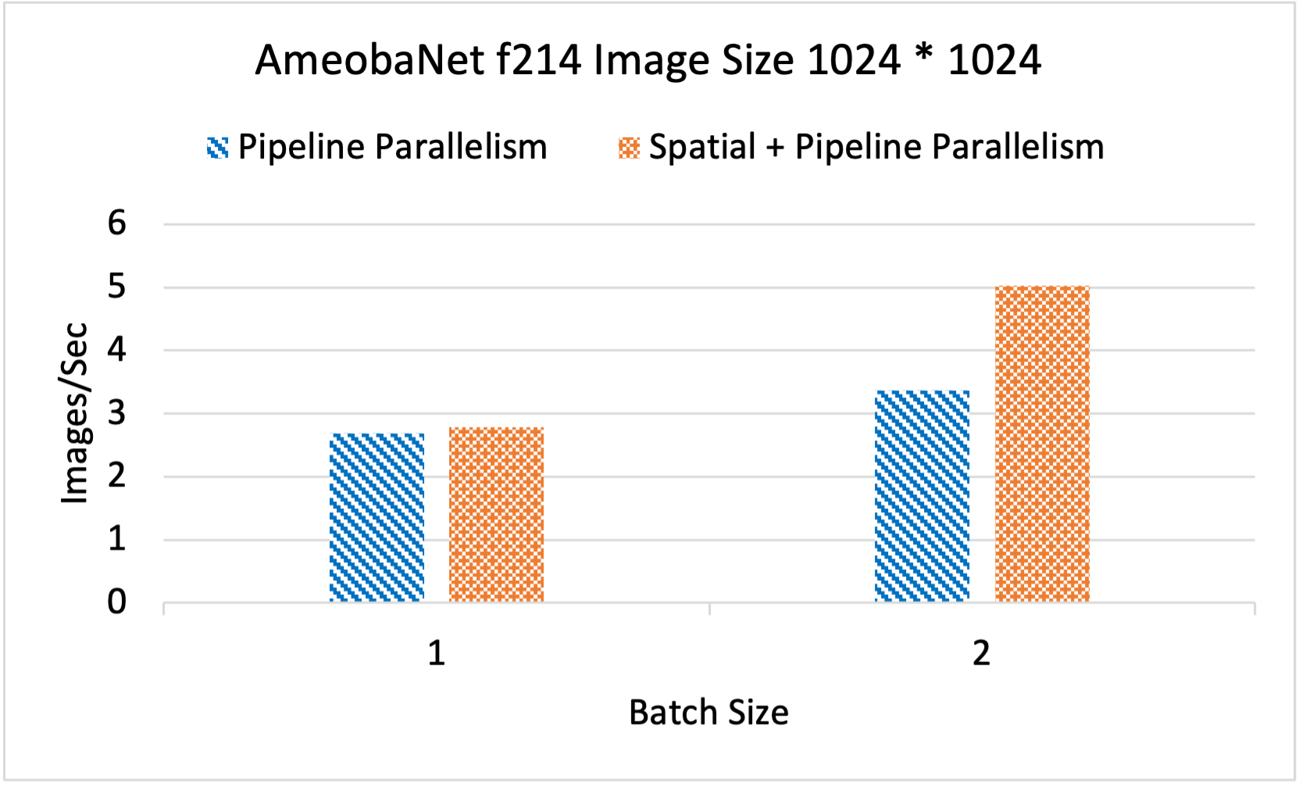
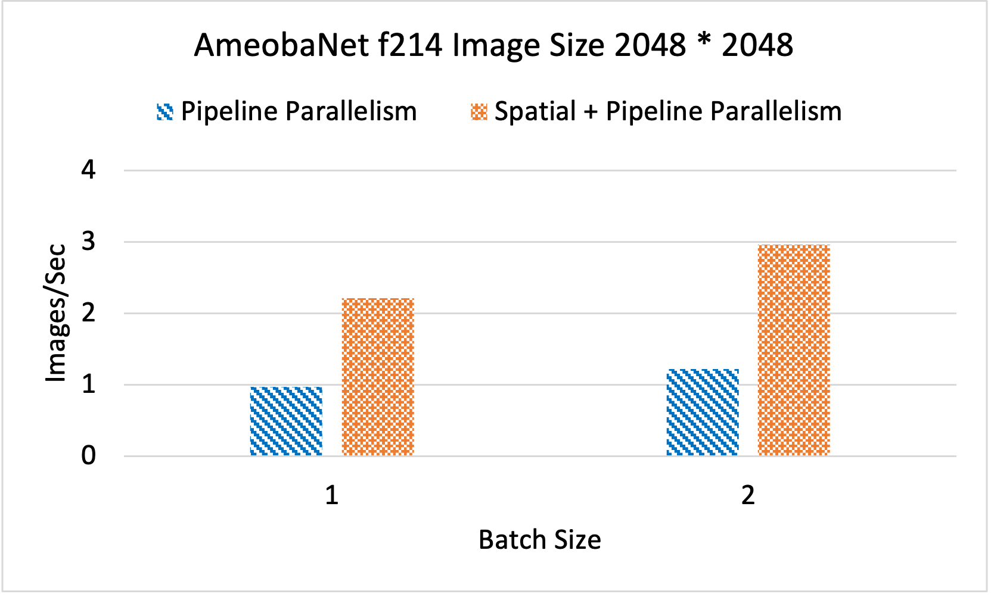
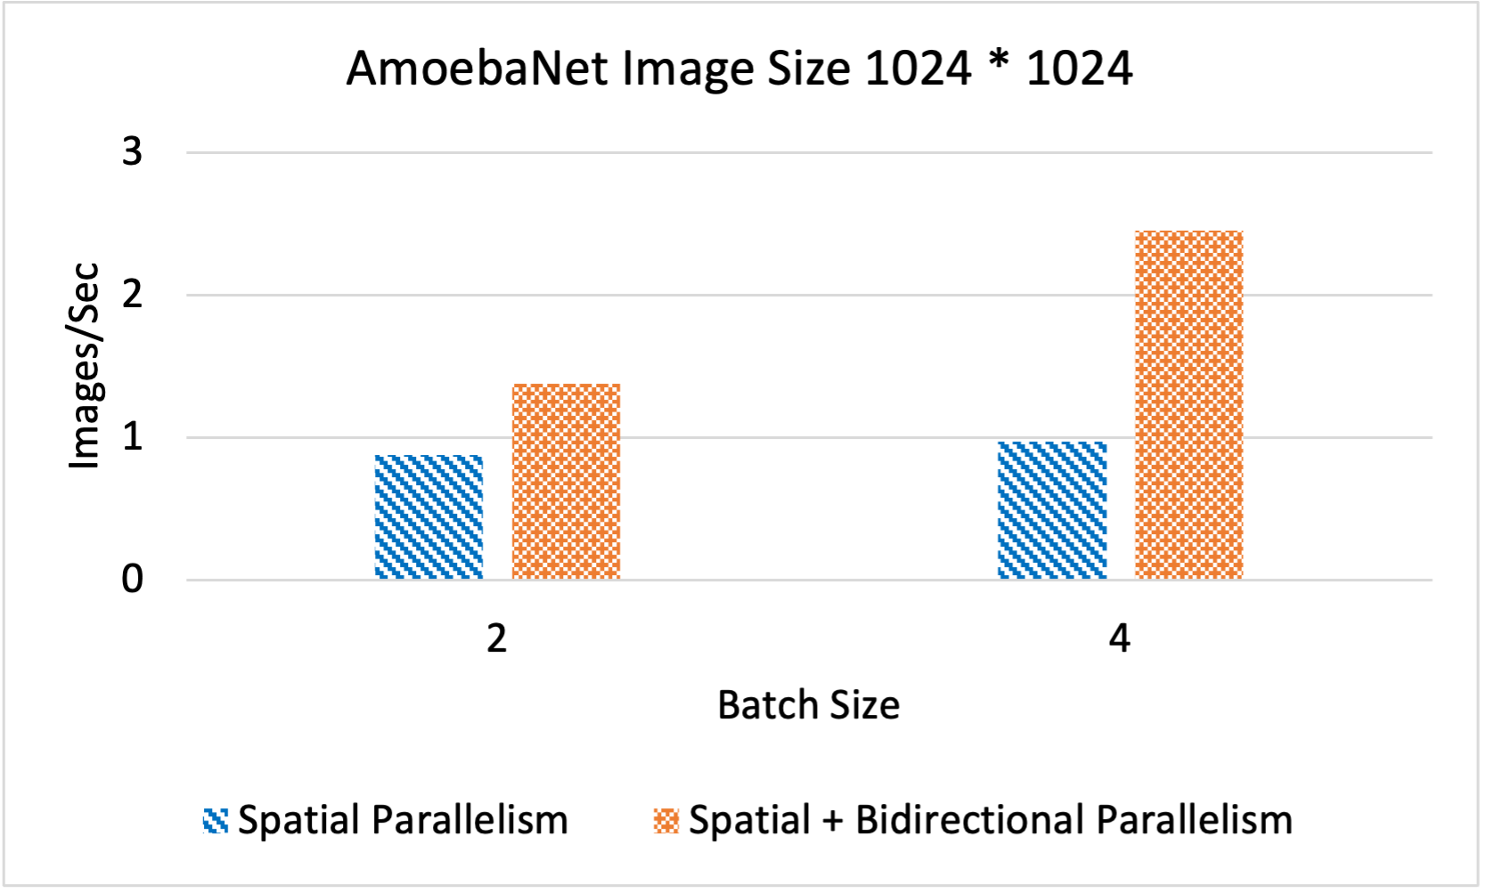
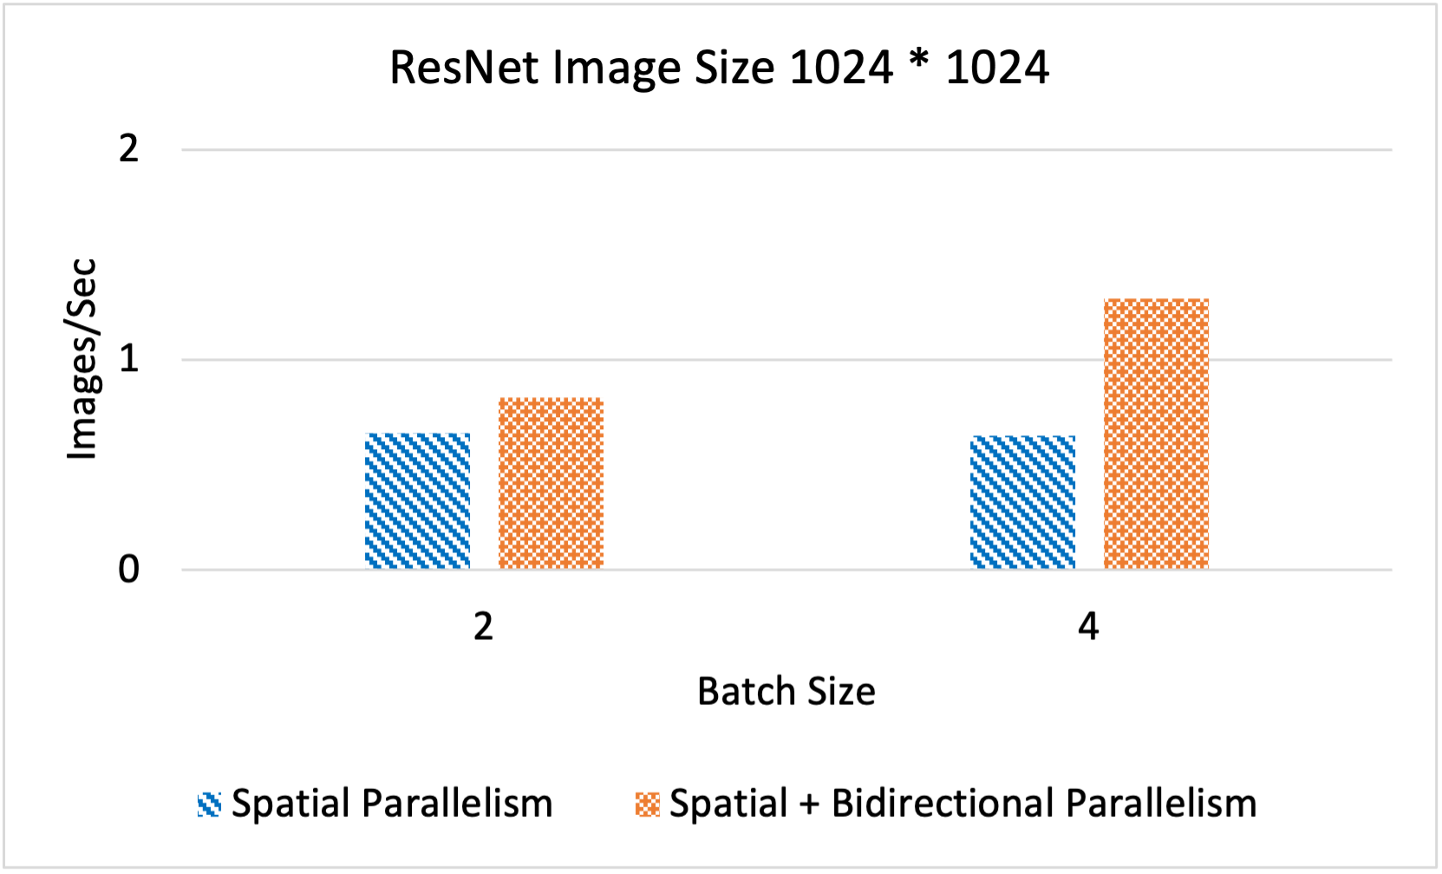
Throughput comparison of Pipeline Parallelism and Pipeline + Spatial Parallelism techniques for AmoebaNet on 1024 * 1024 and 2048 * 2048 image sizes.
Throughput comparison of Spatial Parallelism and Spatial + Bidirectional Parallelism for AmoebaNet and ResNet with the following configurations: 5 model splits,4 spatial parts, and 2 model replicas for Bidirectional Parallelism.

Slide 29
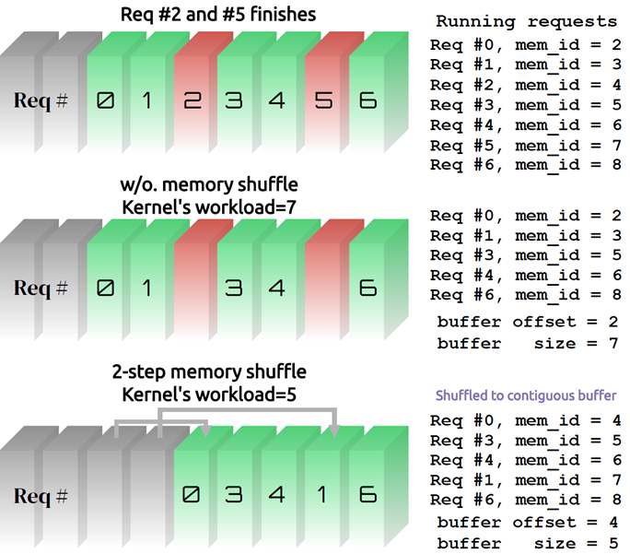
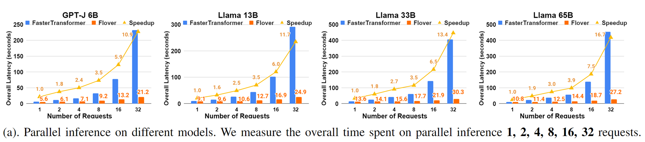
ParaInfer-X v1.0: a Temporal Fusion framework for LLM inference
ParaInfer-X is a collection of parallel inference techniques that can facilitate the deployment of emerging AI models on edge devices and HPC clusters. In v1.0, we proposes a temporal fusion framework, named Flover, to smartly batch multiple requests during LLM generation, which is also known as temporal fusion/in-flight batching.
Features:
Based on Faster Transformer
Support for inference of various large language models:
  GPT-J 6B, LlaMA 7B, 13B, 33B, 65B
  Support for persistent model inference stream
  Support for temporal fusion/in-flight batching of multiple requests
  Support for multiple GPU tensor parallelism
  Support for asynchronous memory reordering for evicting finished requests

Slide 30
Outline
Introduction
Machine Learning Solutions
Deep Learning
  Deep Neural Networks
  Distributed Deep Learning
  DL Solutions
Conclusion

Slide 31
Conclusion
Exponential growth in Machine Learning and Deep Learning frameworks
Provided an overview of issues, challenges, and opportunities for designing efficient communication runtimes
  Efficient, scalable, and hierarchical designs are crucial for ML and DL frameworks
  Co-design of communication runtimes and ML and DL frameworks will be essential
Presented use-cases to demonstrate the complex interaction between DL and ML middleware with the underling HPC technologies and middleware
Need collaborative efforts to achieve the full potential

Slide 32






















Funding Acknowledgments
Funding Support by
Equipment Support by

Slide 33
Acknowledgments to all the Heroes (Past/Current Students and Staffs)
Current Students (Graduate)
  N. Alnaasan (Ph.D.)
  Q. Anthony (Ph.D.)
  C.-C. Chun (Ph.D.)
  N. Contini (Ph.D.)
  Current Research Scientists
  M. Abduljabbar
  A. Shafi
  Current Faculty
  H. Subramoni
  K. S. Khorassani (Ph.D.)
  P. Kousha (Ph.D.)
  B. Michalowicz (Ph.D.)
  B. Ramesh (Ph.D.)
  K. K. Suresh (Ph.D.)
  A. H. Tu (Ph.D.)
  S. Xu (Ph.D.)
  Q. Zhou (Ph.D.)
  K. Al Attar (M.S.)
  L. Xu (Ph.D.)
  G. Kuncham (Ph.D.)
  R. Vaidya (Ph.D.)
  J. Yao (Ph.D.)
  M. Han (M.S.)
  A. Guptha (M.S.)
  Current Software Engineers
  B. Seeds
  N. Pavuk
  N. Shineman
  M. Lieber
  Current Students (Undergrads)
  T. Chen
Past Students
  A. Awan (Ph.D.)
  A. Augustine (M.S.)
  P. Balaji (Ph.D.)
  M. Bayatpour (Ph.D.)
  R. Biswas (M.S.)
  S. Bhagvat (M.S.)
  A. Bhat (M.S.)
  D. Buntinas (Ph.D.)
  L. Chai (Ph.D.)
  B. Chandrasekharan (M.S.)
  S. Chakraborthy (Ph.D.)
  N. Dandapanthula (M.S.)
  V. Dhanraj (M.S.)
  C.-H. Chu (Ph.D.)
  T. Gangadharappa (M.S.)
  K. Gopalakrishnan (M.S.)
  J. Hashmi (Ph.D.)
  W. Huang (Ph.D.)
  A. Jain (Ph.D.)
  W. Jiang (M.S.)
  J. Jose (Ph.D.)
  M. Kedia (M.S.)
  S. Kini (M.S.)
  M. Koop (Ph.D.)
  K. Kulkarni (M.S.)
  R. Kumar (M.S.)
  S. Krishnamoorthy (M.S.)
  K. Kandalla (Ph.D.)
  M. Li (Ph.D.)
  P. Lai (M.S.)
  J. Liu (Ph.D.)
  M. Luo (Ph.D.)
  A. Mamidala (Ph.D.)
  G. Marsh (M.S.)
  V. Meshram (M.S.)
  A. Moody (M.S.)
  S. Naravula (Ph.D.)
  R. Noronha (Ph.D.)
  X. Ouyang (Ph.D.)
  S. Pai (M.S.)
  S. Potluri (Ph.D.)
  K. Raj (M.S.)
  R. Rajachandrasekar (Ph.D.)
  D. Shankar (Ph.D.)
  G. Santhanaraman (Ph.D.)
  N. Sarkauskas (B.S. and M.S)
  N. Senthil Kumar (M.S.)
  A. Singh (Ph.D.)
  J. Sridhar (M.S.)
  S. Srivastava (M.S.)
  S. Sur (Ph.D.)
  H. Subramoni (Ph.D.)
  K. Vaidyanathan (Ph.D.)
  A. Vishnu (Ph.D.)
  J. Wu (Ph.D.)
  W. Yu (Ph.D.)
  J. Zhang (Ph.D.)
  Current Research Specialist
  R. Motlagh
  Past Research Scientists
  K. Hamidouche
  S. Sur
  X. Lu
  Past Senior Research Associate
  J. Hashmi
  Past Programmers
  A. Reifsteck
  D. Bureddy
  J. Perkins
  Past Post-Docs
  D. Banerjee
  X. Besseron
  M. S. Ghazimeersaeed
  Past Research Specialist
  M. Arnold
  J. Smith
  H.-W. Jin
  J. Lin
  M. Luo
  A. Ruhela
  J. Vienne
  H. Wang
  E. Mancini
  K. Manian
  S. Marcarelli

Slide 34


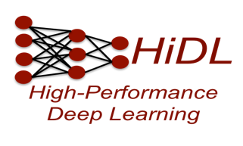
Thank You!
alnaasan.1@osu.edu
Network Based Computing
Follow us on
https://twitter.com/mvapich
Laboratory
Network-Based Computing Laboratory
http://nowlab.cse.ohio-state.edu/
The MVAPICH2 Project
http://mvapich.cse.ohio-state.edu/
The High-Performance Deep Learning Project
http://hidl.cse.ohio-state.edu/

Slide 35
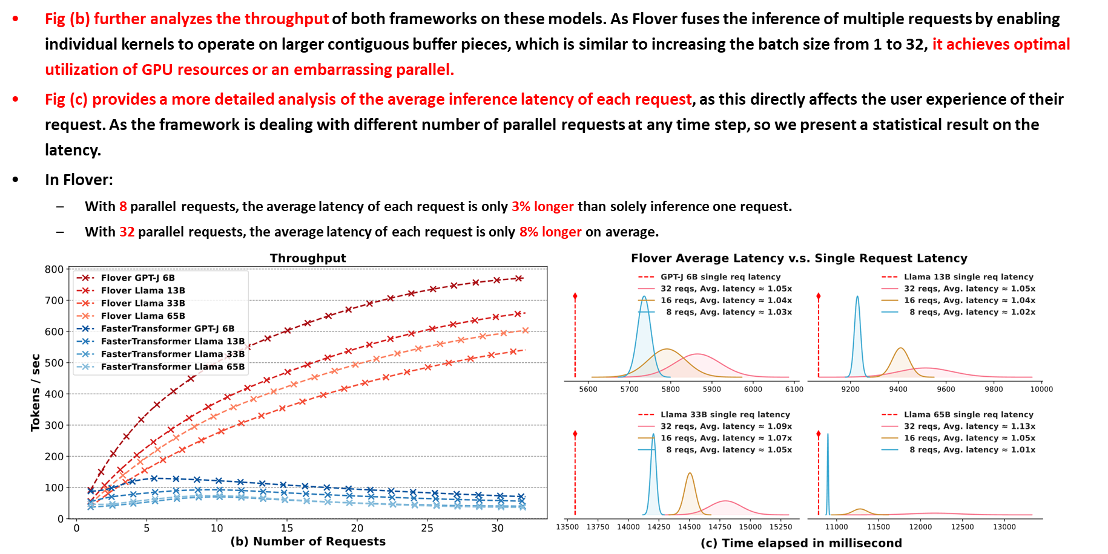
ParaInfer-X v1.0: a Temporal Fusion framework for LLM inference

Slide 36
Install Horovod with MVAPICH2-X and MVAPICH2-GDR
Command to install Horovod for CPU
$ HOROVOD_WITH_MPI=1 pip install --no-cache-dir horovod
Command to install Horovod for GPU
$ HOROVOD_GPU_ALLREDUCE=MPI HOROVOD_CUDA_HOME=/opt/cuda/11.3 HOROVOD_WITH_MPI=1 pip install --no-cache-dir horovod

Slide 37
Run PyTorch on a single GPU
+ python pytorch_synthetic_benchmark.py --batch-size 64 --num-iters=5
.
.
Model: resnet50
Batch size: 64
Number of GPUs: 1
Running warmup...
Running benchmark...
Iter #0: 333.9 img/sec per GPU
Iter #1: 334.2 img/sec per GPU
Iter #2: 333.9 img/sec per GPU
Iter #3: 333.8 img/sec per GPU
Iter #4: 333.9 img/sec per GPU
Img/sec per GPU: 334.0 +-0.2
-----------------------------------------
Total img/sec on 1 GPU(s): 334.0 +-0.2
-----------------------------------------
V100

Slide 38
Run PyTorch on two nodes with 1 GPU/node (using MVAPICH2-GDR)
+ mpirun_rsh -np 2 gpu11 gpu12 MV2_USE_CUDA=1 MV2_CPU_BINDING_POLICY=hybrid MV2_HYBRID_BINDING_POLICY=spread MV2_USE_RDMA_CM=0 MV2_GPUDIRECT_GDRCOPY_LIB=/opt/gdrcopy2.0/lib64/libgdrapi.so LD_PRELOAD=mv2-gdr/lib/libmpi.so
python pytorch_synthetic_benchmark.py --batch-size 64 --num-iters=5
.
.
Model: resnet50
Batch size: 64
Number of GPUs: 2
Running warmup...
Running benchmark...
Iter #0: 317.0 img/sec per GPU
Iter #1: 314.9 img/sec per GPU
Iter #2: 315.4 img/sec per GPU
Iter #3: 318.0 img/sec per GPU
Iter #4: 316.7 img/sec per GPU
Img/sec per GPU: 316.4 +-2.2
-----------------------------------------
Total img/sec on 2 GPU(s): 632.8 +-4.3
-----------------------------------------
V100
~1.89X on 2 GPUs

Slide 39
The cuML Library: Accelerating ML on GPUs
The NVIDIA RAPIDS project aims to build end-to-end data science analytic pipelines on GPUs
An important component is the cuML library:
  GPU-accelerated ML library
  GPU-counterpart of Scikit-learn
  Supports the execution of ML workloads on Multi-Node Multi-GPUs (MNMG) systems
Most existing ML libraries, including Scikit-learn and Apache Spark’s MLlib, only support CPU execution of ML algorithms
  Conventional wisdom has been that only DNNs are a good match for GPUs because of high computational requirements
Notes:
Aamir – Need to move this to either introduction or types of learning section

Slide 40
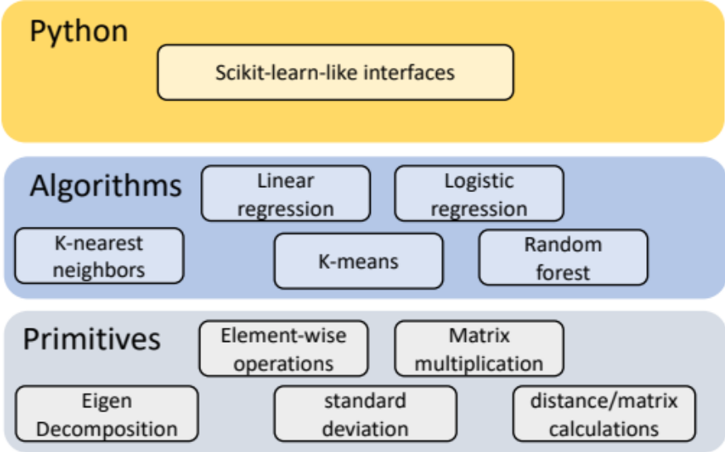
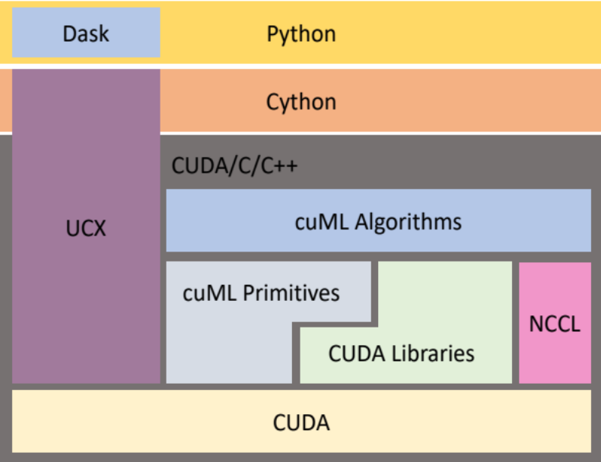
Main components of the cuML library
Main components
  Python layer
    Provides a Scikit-learn like interface
    Hides the complexities of the CUDA/C/C++ layer
  Primitives and cuML algorithms built on top of CUDA
    ML Algorithms
    Primitives
      Reusable building blocks for building machine learning algorithms
      Common for different machine learning algorithms
      Used to build different machine learning algorithms
  Communication Support in cuML:
    Point-to-point communication: Dask
    Collective communication: NVIDIA Collective Communications Library (NCCL)

Slide 41
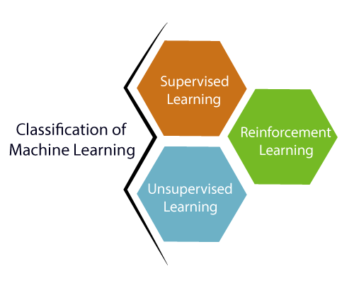
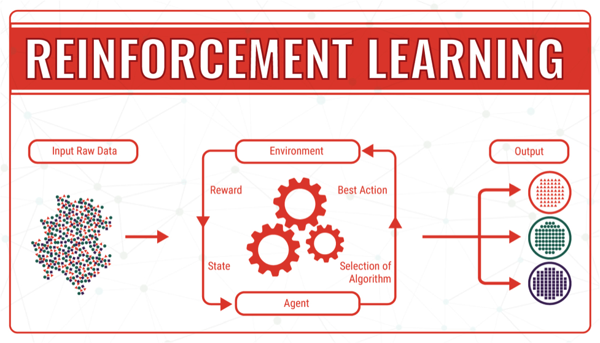
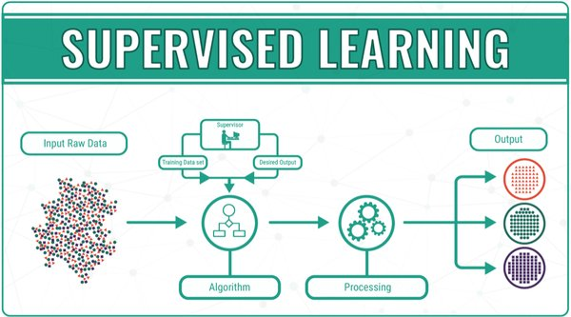
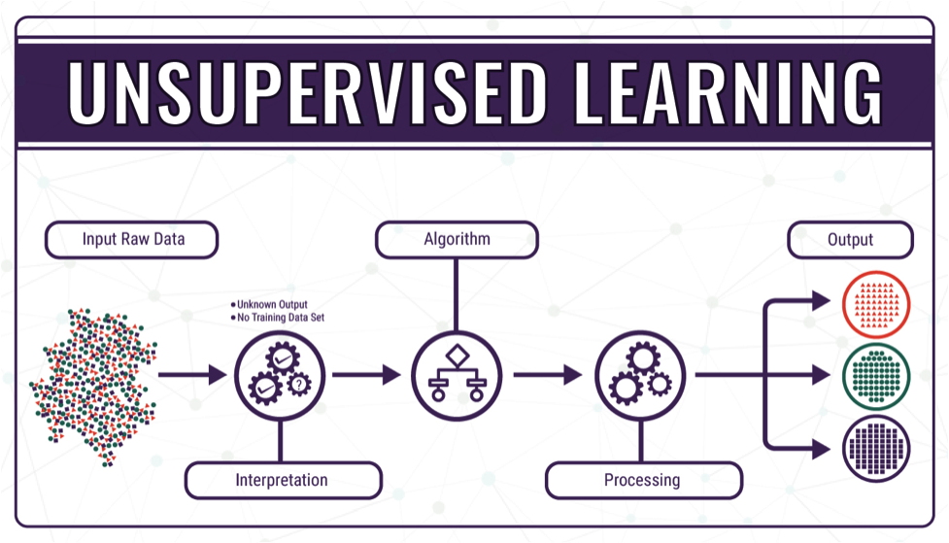
Three Main Types of Machine Learning
Courtesy: https://bigdata-madesimple.com/machine-learning-explained-understanding-supervised-unsupervised-and-reinforcement-learning/
Notes:
Aamir – Talk about ML models

Slide 42
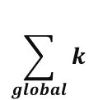
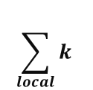
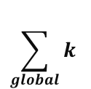

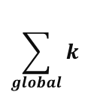
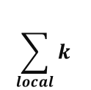


Parallelizing the K-means Algorithm
Set of input elements
Step 0: Initialize centroids
  Assign initial cluster means randomly
Step 1: Data Division
  Distribute elements among GPUs
Step 2: Assign elements (color)
  Assign each element to the cluster with the closest mean
Step 3: Update local cluster mean
  Calculate local cluster means for all local points
Step 4: Update global cluster mean*
  Calculate global cluster means by calling Allreduce()
Step 5: Repeat steps 2-4 until convergence
Step 1
GPU 0
GPU 1
GPU 2
GPU 3
Step 2
Assign all local elements to the cluster with closest mean
$$\sum_{local}{k}$$
$$\sum_{local}{k}$$
$$\sum_{local}{k}$$
$$\sum_{local}{k}$$
Step 3
Allreduce()
Step 4
$$\sum_{global}{k}$$
$$\sum_{global}{k}$$
$$\sum_{global}{k}$$
$$\sum_{global}{k}$$
Step 5: Repeat 2-4 until convergence

Slide 43
Allreduce Collective Communication Pattern
Element-wise Sum data from all processes and sends to all processes
int MPI_Allreduce (const void *sendbuf, void * recvbuf, int count, MPI_Datatype datatype,
MPI_Op operation, MPI_Comm comm)
Input-only Parameters
Parameter | Description
sendbuf | Starting address of send buffer
recvbuf | Starting address of recv buffer
type | Data type of buffer elements
count | Number of elements in the buffers
operation | Reduction operation to be performed (e.g. sum)
comm | Communicator handle
Sendbuf (Before)
T1
T2
T3
T4
1
1
1
1
2
2
2
2
3
3
3
3
4
4
4
4
Recvbuf (After)
T1
T2
T3
T4
Input/Output Parameters
Parameter | Description
recvbuf | Starting address of receive buffer
4
4
4
4
8
8
8
8
12
12
12
12
16
16
16
16

Slide 44

Overview of the MVAPICH Project
High Performance open-source MPI Library
Support for multiple interconnects
  InfiniBand, Omni-Path, Ethernet/iWARP, RDMA over Converged Ethernet (RoCE), AWS EFA, OPX, Broadcom RoCE, Intel Ethernet, Rockport Networks, Slingshot 10/11
Support for multiple platforms
  x86, OpenPOWER, ARM, Xeon-Phi, GPGPUs (NVIDIA and AMD)
Started in 2001, first open-source version demonstrated at SC ‘02
Supports the latest MPI-3.1 standard
http://mvapich.cse.ohio-state.edu
Additional optimized versions for different systems/environments:
  MVAPICH2-X (Advanced MPI + PGAS), since 2011
  MVAPICH2-GDR with support for NVIDIA (since 2014) and AMD (since 2020) GPUs
  MVAPICH2-MIC with support for Intel Xeon-Phi, since 2014
  MVAPICH2-Virt with virtualization support, since 2015
  MVAPICH2-EA with support for Energy-Awareness, since 2015
  MVAPICH2-Azure for Azure HPC IB instances, since 2019
  MVAPICH2-X-AWS for AWS HPC+EFA instances, since 2019
Tools:
  OSU MPI Micro-Benchmarks (OMB), since 2003
  OSU InfiniBand Network Analysis and Monitoring (INAM), since 2015
Used by more than 3,300 organizations in 90 countries
More than 1.68 Million downloads from the OSU site directly
Empowering many TOP500 clusters (June ‘23 ranking)
  7th , 10,649,600-core (Sunway TaihuLight) at NSC, Wuxi, China
  21st, 448, 448 cores (Frontera) at TACC
  36th, 288,288 cores (Lassen) at LLNL
  49th, 570,020 cores (Nurion) in South Korea and many others
Available with software stacks of many vendors and Linux Distros (RedHat, SuSE, OpenHPC, and Spack)
Partner in the 19th ranked TACC Frontera system
Empowering Top500 systems for more than 17 years

Slide 45
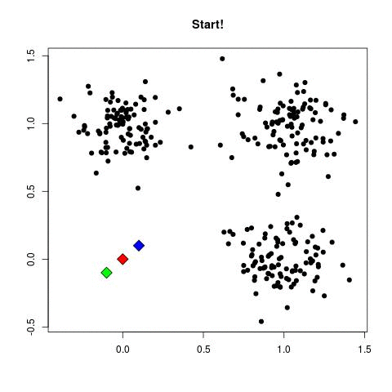
Parallelizing K-Means
Step 0: Initialize centroids
  Assign initial cluster means randomly
Step 1: Data Division
  Distribute elements among GPUs
Step 2: Assign elements (colors)
  Assign each element to the cluster with the closest mean
Step 3: Update local cluster mean
  Calculate local cluster means for all local points
Step 4: Update global cluster mean*
  Calculate global cluster means by calling Allreduce()
Step 5: Repeat steps 2-4 until convergence

Slide 46
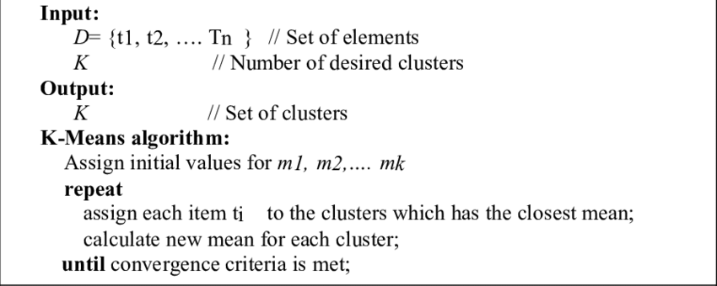
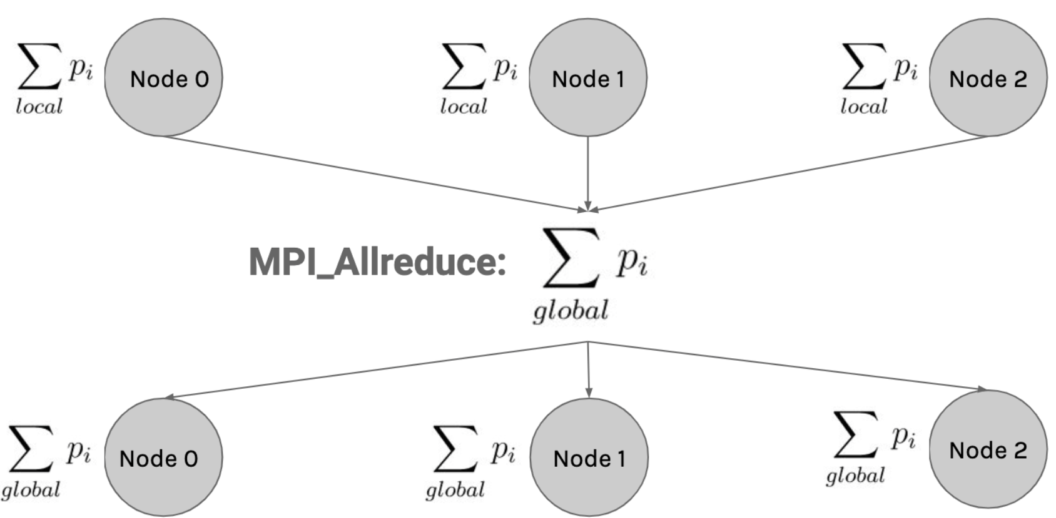
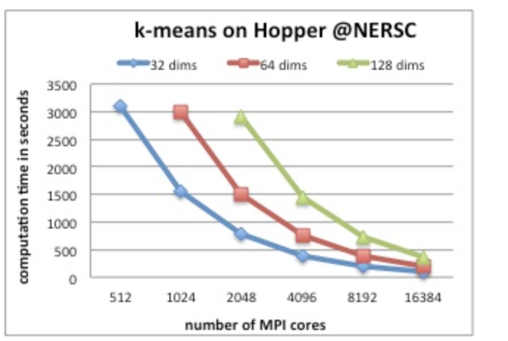
Parallelizing K-Means Clustering
Node 0
Node 1
Domain Decomposition
Global reduction for all cluster centers is performed at the end of each iteration in order to generate the new cluster centers.
Recompute centroids after MPI_Allreduce
Courtesy: https://github.com/tmscarla/k-means-parallel http://users.eecs.northwestern.edu/~wkliao/Kmeans/
Notes:
https://user.ceng.metu.edu.tr/~akifakkus/courses/ceng574/k-means/
The parallel implementation uses data parallelism. Data objects to be clustered are evenly partitioned among all processes while the cluster centers are replicated. Global-sum reduction for all cluster centers is performed at the end of each iteration in order to generate the new cluster centers.

Slide 47
K-Means
Linear Regression
Nearest Neighbors
Truncated SVD
  M. Ghazimirsaeed , Q. Anthony , A. Shafi , H. Subramoni , and D. K. Panda, Accelerating GPU-based Machine Learning in Python using MPI Library: A Case Study with MVAPICH2-GDR, MLHPC Workshop, Nov 2020

Slide 48
Solutions and Case Studies: Exploiting HPC for DL
Deep Learning and Machine Learning Frameworks
CNTK
LBANN
FlexFlow
TensorFlow
PyTorch
Data Parallelism
Model-Parallelism
Major Computation and Communication Phases in DL Frameworks
Model Propagation
Forward
Backward
Gradient Aggregation
Co-Design
Opportunities
Communication Runtimes (MPI/NCCL/Gloo/MLSL)
Point-to-Point
Operations
CUDA-Awareness
Large-message Collectives
HPC Platforms
CPU
InfiniBand
GPU
Notes:
http://research.baidu.com/bringing-hpc-techniques-deep-learning/

Slide 49
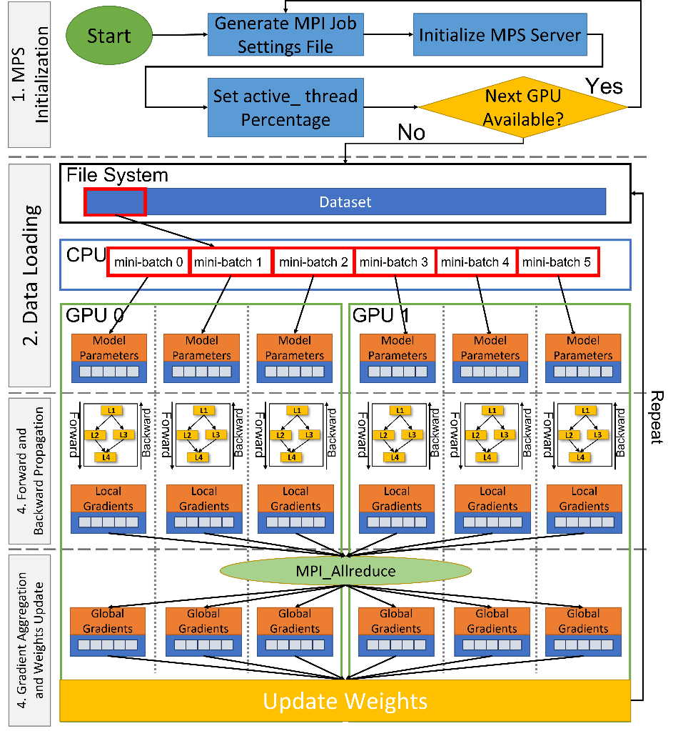
AccDP: Exploiting Data Parallelism
Step 1: MPS Initialization
  Generate MPS settings file for each GPU which includes user ID, GPUs layout, number of MPS processes per GPU, and active threads percentage.
  Initialize MPS Server and clients
Step 2: Data Propagation
  Load data from the file system to host memory
  Pre-process data on the CPU
  Distribute the Data among MPS processes
Step 3: Forward Backward Pass
  Perform forward pass and calculate the prediction
  Calculate Error by comparing prediction with actual output
  Perform backward pass and calculate gradients
Step 4: Gradient Aggregation
  Call MPI_Allreduce to reduce the local gradients
  Update the weights locally using global gradients
  N. Alnaasan, A. Jain, A. Shafi, H. Subramoni, and DK Panda, “AccDP: Accelerated Data-Parallel Distributed DNN Training for Modern GPU-Based HPC Clusters”, HiPC’22.

Slide 50
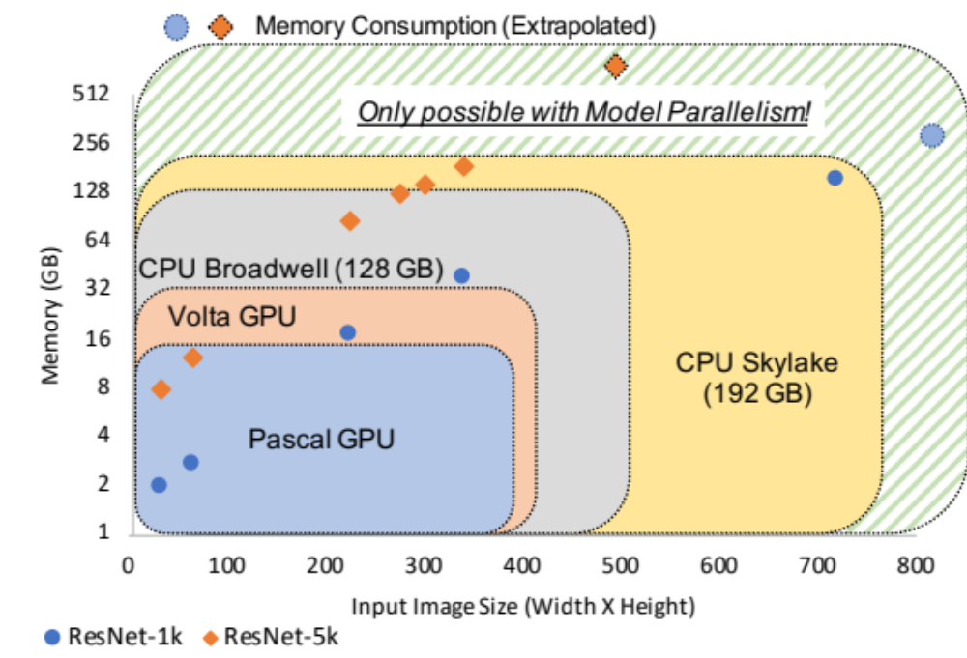
HyPar-Flow: Hybrid Parallelism for TensorFlow
Why Hybrid parallelism?
  Data Parallel training has limits! →
We propose HyPar-Flow
  An easy to use Hybrid parallel training framework
    Hybrid = Data + Model
  Supports Keras models and exploits TF 2.0 Eager Execution
  Exploits MPI for Point-to-point and Collectives
  Benchmarking large-models lead to better insights and ability to develop new approaches!
  A. A. Awan, A. Jain, Q. Anthony, H. Subramoni, and DK Panda, “HyPar-Flow: Exploiting MPI and Keras for Hybrid Parallel Training of TensorFlow models”, ISC ’20, https://arxiv.org/pdf/1911.05146.pdf

Slide 51
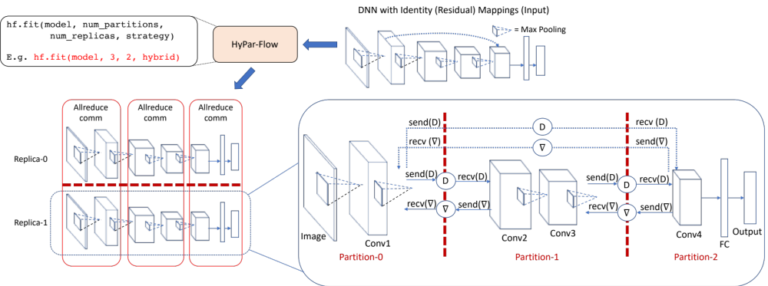
Model/Hybrid Parallelism and MPI Collectives
HyPar-Flow is practical (easy-to-use) and high-performance (uses MPI)
  Based on Keras models and exploits TF 2.0 Eager Execution
  Leverages MPI Pt-to-pt. and Collectives for communication
  A. A. Awan, A. Jain, Q. Anthony, H. Subramoni, and DK Panda, “HyPar-Flow: Exploiting MPI and Keras for Hybrid Parallel Training of TensorFlow models”, ISC ’20, https://arxiv.org/pdf/1911.05146.pdf

Slide 52
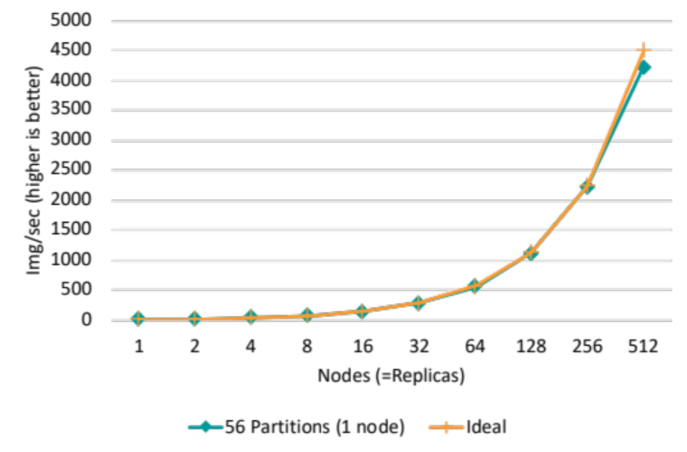
HyPar-Flow at Scale (512 nodes on TACC Frontera)
ResNet-1001 with variable batch size
Approach:
  48 model-partitions for 56 cores
  512 model-replicas for 512 nodes
  Total cores: 48 x 512 = 24,576
Speedup
  253X on 256 nodes
  481X on 512 nodes
Scaling Efficiency
  98% up to 256 nodes
  93.9% for 512 nodes
  481x speedup on 512 Intel Xeon Cascade Lake nodes (TACC Frontera)
  A. A. Awan, A. Jain, Q. Anthony, H. Subramoni, and DK Panda, “HyPar-Flow: Exploiting MPI and Keras for Hybrid Parallel Training of TensorFlow models”, ISC ‘20, https://arxiv.org/pdf/1911.05146.pdf

Slide 53
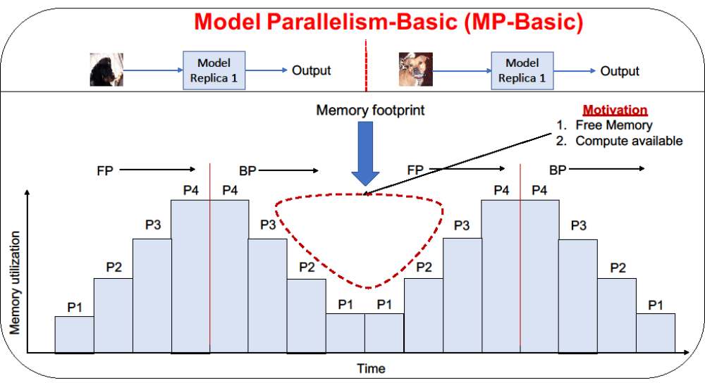
GEMS: GPU Enabled Memory Aware Model Parallelism Systems
Why do we need Memory aware designs?
  Data and Model Parallel training has limitation!
  Maximum Batch Size depends on the memory.
  Basic Model Parallelism suffers from underutilization of memory and compute →
  Memory requirement increases with the increase in image size!
  A. Jain, A. Awan, A. Aljuhani, J. Hashmi, Q. Anthony, H. Subramoni, D. Panda, R. Machiraju, A. Parwani, “GEMS: GPU Enabled Memory Aware Model Parallelism System for Distributed DNN”, SC ’20.

Slide 54
AccDP: Exploiting Data Parallelism
Multi node with ResNet18
Multi node with ShuffleNet
ResNet18 training throughput comparison between regular training and AccDP (proposed design) for different DNN models on up to 8 nodes 2 GPUs per node (16 GPUs) with 4 MPS clients per GPU
ShuffleNet training throughput comparison between regular training and AccDP (proposed design) for different DNN models on up to 8 nodes 2 GPUs per node (16 GPUs) with 4 MPS clients per GPU.
  N. Alnaasan, A. Jain, A. Shafi, H. Subramoni, and DK Panda, “AccDP: Accelerated Data-Parallel Distributed DNN Training for Modern GPU-Based HPC Clusters”, HiPC’22.

Slide 55
MVAPICH2-GDR vs. NCCL2 – Allreduce Operation (OSC Pitzer)
Optimized designs in MVAPICH2-GDR offer better/comparable performance for most cases
MPI_Allreduce (MVAPICH2-GDR) vs. ncclAllreduce (NCCL2) on OSC Pitzer system
Platform: OSC Pitzer system (8 nodes with 2 Nvidia Volta GPUs), CUDA 11.6

